Slide 1
Vocabulary Unit 4
English 10

Slide 2
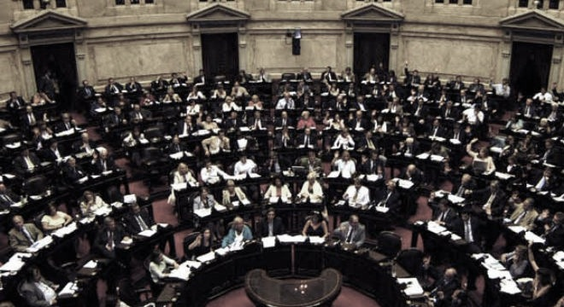
Dictum
A formal decree; formal announcement

Slide 3
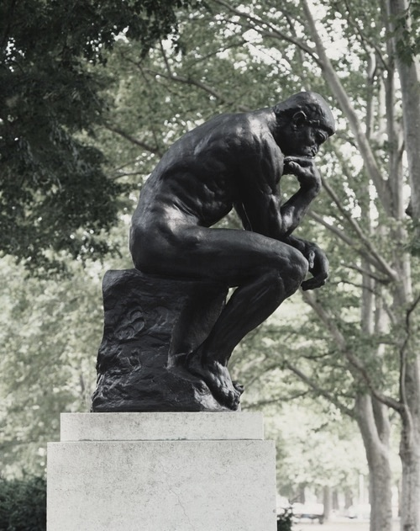
Profound
Full of great insight; deep in thought

Slide 4
Derive
To obtain or get something from a particular source

Slide 5
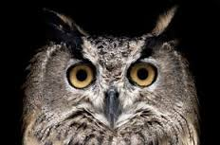
Nocturnal
Done or inclined to do at night

Slide 6
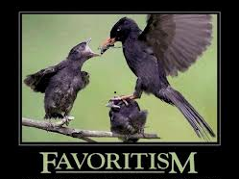
Predilection
a preference or special liking for something; bias in favor

Slide 7
Peculiar
Odd; strange

Slide 8
Apprehensive
to be inclined to worry; worrisome; doubtful

Slide 9
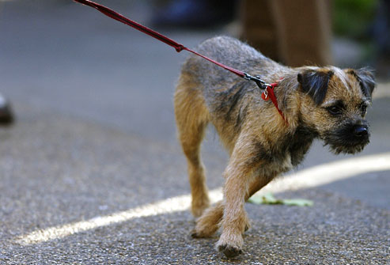
Compel
to be forced or urged to do something

Slide 10
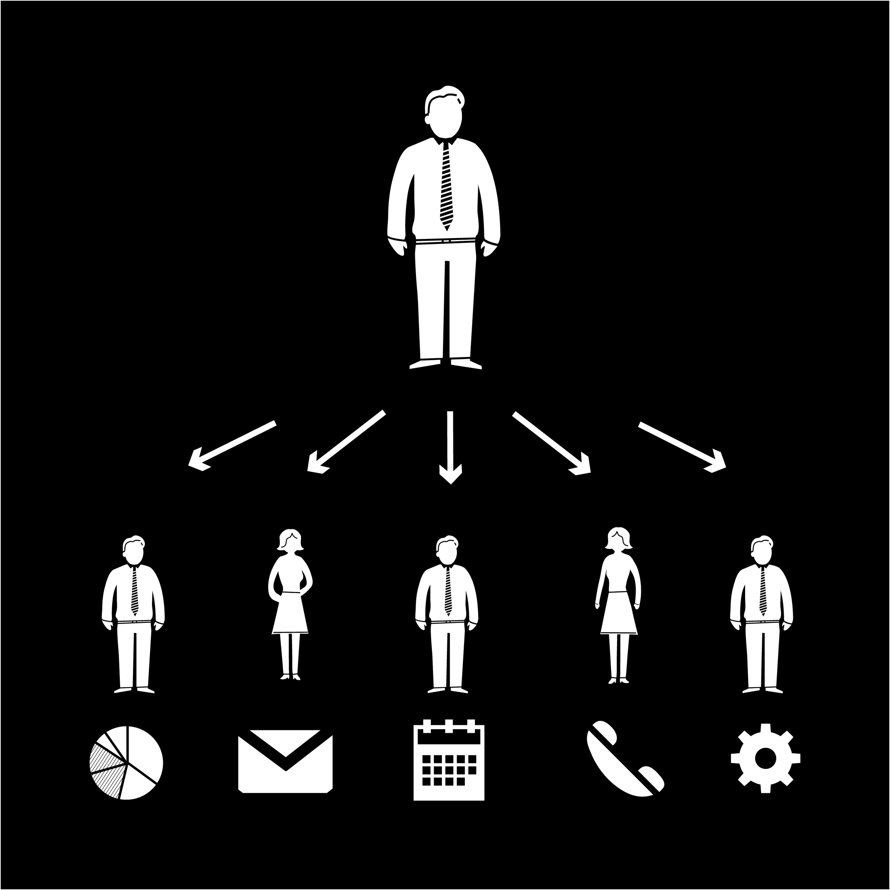
Delegate
to entrust responsibility or a task to another person

Slide 11
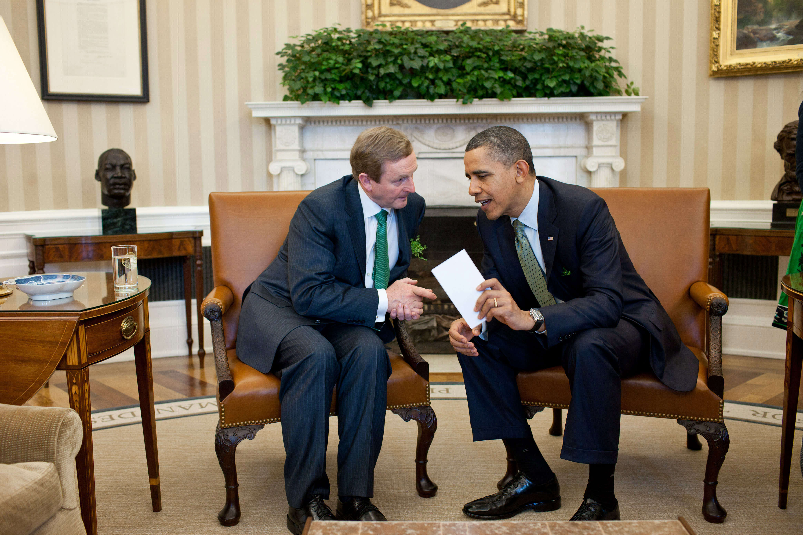
Confer
to give or bestow; to converse with

