Slide 1
Vocabulary Unit
English 10H

Slide 2
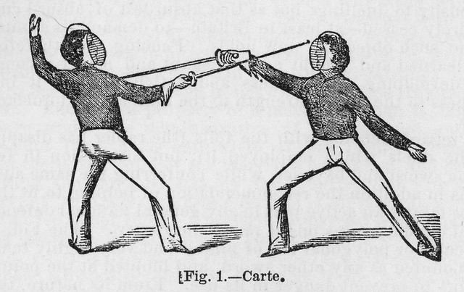
Adversary
an enemy; an opponent

Slide 3
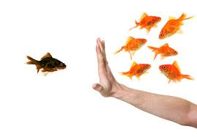
Alienate
to turn away; to make indifferent or hostile; to transfer, convey

Slide 4
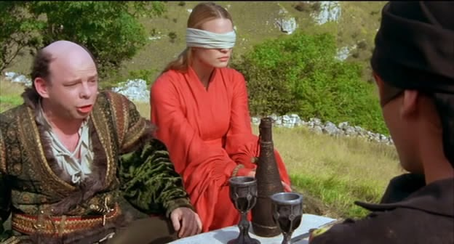
Artifice
a skillful or ingenious device; a clever trick; a clever skill; trickery

Slide 5
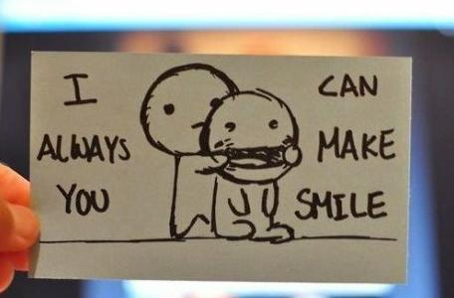
Coerce
to compel, force

Slide 6
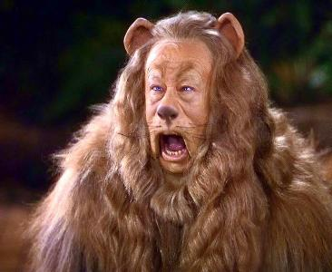
Craven
cowardly; a coward

Slide 7
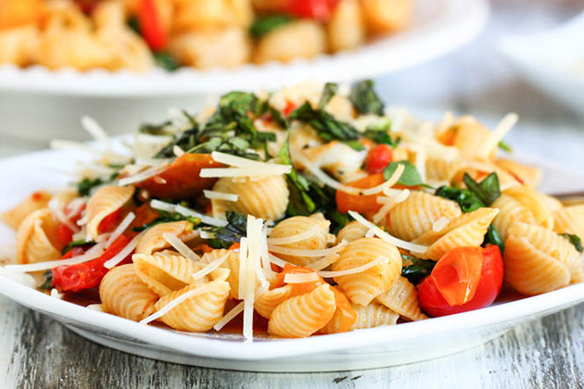
Culinary
of or related to cooking or the kitchen

Slide 8
Delete
to erase, wipe out, cut out

Slide 9
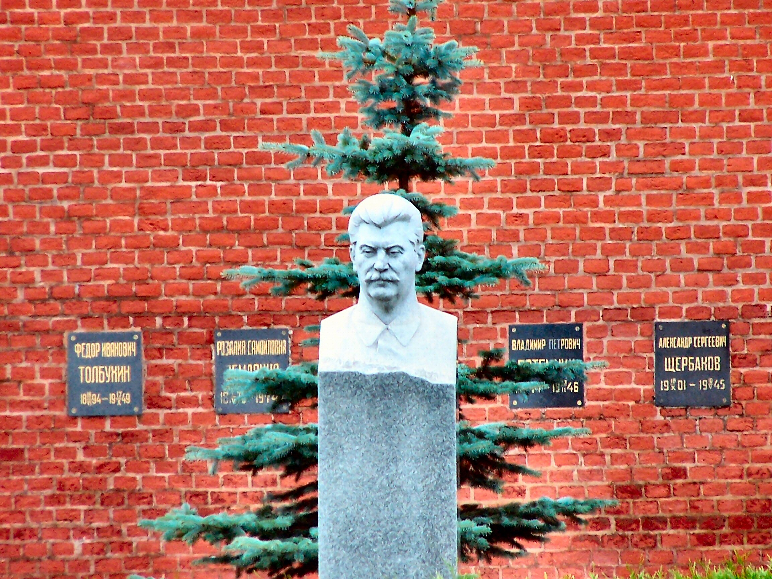
Demise
a death, especially of a person in a lofty position

Slide 10
Exhilarate
to enliven, cheer, give spirit or liveliness to

Slide 11
Fallow
plowed but not seeded; inactive; reddish-yellow; land left unseeded; to plow, but not seed

Slide 12
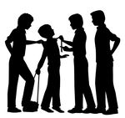
Harass
to disturb, worry; to trouble by repeated attacks

Slide 13
Inclement
stormy, harsh; severe in attitude or action

Slide 14
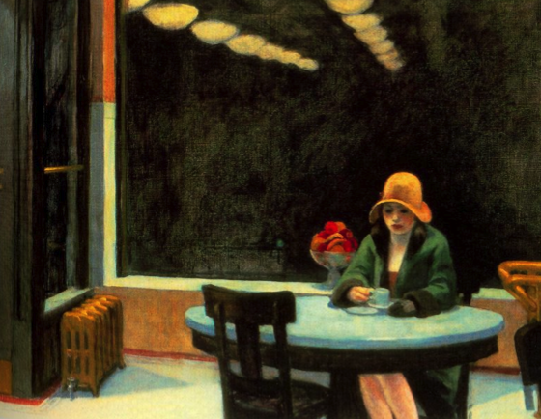
Muse
to think about in a dreamy way; to ponder

Slide 15
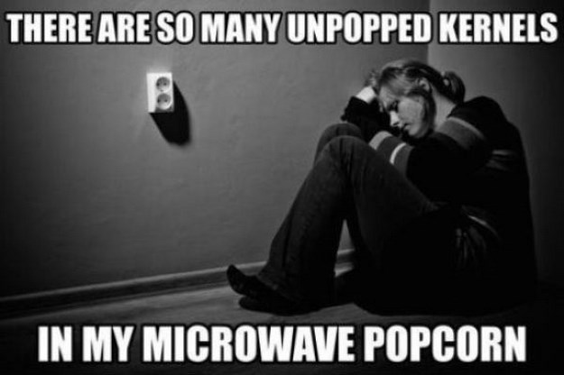
Negligible
so unimportant that it can be disregarded

Slide 16
Perpetuate
to make permanent or long lasting

Slide 17
Precedent
an example that may serve as a basis for imitation or later action

Slide 18
Punitive
inflicting or aiming at punishment

Slide 19
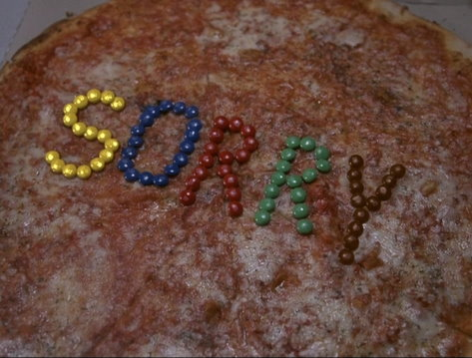
Redress
to set right, remedy; relief from wrong or injury

Slide 20
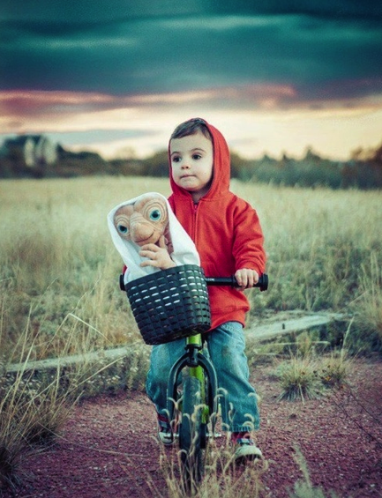
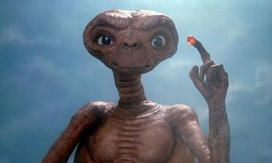
Sojourn
a temporary stay; to stay for a time

Slide 21
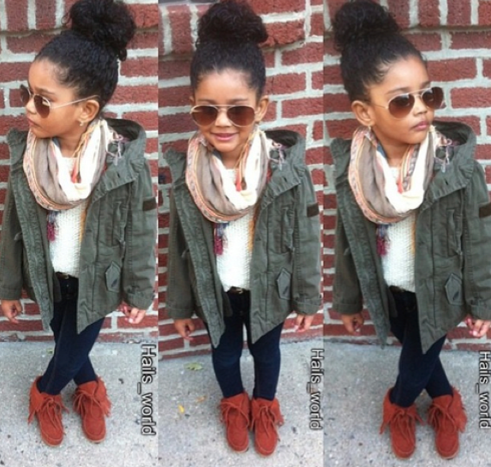
Urbane
refined in manner or style, suave

