Slide 1
Vocabulary Unit
English 10H & AP

Slide 2
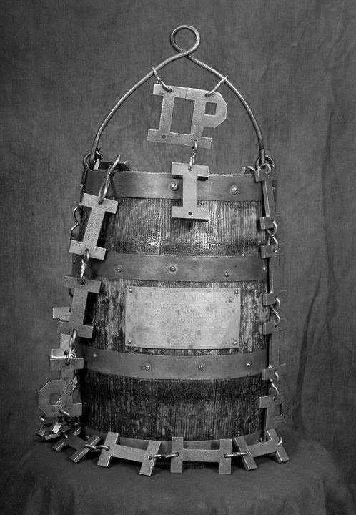
Affiliated
associated, connected

Slide 3
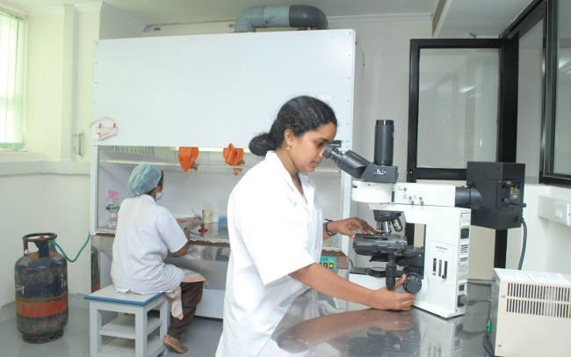
Ascertain
to find out

Slide 4
Attainment
an accomplishment, the act of achieving

Slide 5
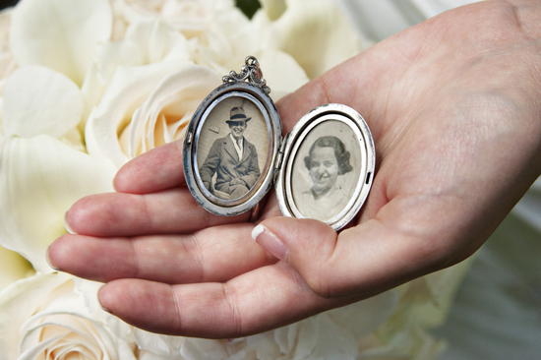
Bequeath
to give or pass on as an inheritance

Slide 6
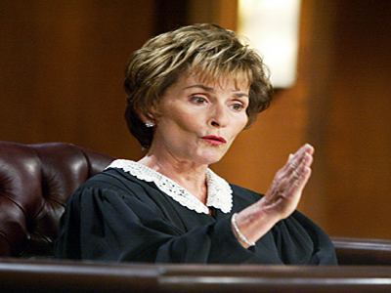
Cogent
forceful; convincing; relevant and to-the-point

Slide 7
Converge
to move toward one point, approach nearer together

Slide 8
Disperse
to scatter, spread far and wide

Slide 9
Esteem
to regard highly

Slide 10
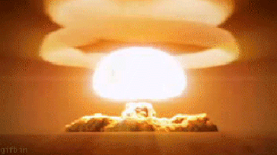
Expunge
to erase, obliterate, destroy

Slide 11
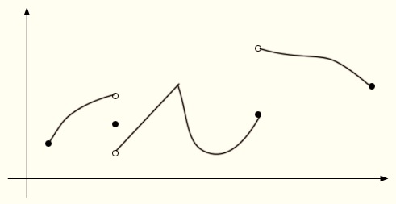
Finite
having limits; lasting for a limited time

Slide 12
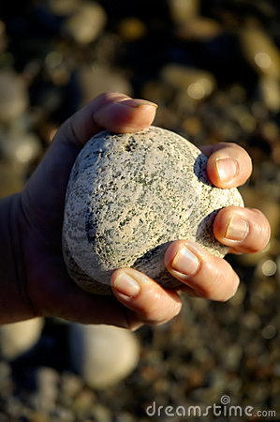
Invulnerable
not able to be wounded or hurt; shielded against attack

Slide 13
Malevolent
spiteful, showing ill will

Slide 14
Nonchalant
cool and confident, unconcerned

Slide 15
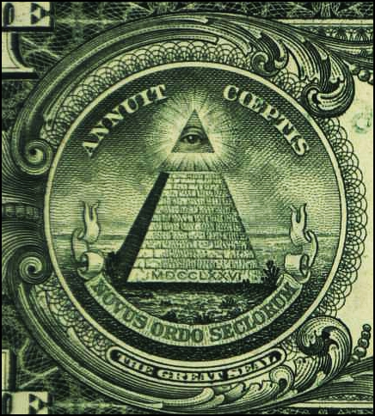
Omniscient
knowing everything; having unlimited awareness or understanding

Slide 16
Panacea
a remedy for all ills; a cure-all; an answer to all problems

Slide 17
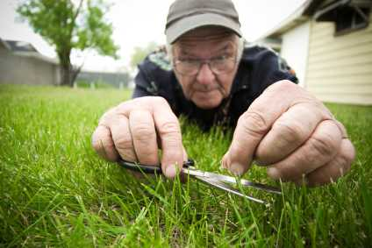
Scrupulous
exact, careful, attending thoroughly to details

Slide 18
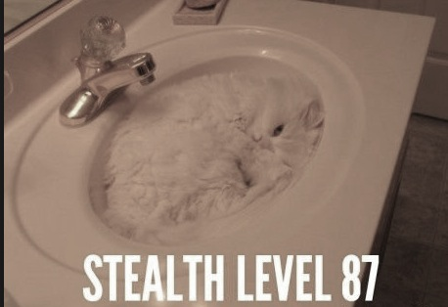
Skulk
to move about stealthily; to lie in hiding

Slide 19
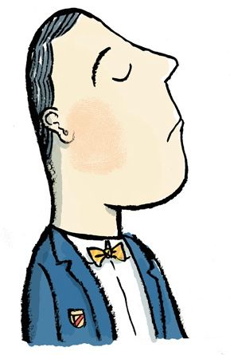
Supercilious
proud and contemptuous; showing scorn due to perceived superiority

Slide 20
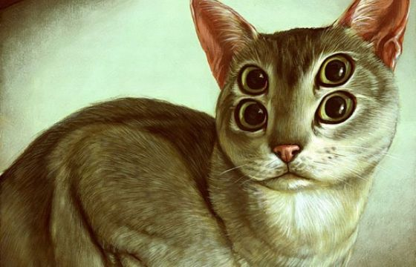
Uncanny
strange; mysterious; weird; beyond explanation

Slide 21
Venial
easily excused; pardonable

