Slide 1
Vocabulary Unit 2
English 10

Slide 2
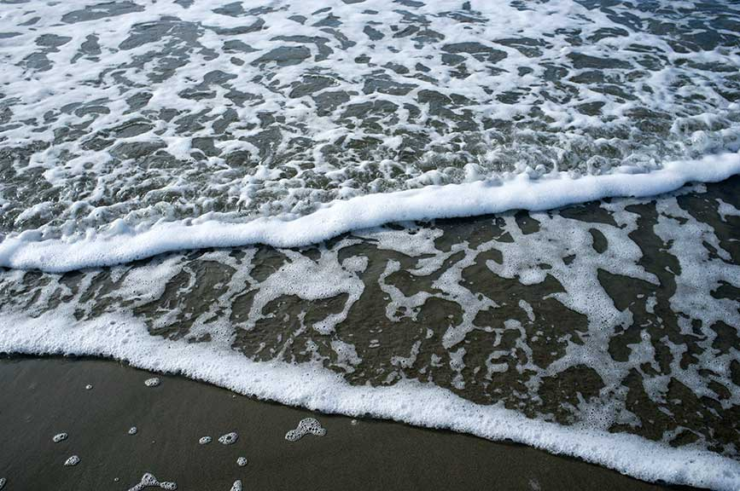
Receding
To become more distant

Slide 3
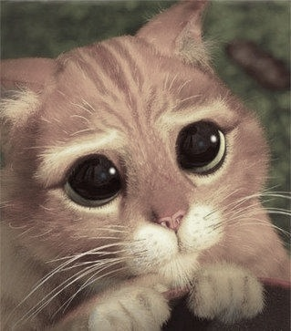
Disarming
Removing or lessening suspicions or fears

Slide 4
Prolonged
To be extended

Slide 5
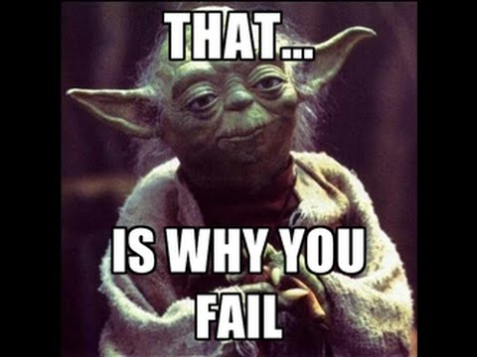
Imprudent
Unwise

Slide 6
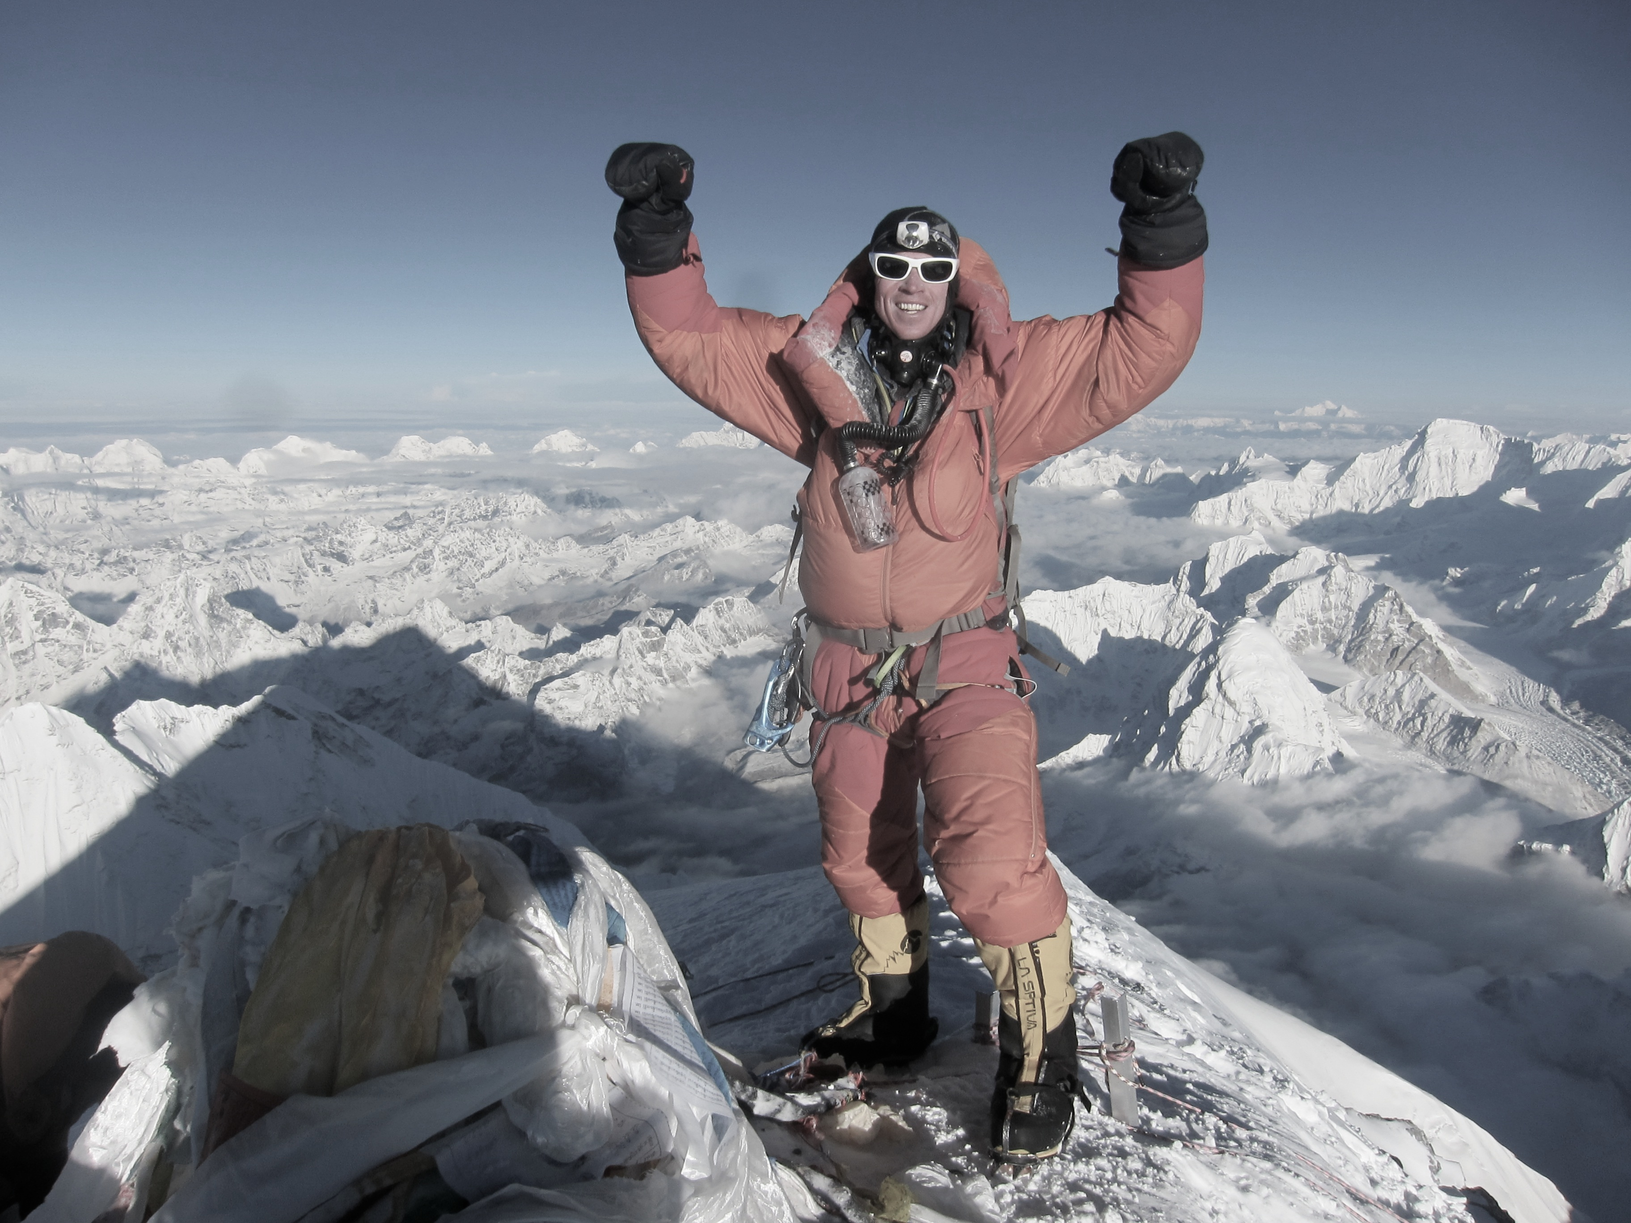
Surmounted
To have overcome

Slide 7
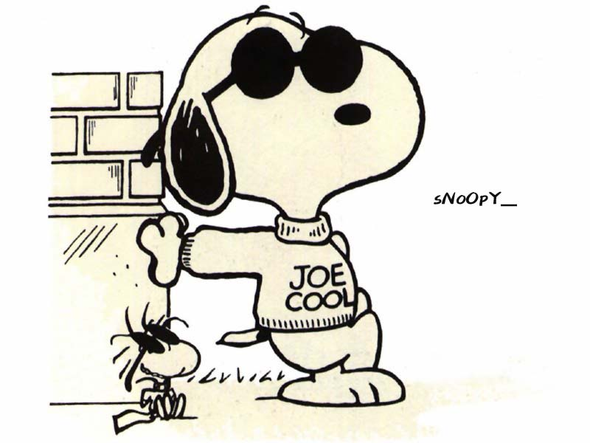
Unruffled
Calm; not disturbed

Slide 8
Invariably
Always; constant; without changing

Slide 9
Diverting
Entertaining

Slide 10
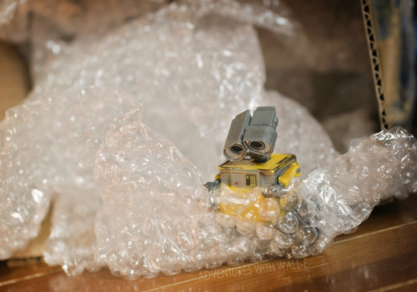
Impulse
A sudden desire to do something

Slide 11
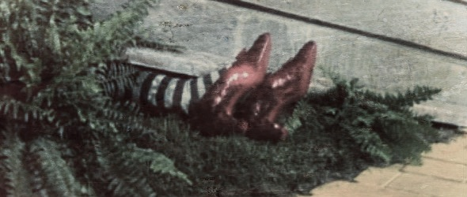
Protrude
To stick out

