Slide 1
Vocabulary
Unit
AP & 10H

Slide 2
Allocate
to set apart or designate for a special purpose

Slide 3
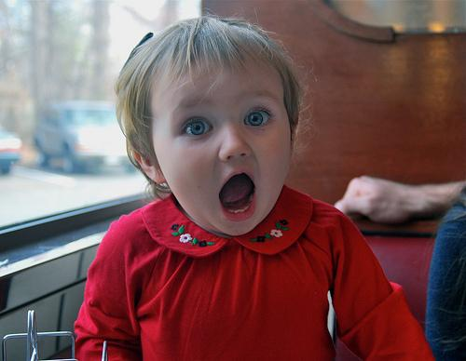
Ardent
very enthusiastic, impassioned

Slide 4
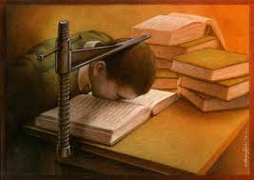
Assiduous
persistent, diligent

Slide 5
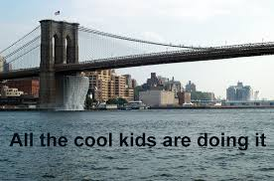
Brash
prone to act in a hasty manner; imprudent

Slide 6
Capricious
subject to whims or passing fancies

Slide 7
Chastise
to inflict physical punishment as a means of correction

Slide 8
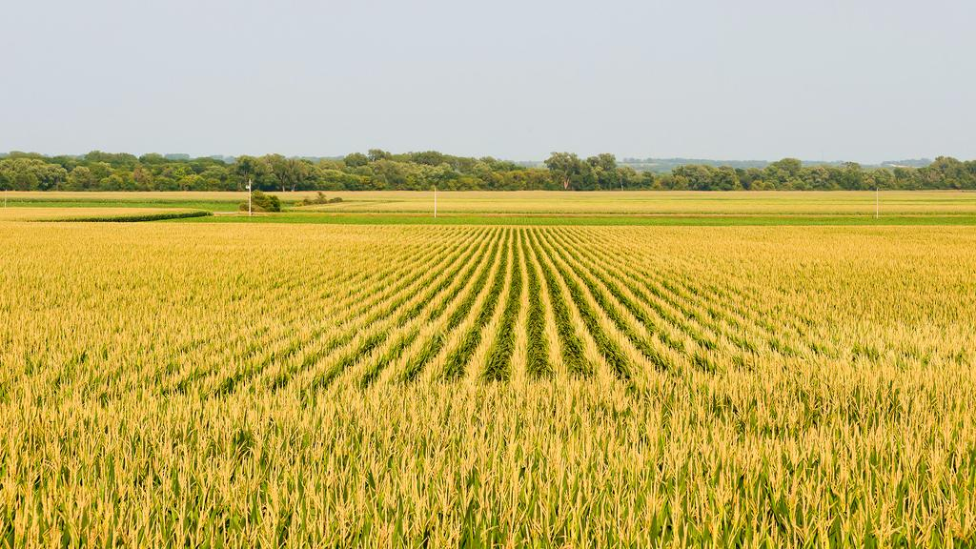
Copious
abundant; plentiful; wordy; verbose

Slide 9
Deviate
to turn aside; to stray from the norm

Slide 10
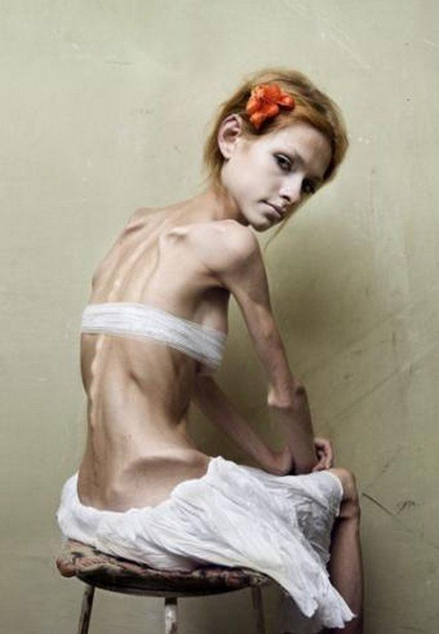
Emaciated
unnaturally thin

Slide 11
Exult
to rejoice greatly

Slide 12
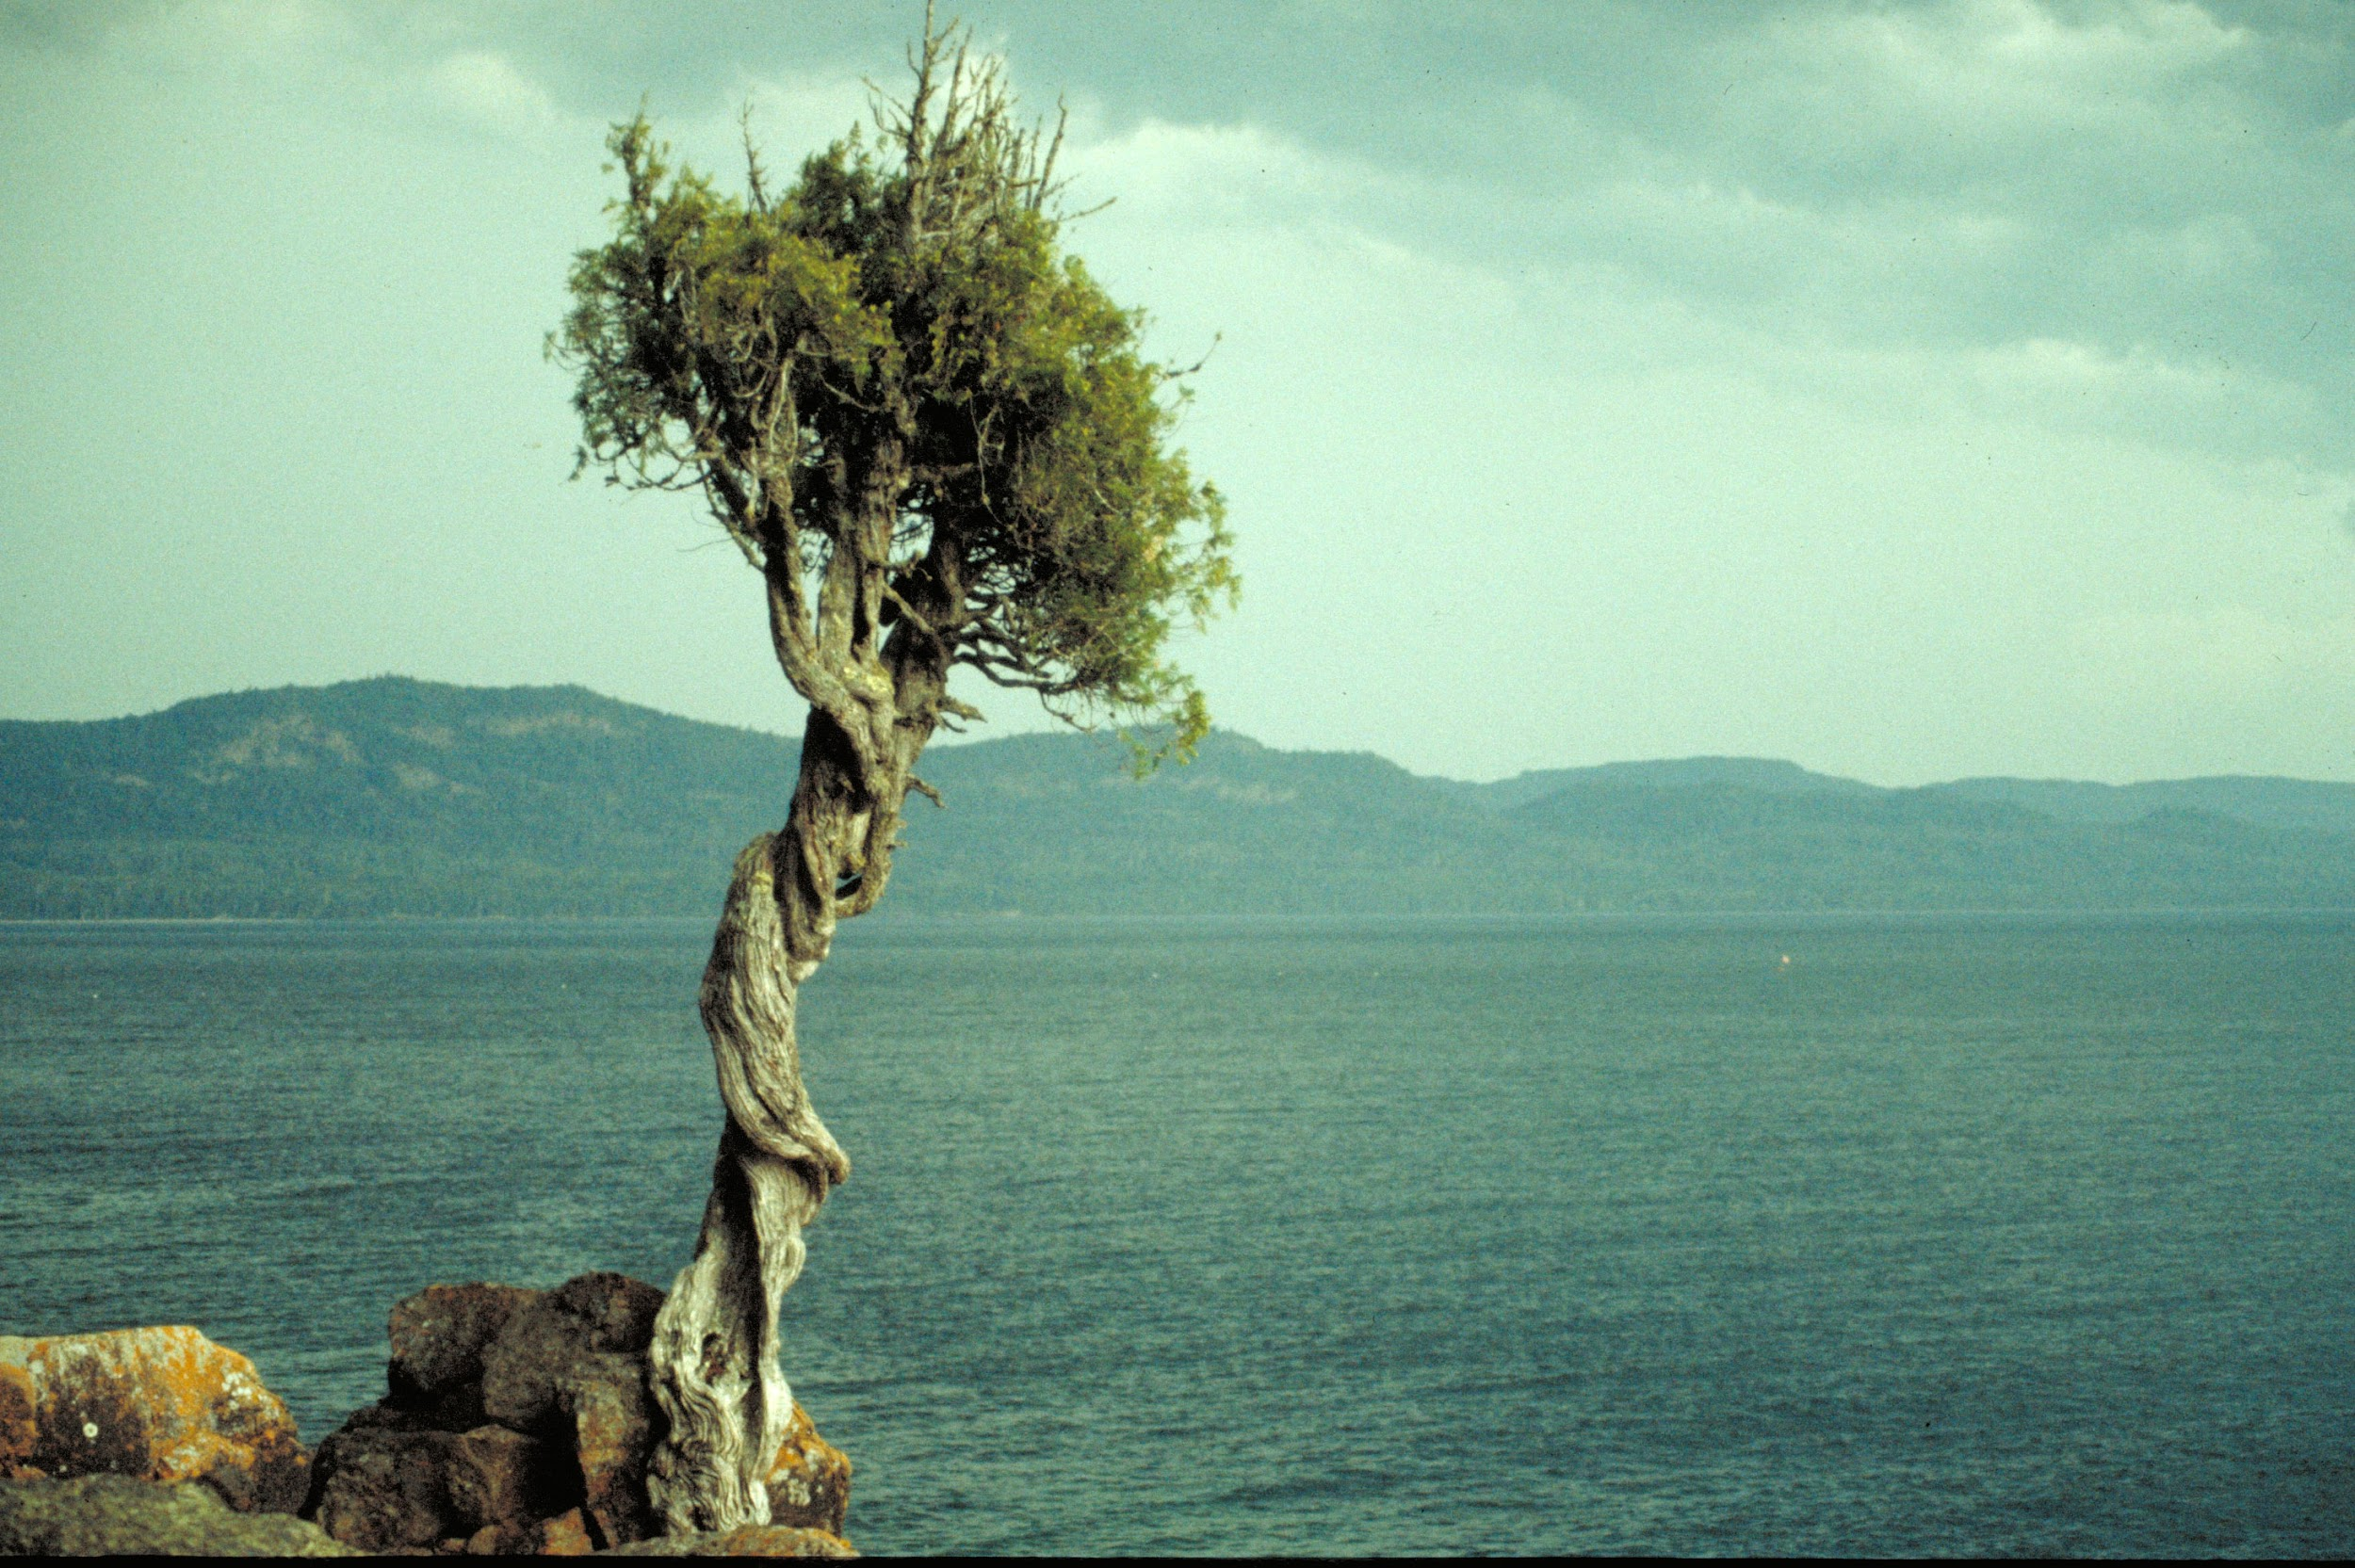
Gnarled
knotted and twisted

Slide 13
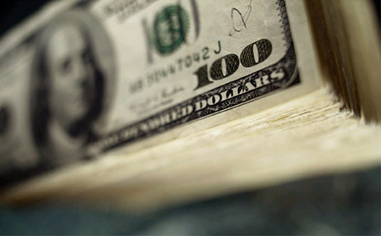
Indemnity
a payment for damage or loss

Slide 14
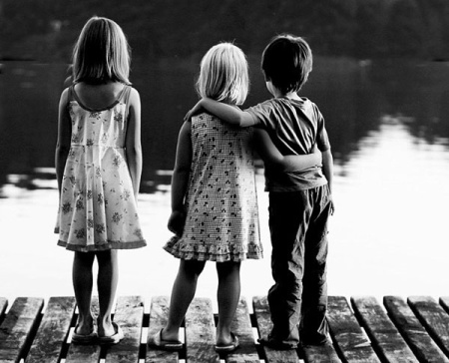
Inkling
a hint; a vague notion

Slide 15
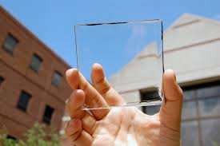
Limpid
clear and transparent

Slide 16
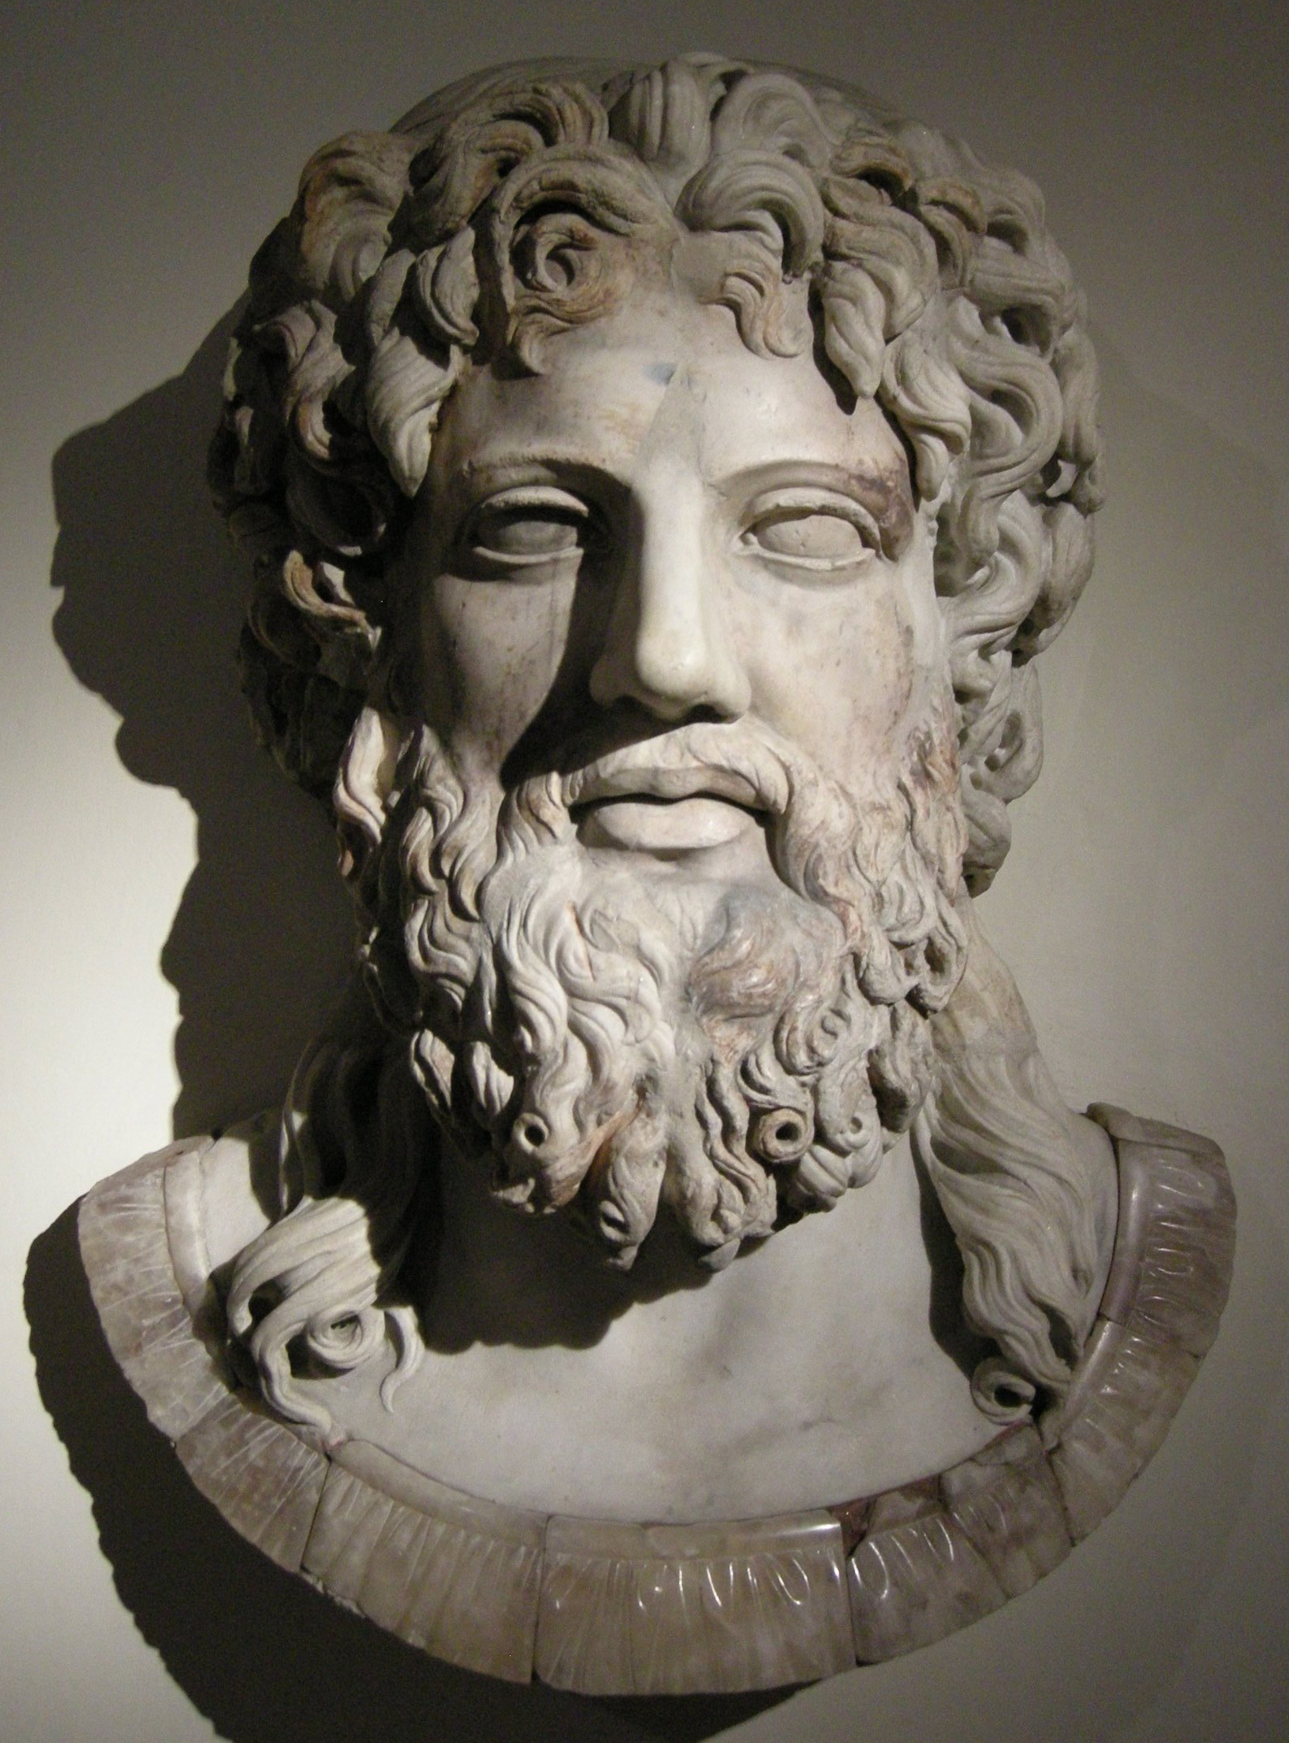
Omnipotent
almighty, having unlimited power or authority

Slide 17
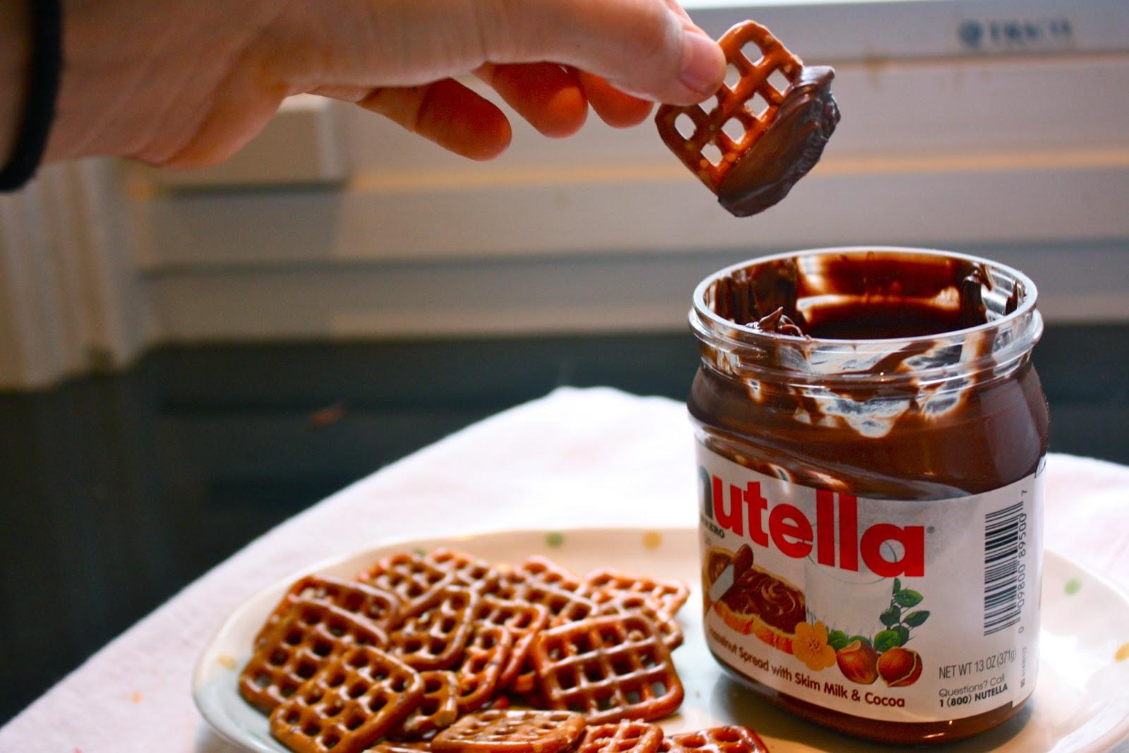
Palatable
agreeable to the taste or one’s sensibilities

Slide 18
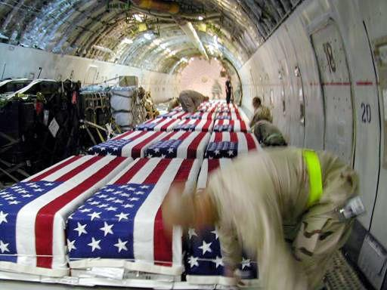
Poignant
deeply affecting or deeply touching

Slide 19
Rancor
bitter resentment

Slide 20
Sophomoric
immature and overconfident; conceited
I will leave this to the imagination. Insert mental image here.

Slide 21
Spontaneous
arising naturally; not planned or engineered in advance

