Slide 1
Vocabulary Unit
English AP & 10H

Slide 2
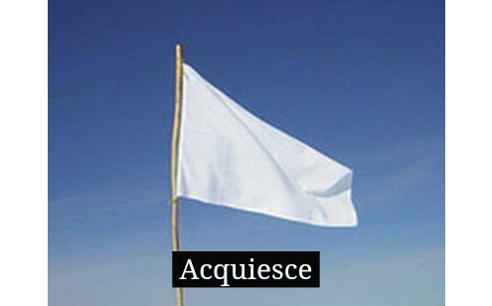
Acquiesce
to accept without protest

Slide 3
Allure
to entice or tempt

Slide 4
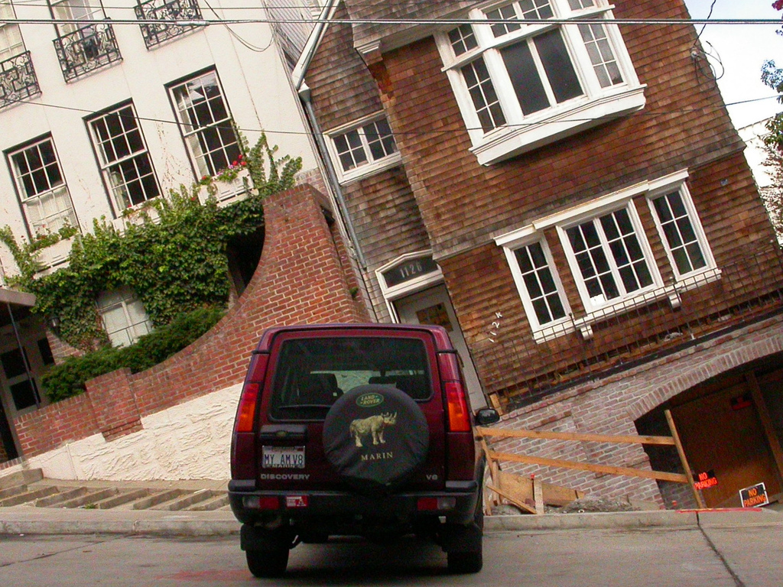
Askew
twisted to one side

Slide 5
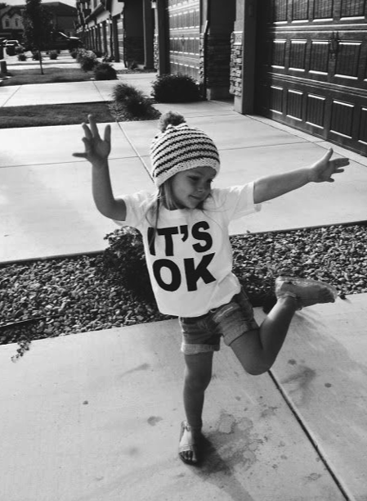
Blithe
cheerful, lighthearted

Slide 6
Contentious
quarrelsome, inclined to argue

Slide 7
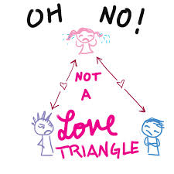
Covet
to desire something belonging to another

Slide 8
Crestfallen
discouraged, dejected, downcast

Slide 9
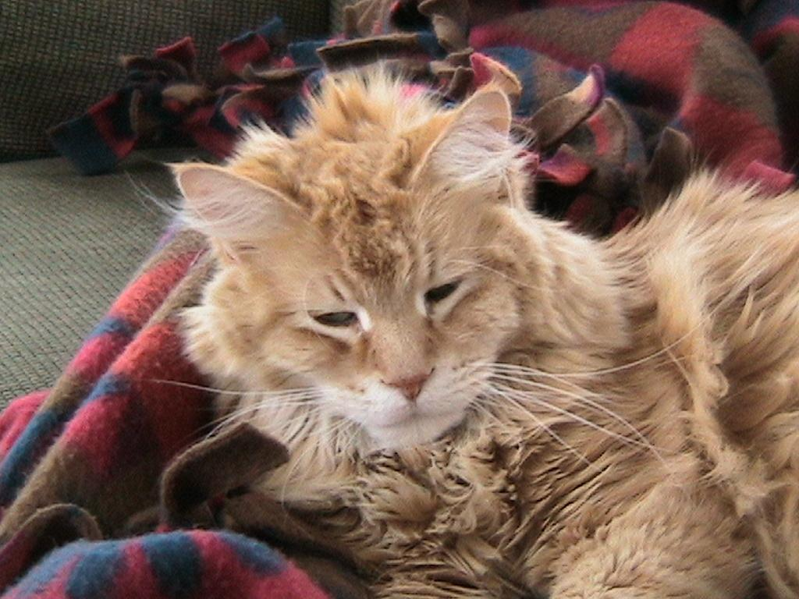
Disheveled
rumpled, mussed; hanging in disorder

Slide 10
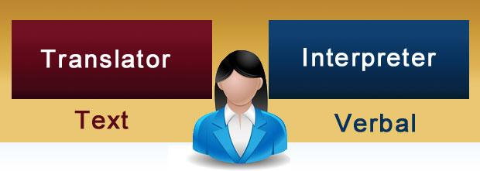
Exponent
one who advocates, speaks for, explains, or interprets

Slide 11
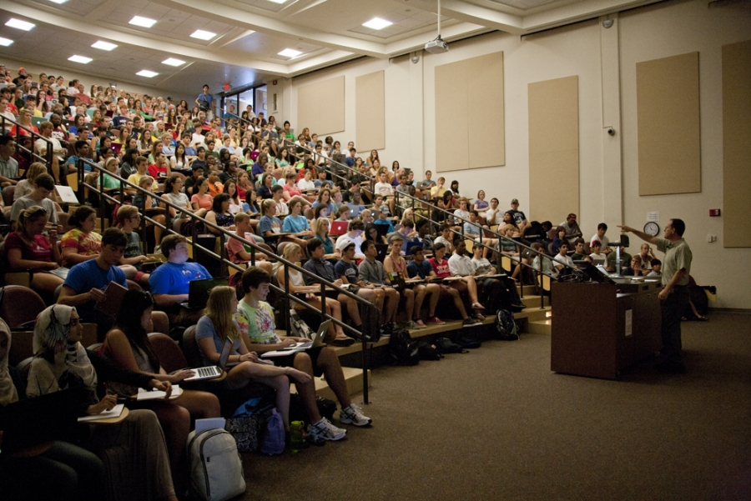
Garrulous
given to much talking

Slide 12
Insuperable
incapable of being overcome

Slide 13
Lamentable
to be regretted or pitied

Slide 14
Misnomer
an unsuitable or misleading name

Slide 15
Profess
to affirm openly

Slide 16
Respite
a period of relief or rest

Slide 17
Retribution
a repayment

Slide 18
Sinuous
winding; having many curves

Slide 19
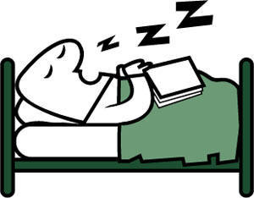
Sonorous
full, deep, rich in sound

Slide 20
Vanguard
the foremost part of an army

Slide 21
Wastrel
a wasteful person; a good-for-nothing

