Slide 1
Vocabulary Unit 9
English 10

Slide 2
Adulterate
to corrupt, make worse, by the addition of something of lesser value

Slide 3
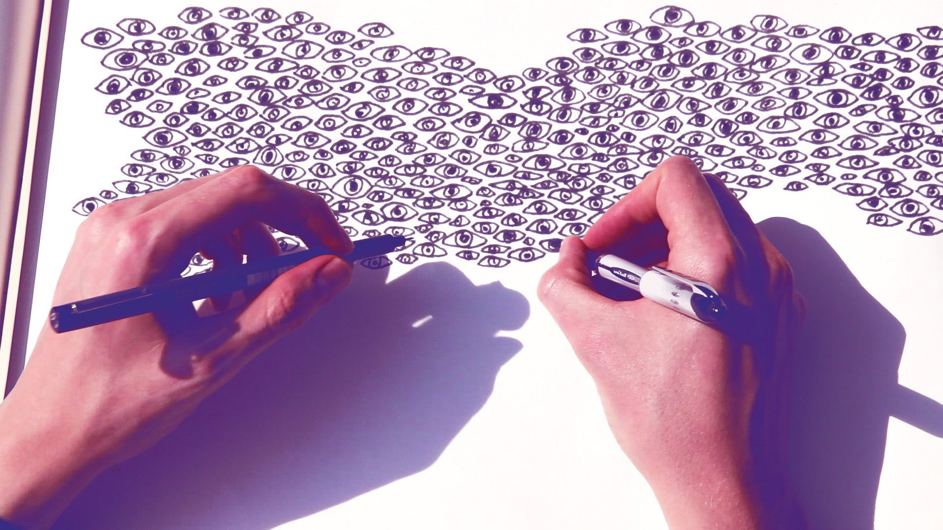
Ambidextrous
able to use both hands equally well; very skillful; deceitful, hypocritical

Slide 4
Augment
to make larger; to increase

Slide 5
Bereft
deprived of; made unhappy through a loss

Slide 6
Deploy
to position or arrange; to utilize; to form up

Slide 7
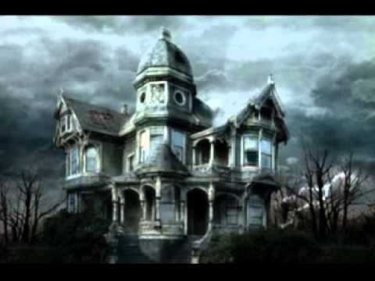
Dour
stern, unyielding, gloomy, ill-humored

Slide 8
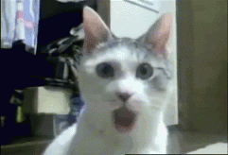
Gape
to stare with open mouth; to open the mouth wide; to open wide

Slide 9
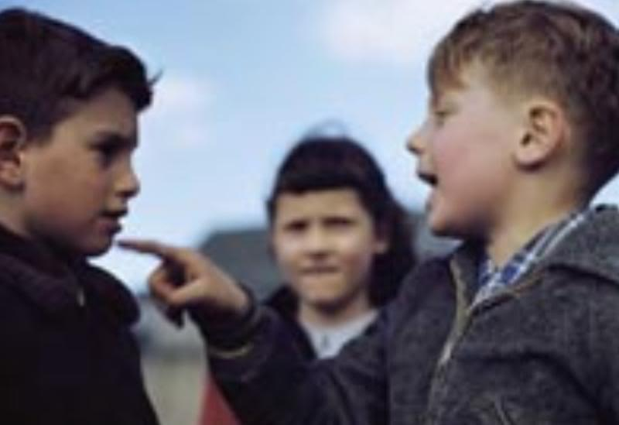
Gibe
to utter taunting words; an expression of scorn

Slide 10
Insidious
intended to deceive or entrap; sly; treacherous

