Slide 1
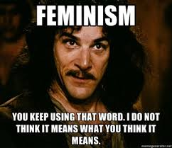
“The Yellow Wallpaper”
Charlotte Perkins Gilman
Critical Connections

Slide 2
Did You Know… ?
The Rule of Thumb
Godey’s Lady’s Handbook
The Story of Adam & Eve
The Lack of Mothers in Disney Films
The Lack of Women Writers in Classic American Literature

Slide 3
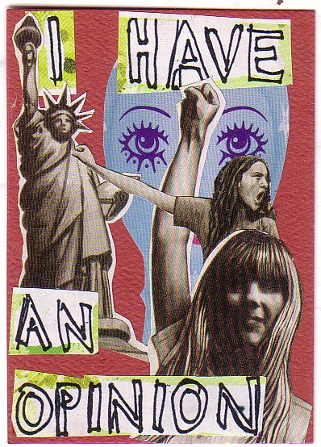
Stories Infiltrating Critique
Define the following: Patriarchy; Feminism; Masculinity

Slide 4
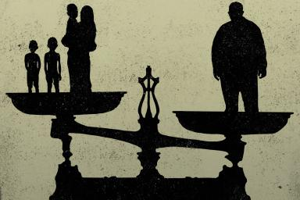
Patriarchy
Patriarchy is the ideological framework and subsequent practices in society that reveal a predilection for men over women in terms of power.

Slide 5
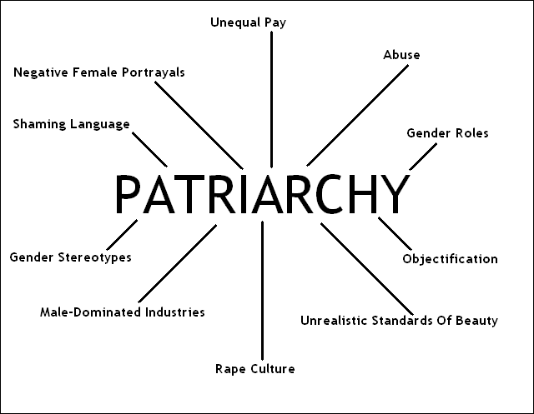
Patriarchy Diagram

Slide 6
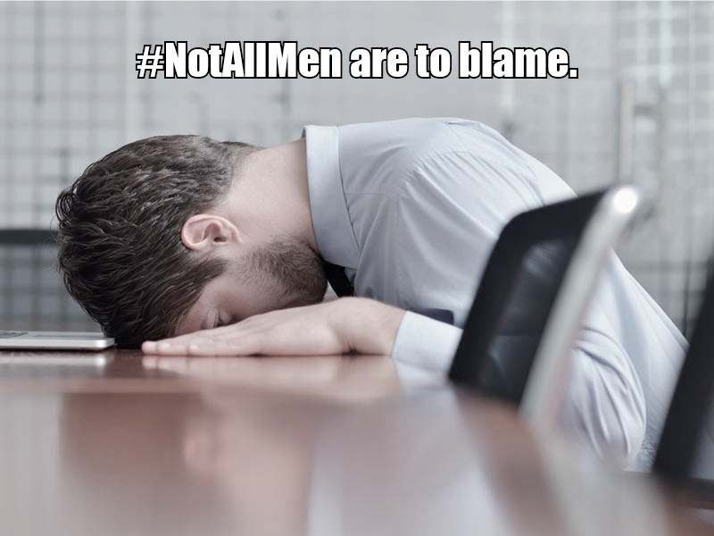
Feminism
Feminism is the ideological framework and subsequent practices in society that advocates for equity, choice, and agency for men and women equally in society.

Slide 7
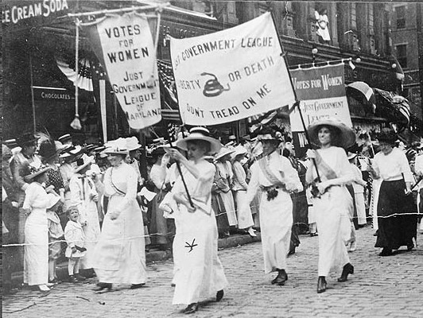
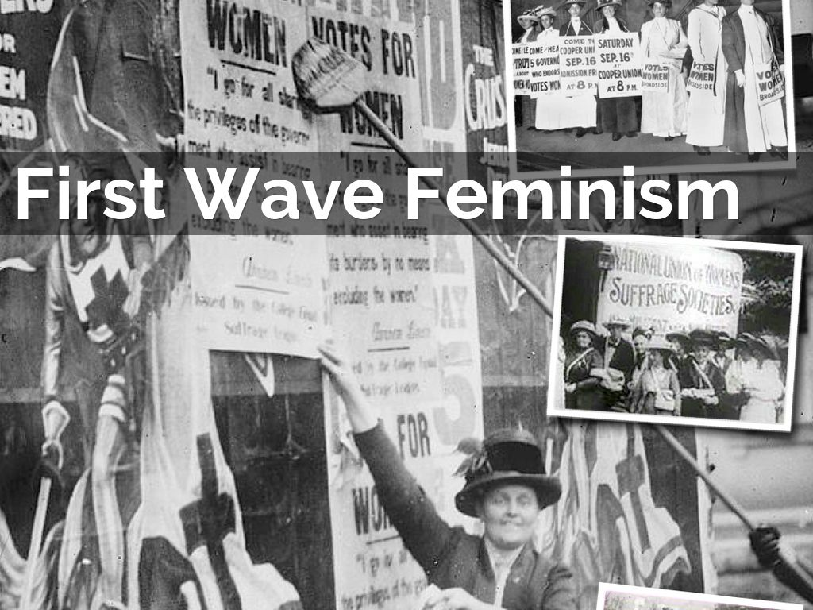
First Wave Feminism
The First Wave: focused on women’s rights to vote.
Called the Suffragettes
Women’s Suffrage was achieved in 1919.

Slide 8
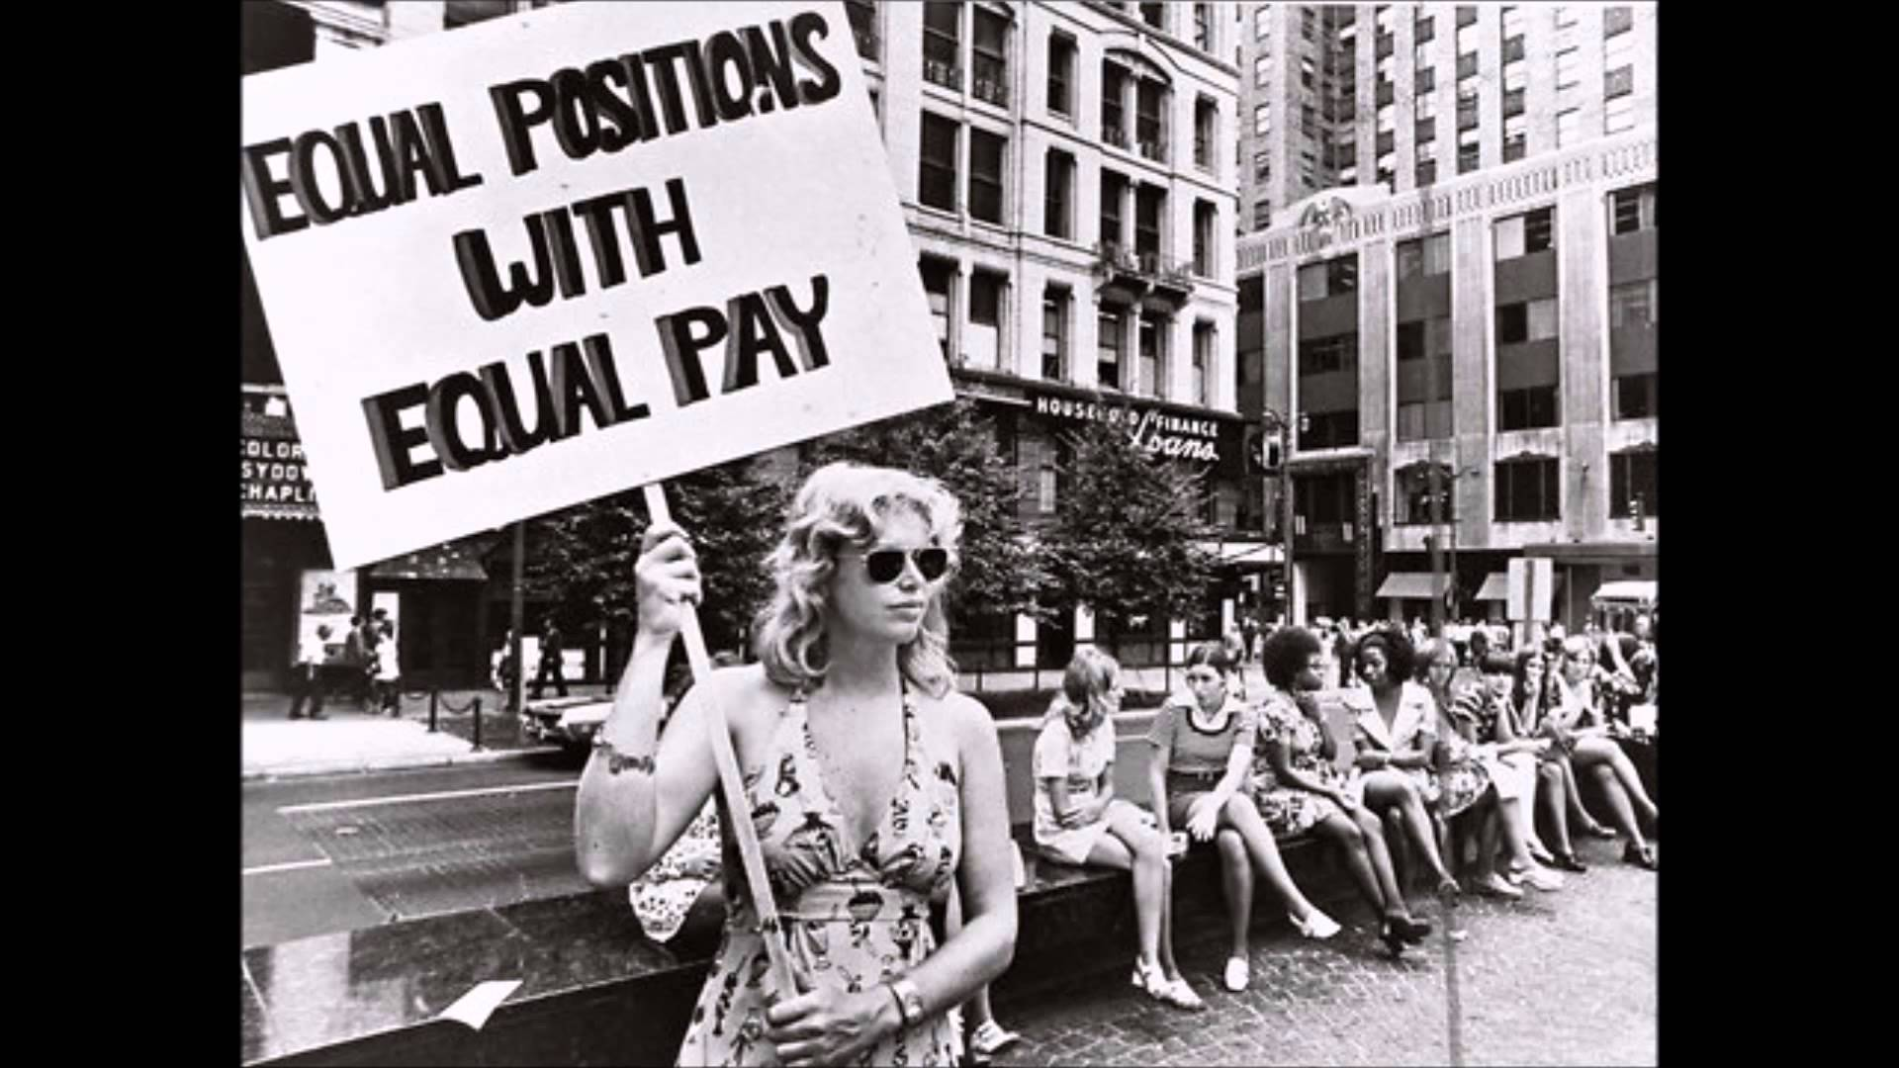
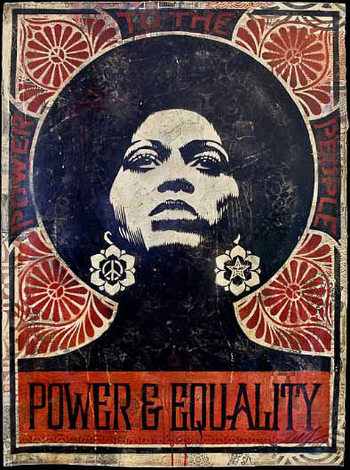
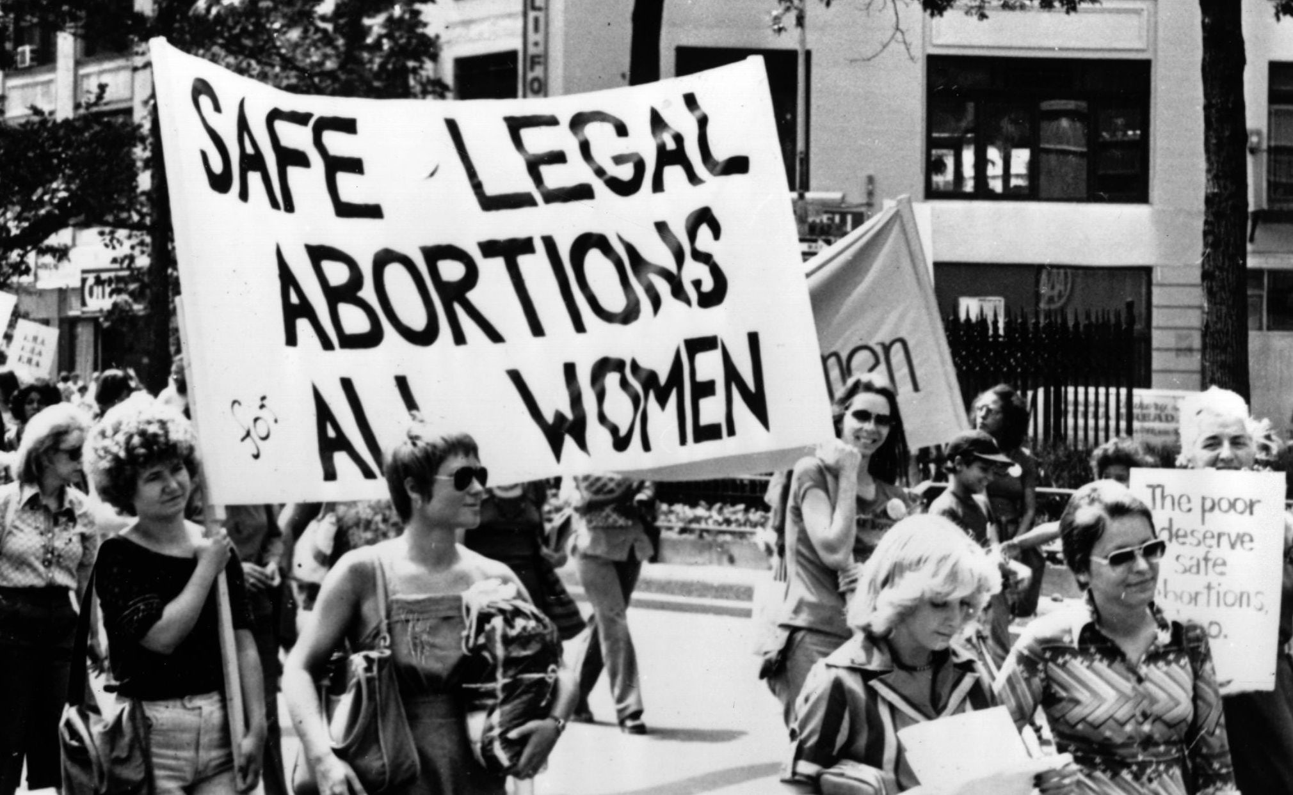
Second Wave Feminism
Second wave feminism: focused on women’s rights regarding reproductive and women’s rights to equal pay in the workforce. This movement was inspired by the Civil Rights Movement. (Time frame: 1970s)

Slide 9
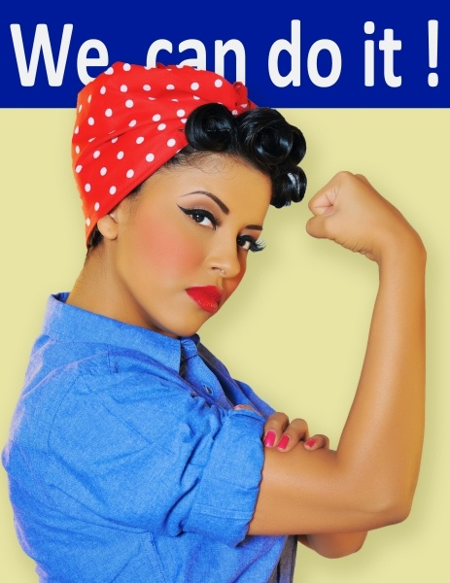
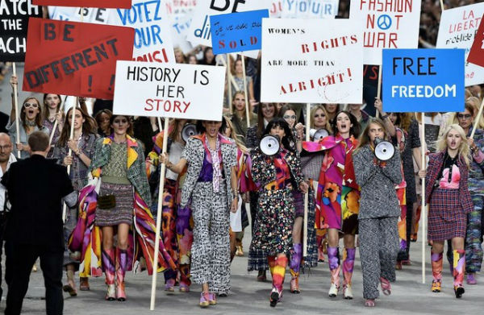
Third Wave Feminism
Third wave feminism: focuses on more implicitly engrained aspects of patriarchal views in society, such as rape culture, forms of media objectification, etc.

Slide 10
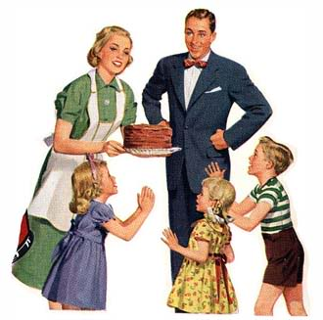
Traditionally Gendered Spheres
Public Sphere: Males
Work Force
Breadwinner
Financial Provider
Private Sphere: Females
Domestic Cares
Home Keeper
Raises Children

Slide 11
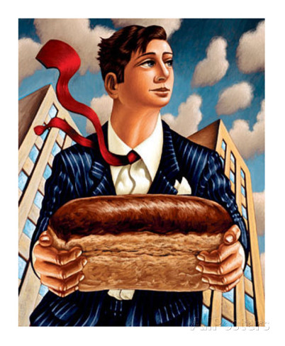
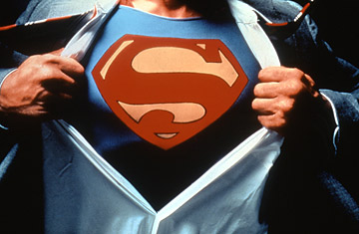
Masculinity
Masculinity: a culturally constructed set of expectations and conceptualizations that encompass traditional, masculine gender identity.

Slide 12
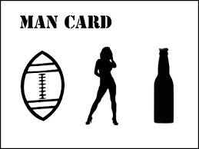
Male Stereotypes
Traditional labels associated with men.

Slide 13
Today…

Slide 14
Today…

Slide 15
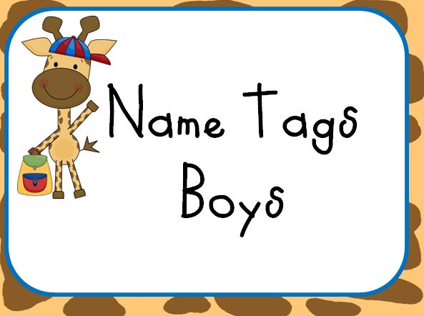
Today…

Slide 16
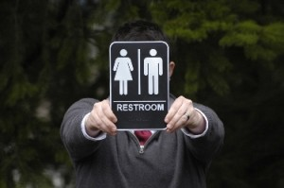
Today…

