Slide 1
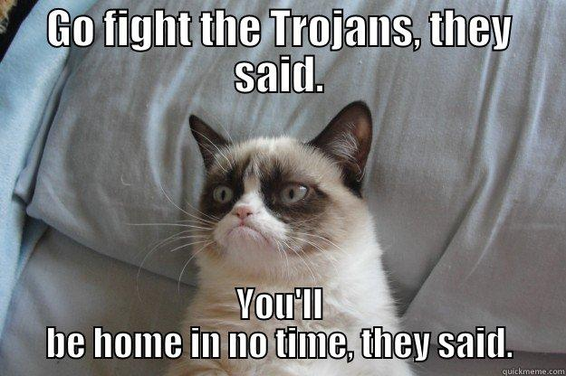
The Odyssey A Synopsis of the Books.
.

Slide 2
Learning Objective
Students will understand the general plot of The Odyssey along with other fundamental aspects of narration such as symbolism, characterization, Greek mythological allusions, and structure.

Slide 3
Some Quick Questions
Is The Odyssey an example of poetry or prose?
How many books are in The Odyssey?
Who is considered the ”author” of The Odyssey?
What’s a frame story?

Slide 4
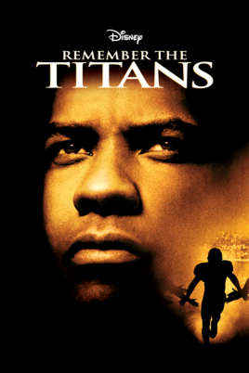
Examples of a Frame Story

Slide 5
LOOK AT YOUR READING GUIDE.
Fill in the boxes with a brief synopsis.

Slide 6
Book One
Homer calls upon a Muse (a daughter of Zeus) to help him tell the story of Odysseus.
Odysseus is “trapped” on Calypso’s island. Suitors are trying to marry Penelope.
He’s been gone for almost 20 years.

Slide 7
Book Four
Telemachus goes to Menelaus to ask about his father. Menelaus reflects on the Wooden Horse Trick.
The suitors plot to kill Telemachus.

Slide 8
Book Five
Calypso lets Odysseus build a ship and leave her island after the gods make her.
Odysseus encounters an intense storm that nearly kills him.

Slide 9
Book Six
Odysseus washes up on the island of the Phaecians. Nausicaa, daughter of King Alcinous, finds Odysseus.
They welcome the “stranger.”

Slide 10
Book Eight
Odysseus finally tells the Phaecians his story.

Slide 11
Book Nine
He talks about the Cicones. The first city they raided after the war.
He talks about the Lotus Eaters.
He shares the story about how he blinded the cyclops Polyphemus.

Slide 12
Book Ten
Odysseus receives a bag of winds from Aeolus, but his men open the bag.
The men end up on the island of Circe, the enchantress that turns men into pigs. Odysseus escapes because he eats a drug that prevents him from falling victim to her spell.

Slide 13
Book Eleven
Odysseus goes to the underworld to talk to the blind prophet Tiresias. Tiresias tells him that he should avoid the island of the sun god. For, if Odysseus’s men eat the cattle, they will all die.

Slide 14
Book Twelve
Odysseus has his men tie him to the ship so that he can listen to the sirens.
Odysseus choses to go past Scylla (the six-headed monster) instead of Charybdis (the whirlpool).
Even though he doesn’t want to, they stop at the island of Helios.

Slide 15
Book Sixteen
Odysseus returns to Ithaca in disguise (dressed as a beggar) and speaks with Eumaeus. He meets Telemachus (his son)- first time in 20 years.

Slide 16
Book Seventeen
Odysseus, still disguised as a beggar, is beaten and mistreated by the suitors (especially by Antinous).
However, he is granted permission to see Penelope.

Slide 17
Book Twenty-One
Penelope devises the Great Bow test. She says that she will marry anyone who can string it and make the target.
Odysseus wins. He kills all the suitors and anyone who slept with them.

Slide 18
Book Twenty-Three
Penelope tests Odysseus to see if it’s actually him.
He proves himself by referencing the bridal bed (the tree).

Slide 19
Book Twenty-Four
Odysseus visits his parents. Peace is restored.

