Slide 1
The History of the English Language
High School English Language Arts

Slide 2
Overview of English Language [Timeframes]
England before the English (55BC-600AD)
Old English (600-1100)
Middle English (1100-1500)
Early Modern English (1500-1700)
Present-Day English (1700-Today)

Slide 3
England before the English (55BC-600AD)
Celts were living there first (BC years)
Roman Emperor Julius Caesar wanted the land (50-410)
Romans leave- Picts invade from north, the Scots from Ireland, and the Jutes, Angles, and Saxons from Germany (410-600)
Celts moved to Cornwall and Wales (410-600)
Anglo-Saxons dominated

Slide 4
Old English (Anglo-Saxon English) (600-1100)
Anglo Saxons influenced the rise of Old English
Germanic Structure
Mostly words for everyday things
Exp. House, woman, werewolf
Days of the Weeks for Anglo-Saxon gods: Tuesday, Wednesday, Thursday, and Friday
In 597, the arrival of Christian missionaries influences the English language. Latin infiltrates Anglo-Saxon English. We get words like bishop, martyr, and font.

Slide 5
Vikings Interlude
Vikings bring action-packed words like “drag,” “ransack,” “thrust,” “die,” “give,” and “take.”
Vikings introduced two thousand words into the English language.

Slide 6
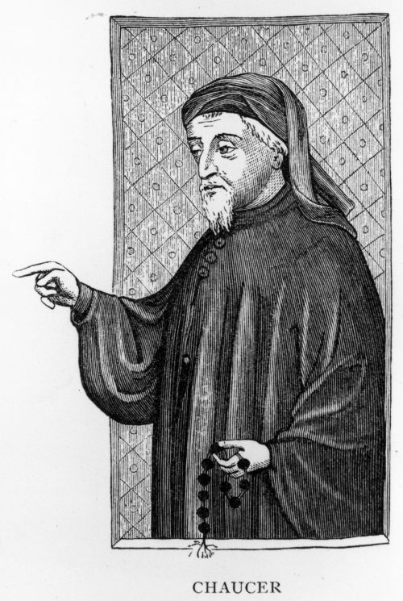
Middle English (1100-1500)
“Really” commences with the Norman Invasion (or the Norman Conquest led by William the Conqueror in 1066)
French language meets Old English
Brings in words like “judge,” “jury,” “evidence,” and “justice” (as well as restaurant terminology- poultry, beef, etc.)
Acquired 10,000 new words from the Normans
Latin used in church- English was the vernacular
Hundred Years War with France creates tension between French and English language. In the end, the English language in England becomes the common language.

Slide 7
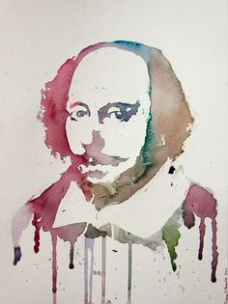
Early Modern English (1500-1700)
BIBLE, SCIENCE, & SHAKESPEARE
Shakespeare creates (or steals) 2000 new words and phrases
Elizabethan theatre culture perpetuates these neologisms
The King James Bible brings new phrases and languages
Metaphors and moral parables
The language of science commences in Latin and transfers to English
Health-related and bodily-related terms

Slide 8
Present-Day English (1700-Today)
Colonization and imperialist efforts brought in new words from languages throughout the world- from Africa, from Australia, etc.
From 1746-1755, scholars worked to standardize spelling with the publication of a common English dictionary (42+ thousand entries)
Then, we have American English, which intertwined with Native Americans, the Dutch, the French, the Spanish, and the Germans.
In 1972, the first email is sent. Then, internet English brought its own compendium of terms. Texting continuously changes the English language.
Then = Global English

Slide 9
Helpful Video References
The History of the English Language in Ten Minutes (illustrated, informative, annoyingly immature)
https://www.youtube.com/watch?v=H3r9bOkYW9s.
A Lecture from Linguistics Professor Dr. Handke
https://www.youtube.com/watch?v=Oz8tEPXI25A

