Slide 1
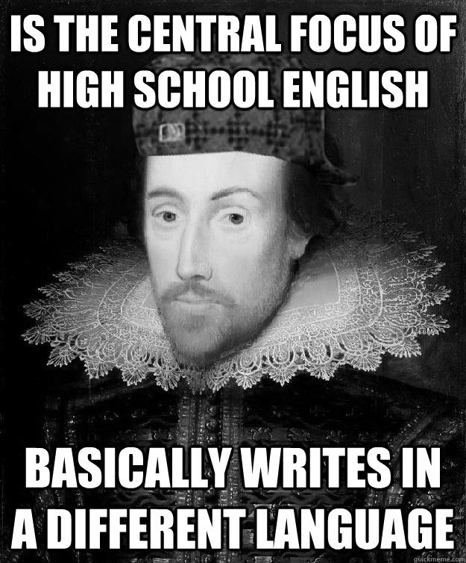
Shakespeare…

Slide 2
Shakespeare or Not?
“To destroy the beauty from which one came”
“Maybe it’s hatred I spew, maybe it’s food for the spirit”
“Men would rather use their broken records than their bear hands”
“I was not born under a rhyming planet”
“The most benevolent king communicates through your dreams”
“Socrates, philosophy and hypotheses can’t define me”

Slide 3
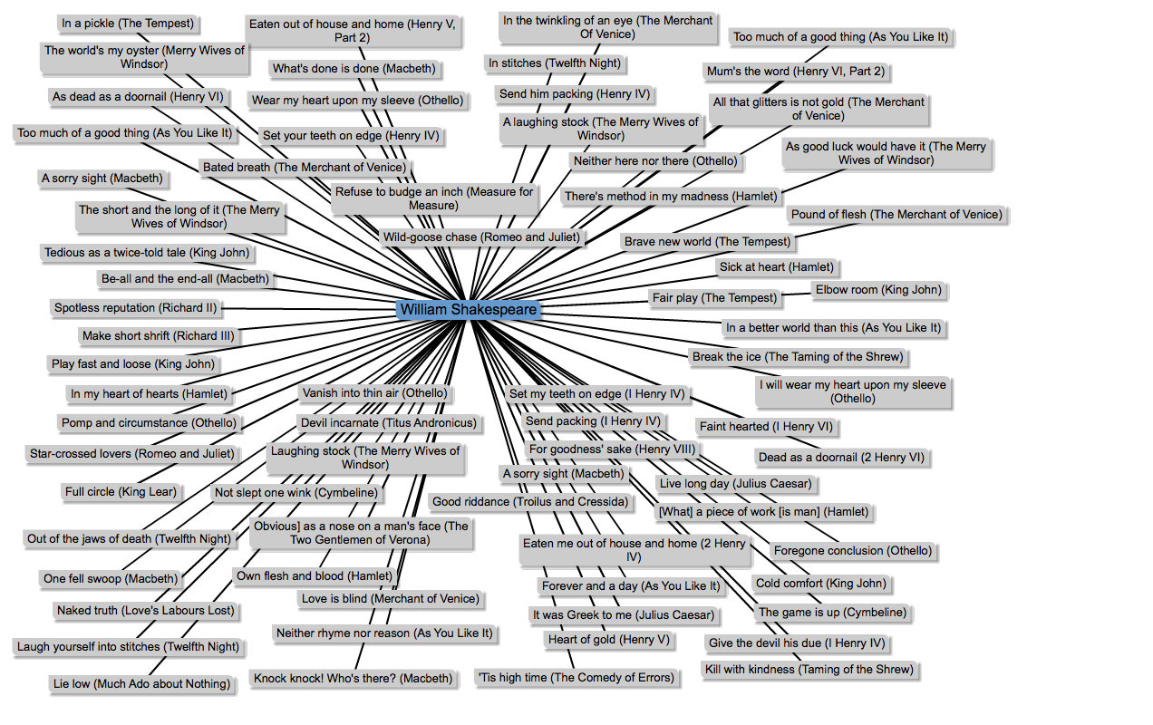

Slide 4
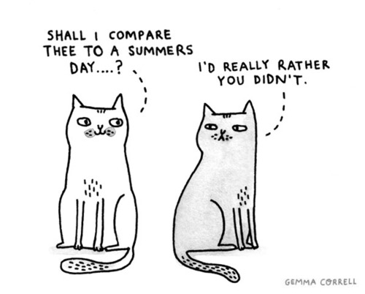
Shakespearean Sonnet
Rhyme Scheme: abab cdcd efef
The Couplet (last two lines): gg
Quatrains (Why?)

Slide 5
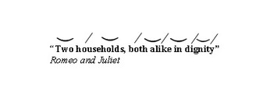

Slide 6
Sonnet 18
Shall I compare thee to a summer's day?
Thou art more lovely and more temperate:
Rough winds do shake the darling buds of May,
And summer's lease hath all too short a date:
Sometime too hot the eye of heaven shines,
And often is his gold complexion dimm'd;
And every fair from fair sometime declines,
By chance, or nature's changing course, untrimm'd;
But thy eternal summer shall not fade
Nor lose possession of that fair thou ow'st;
Nor shall Death brag thou wander'st in his shade,
When in eternal lines to time thou grow'st;
So long as men can breathe or eyes can see,
So long lives this, and this gives life to thee.

Slide 7
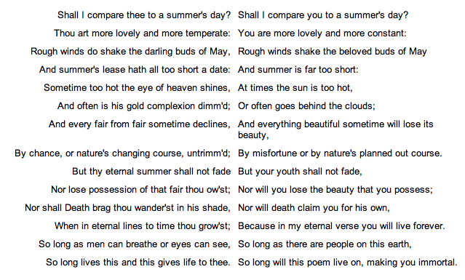
And Again…

Slide 8
