Slide 1
Introduction to Rhetorical Fallacies
AP Language & Composition | Unit 3 The Art of Argumentation

Slide 2
Fallacious Reasoning.
The Categories of
Appeals of the Mind
Appeal to Emotions
Faulty Deduction
Manipulating Content
Garbled Cause & Effect
On the Attack
Questions at this point?

Slide 3
Faulty Deduction.
The Types of
Perfectionist Fallacy
Relativist Fallacy
Anecdotal Evidence
Hasty Generalizations
Composition
Divison
Spotlight
Design Fallacy
Jumping to Conclusions
Gambler’s Fallacy
Middle Ground
Undistributed Middle Ground
Sweeping Generalizations

Slide 4
Anecdotal Evidence.
Definition: Discounting evidence arrived by systematic search or testing in favor of a few firsthand stories.

Slide 5
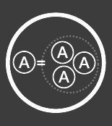
Composition.
Definition: Assuming that characteristics or beliefs of some or all of a group applies to the entire group.

Slide 6
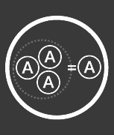
Division.
Definition: Assuming that characteristics or beliefs of a group automatically apply to any individual member.

Slide 7
Design Fallacy.
Definition: Assuming that because something is nicely designed or beautifully visualized, it’s more true.

Slide 8
Gambler’s Fallacy.
Definition: Assuming the history of outcomes will affect future outcomes.

Slide 9
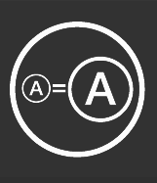
Hasty Generalization.
Definition:Drawing a general conclusion from a tiny sample.

Slide 10
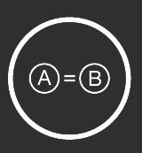
Jumping to Conclusions.
Definition: Drawing a quick conclusion without fairly considering relevant (and easily available) evidence.

Slide 11
Middle Ground.
Definition: Assuming because two opposing arguments have merit, the answer must lie somewhere between them.

Slide 12
Perfectionist Fallacy.
Definition: Assuming that the only option on the table is perfect success, then rejecting anything that will not work perfectly.

Slide 13
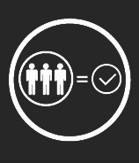
Relativistic Fallacy.
Definition: Rejecting a claim because of a belief that truth is relative to a person or group.

Slide 14
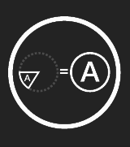
Spotlight Fallacy.
Definition: Assuming an observation from a small sample size applies to an entire group.

Slide 15
Sweeping Generalization.
Definition: Applying a general rule too broadly.

Slide 16
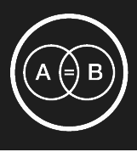
Undistributed Middle.
Definition: Assuming that because two things share a property, that makes them the same thing.

