Slide 1
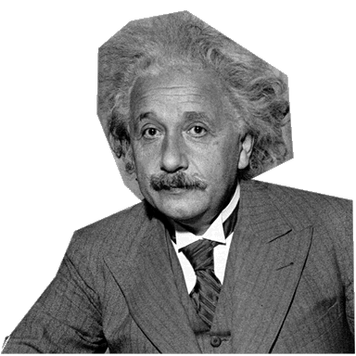
Research Writing. Revisions.
English 10H

Slide 2
The Creed.
Question. Research. Explain.
Use the Views of Others.
Be as Objective as Possible.
Use Credible Sources.
Structure Systematically.

Slide 3
Questions.
Most research starts with questions. Looking back at your paper, what five questions did your paper investigate?
Write them in your journal.
Now, generate three more questions that your paper could have addressed, but did not.
Write them in your journal.

Slide 4
The Systematic Structure.
Topic Sentence. Highlight Color 1
Elaboration. Underline
Textual Support. (Quote). Highlight Color 2
In-Text Citation. Circle
Explanation. Star *
Tie Back to the Thesis. Underline

Slide 5
Plug & Chug. Outline.
In the outline provided, write in or copy and paste each indicated area.
Then, in a new color, go back and add more to the explanation section.

Slide 6
Peer Review
After you have revised and edited your paper, allow a peer to review your new “final” paper. Use the peer review sheet posted on Google Classroom.

