Slide 1
Research Citations
MLA & APA Formatting Options
English | Explanatory Writing

Slide 2
MLA Format
https://owl.english.purdue.edu/owl/resource/747/06/
Humanities & the Arts (English Classes)
Bibliography: Works Cited Page
Citation:
Lastname, Firstname. Title of Book. City of Publication: Publisher, Year of Publication. Medium of Publication. Date Accessed.
In-text Citation: (Author Last Name Page #).
Header: (Your Last Name & Page #)
Paper Layout
Your Name
Instructor’s Name
Course Title
Date (Day Month Year)

Slide 3
MLA Works Cited
Citation for a Book:
Lastname, Firstname. Title of Book. City of Publication: Publisher, Year of Publication. Medium of Publication. Date Accessed.
Citation for an Article:
Author(s). "Title of Article." Title of Periodical Day Month Year: pages. Medium of publication. Date Accessed.

Slide 4
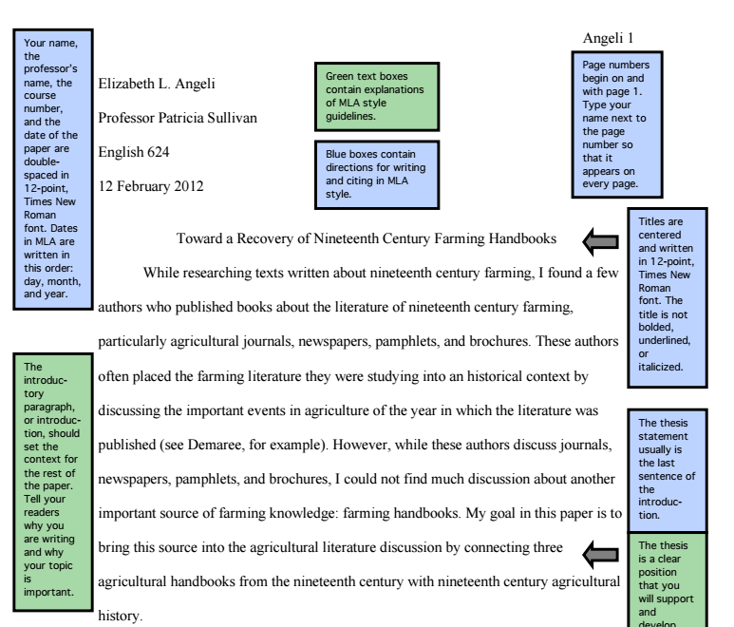
MLA Format

Slide 5
APA Format
https://owl.english.purdue.edu/owl/resource/560/05/
Physical & Social Sciences
Bibliography: Reference List
Citation:
Author, A. A. (Year of publication). Title of work: Capital letter also for subtitle. Location: Publisher.
In-text Citation: (Author Last Name, Year, Page #).
Header: Paper Title (IN ALL CAPS) and Page #
Paper Layout (Centered)
Paper Title
Your Name
School or Institution

Slide 6
APA Reference List
Citation for Book:
Author, A. A. (Year of publication). Title of work: Capital letter also for subtitle. Location: Publisher.
Citation for Articles:
Author, A. A., Author, B. B., & Author, C. C. (Year). Title of article. Title of Periodical, volume number(issue number), pages. http://dx.doi.org/xx.xxx/yyyyy

Slide 7
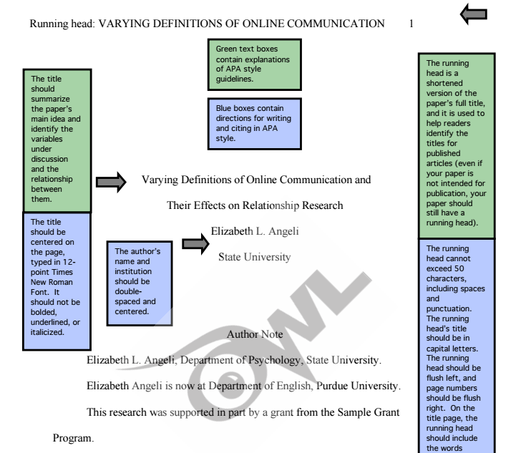
APA Format

