Slide 1
Poetry Analysis

Slide 2
Poetry Analysis
Read It. (Is it a poem or prose?)
Structure. (Meter/Rhyme Scheme/Type of Verse)
Figures of Speech. (Note Technique)
Main Idea. (What is happening in the poem?)
Theme. (What ties this poem to other poems?)
Word Choice. (Study connotations & tone.)

Slide 3
That Meter.
Meter: the pattern of unstressed and stressed syllables in poetry.
U=unstressed syllable
/=stressed syllable
U/= the iamb couple
Sets of “U/”= iambic meter

Slide 4
Iambic Meters.
Iambic Monometer
Iambic Dimeter
Iambic Trimeter
Iambic Tetrameter
Iambic Pentameter
Iambic Hexameter
Iambic Heptameter
Iambic Octameter

Slide 5
Rhyme Scheme.
Masculine Rhyme: Direct Rhyme (Rhyming that ends with stressed syllables.)
Feminine Rhyme: Indirect Rhyme (Rhyming that ends with unstressed syllables.)
Types of Rhymes:
Internal Rhyme: rhyme that occurs within a line.
End Rhyme: rhyme that occurs at the end of a rhyme.
Slant Rhyme: rhyme between similar sounds.
Couplet: two successive lines that rhyme.

Slide 6
Types of Verse.
Free Verse: NO METER | NO RHYME SCHEME
Rhymed Verse: NO METER | RHYME SCHEME
Blank Verse: IMABIC METER | NO RHYME SCHEME
Verse: IAMBIC METER | RHYME SCHEME

Slide 7
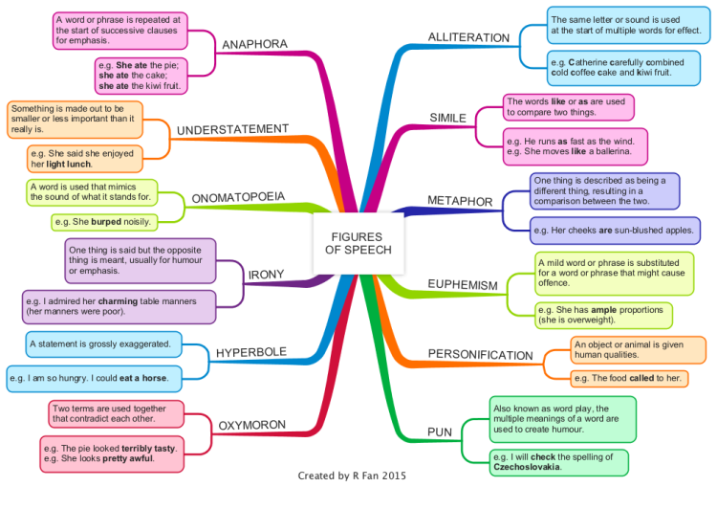
Figures of Speech.

Slide 8
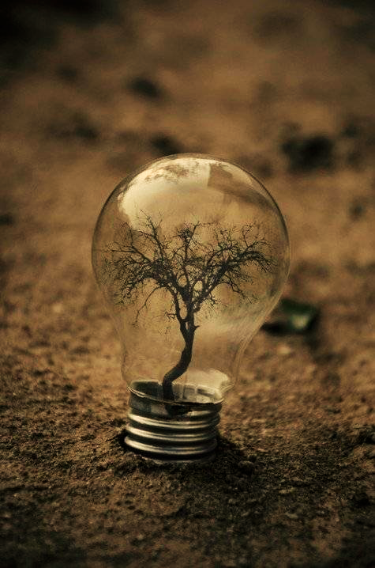
Main Idea.
What is happening in the poem? What is the plot synopsis in one sentence?

Slide 9
Theme.
What is the recurrent element or category?
What is the underlying meaning?

Slide 10
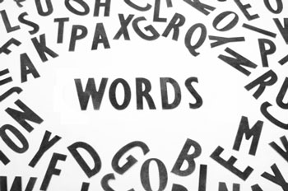
Word Choice.
Connotative Meaning= positive, negative, or neutral implications encompassing a word.
How do these word choice shape the atmosphere of the poem? How does the word choice show the poet’s tone?

