Slide 1
Photography
club
meeting two

Slide 2
Scavenger
shares

Slide 4
Types of cameras

Slide 5
Notes:
DSLR= digital single lens reflective

Slide 6
Genres of photography

Slide 7
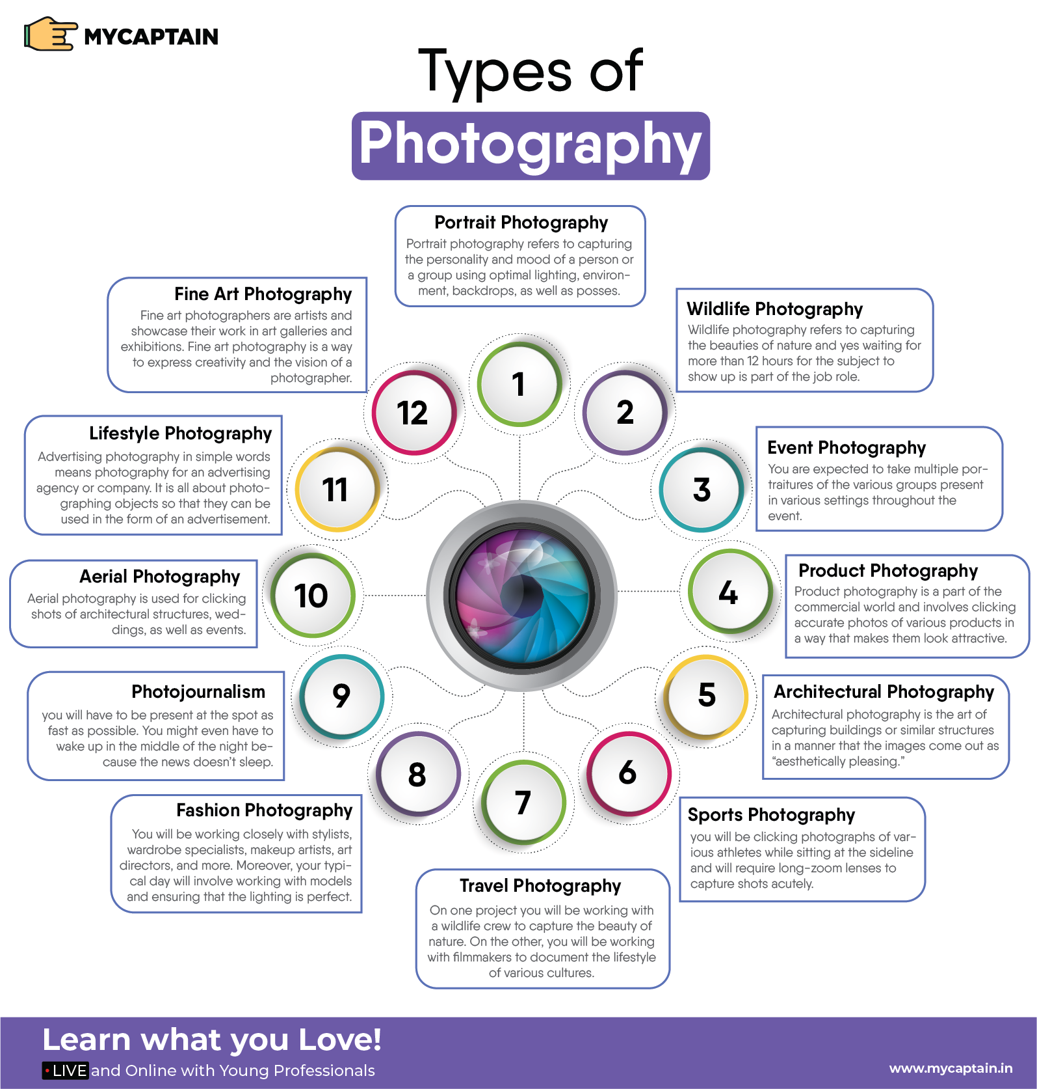
Portrait Photography
Wildlife Photography
Event Photography
Product Photography
Architectural Photography
Sports Photography
Travel Photography
Photojournalism
Fashion Photography
Aerial Photography
Lifestyle Photography
Fine Art Photography

Slide 8
Types of lenses

Slide 9
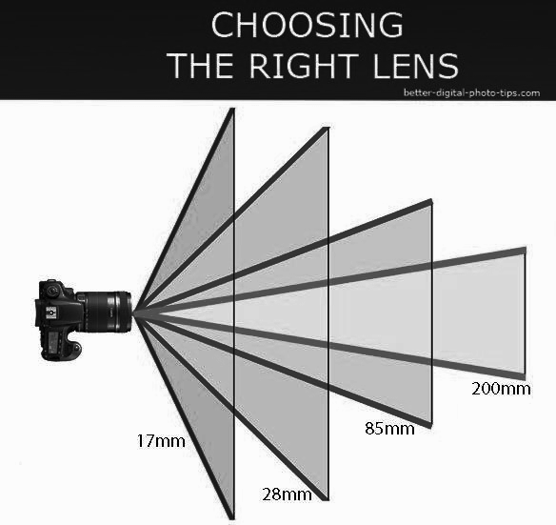

Slide 10
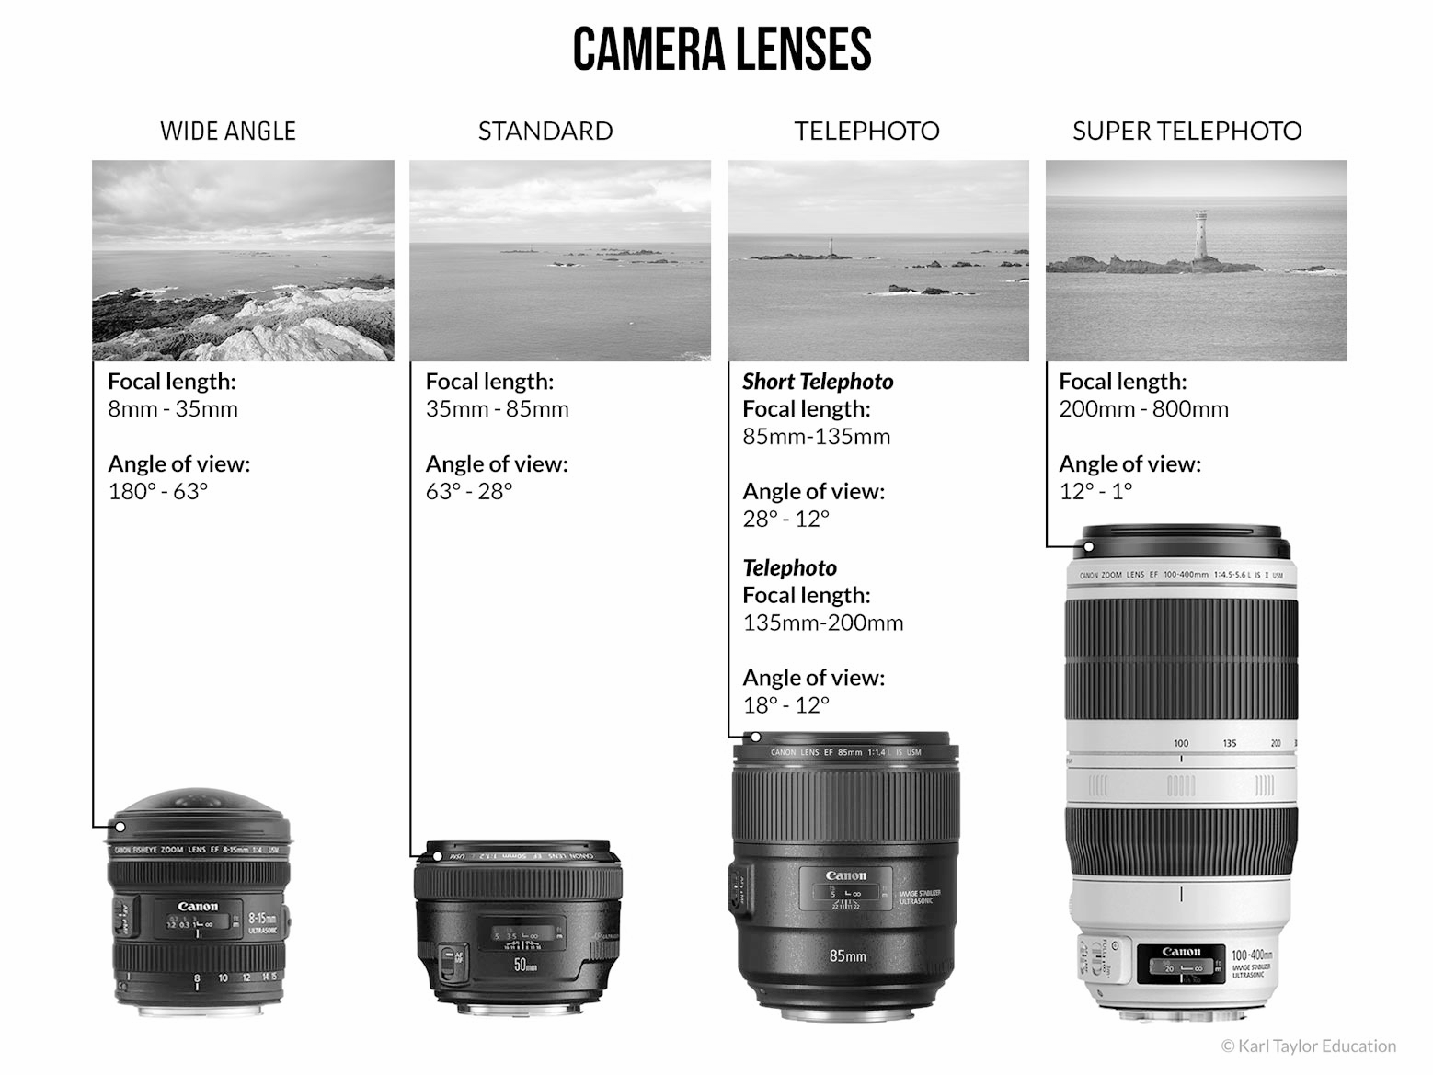

Slide 11
Manual photography

Slide 12
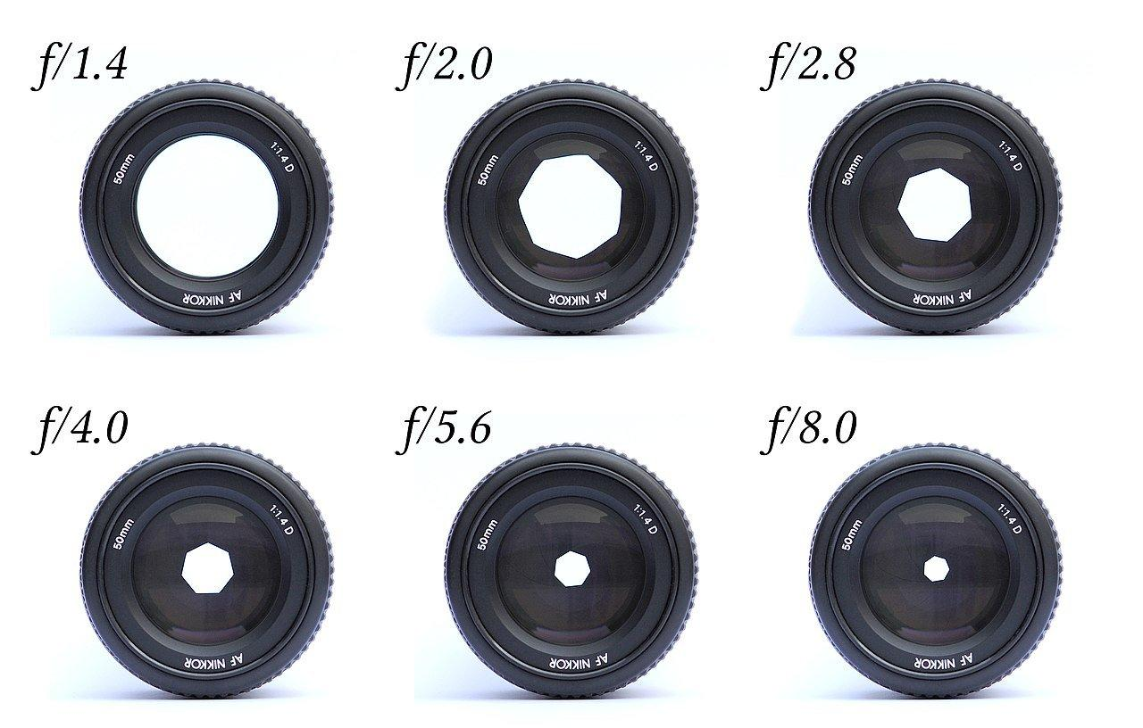
aperture

Slide 13
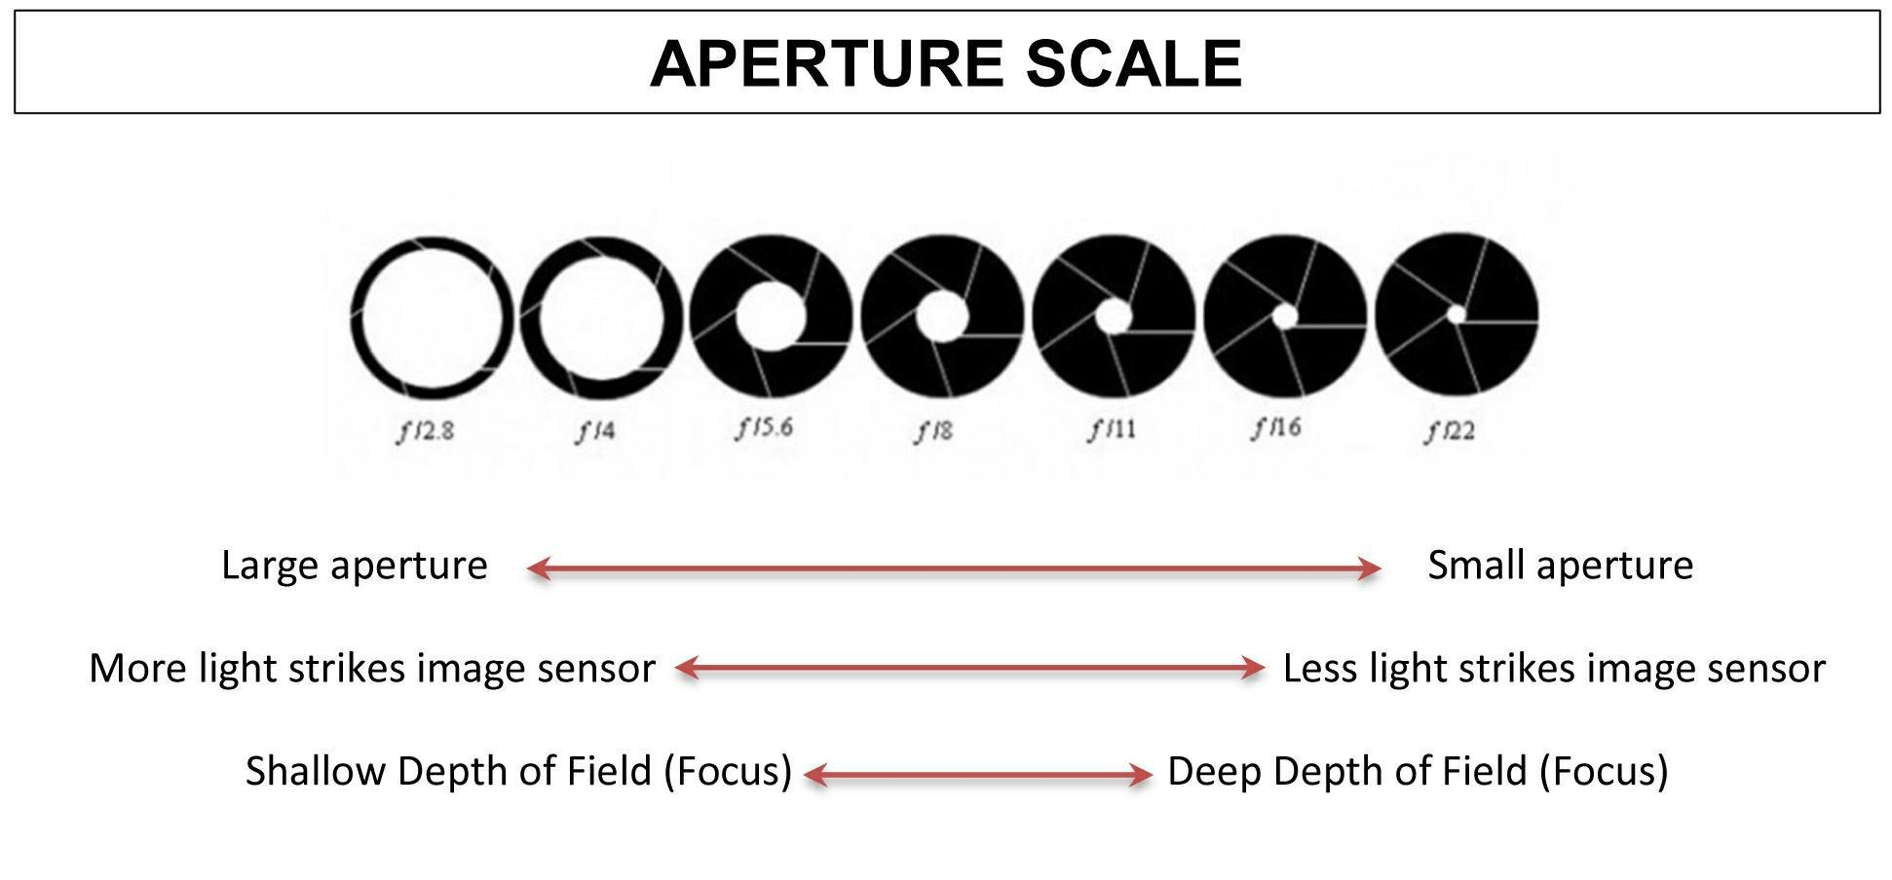

Slide 14
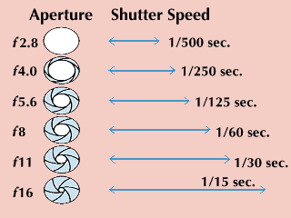
shutter speed

Slide 15
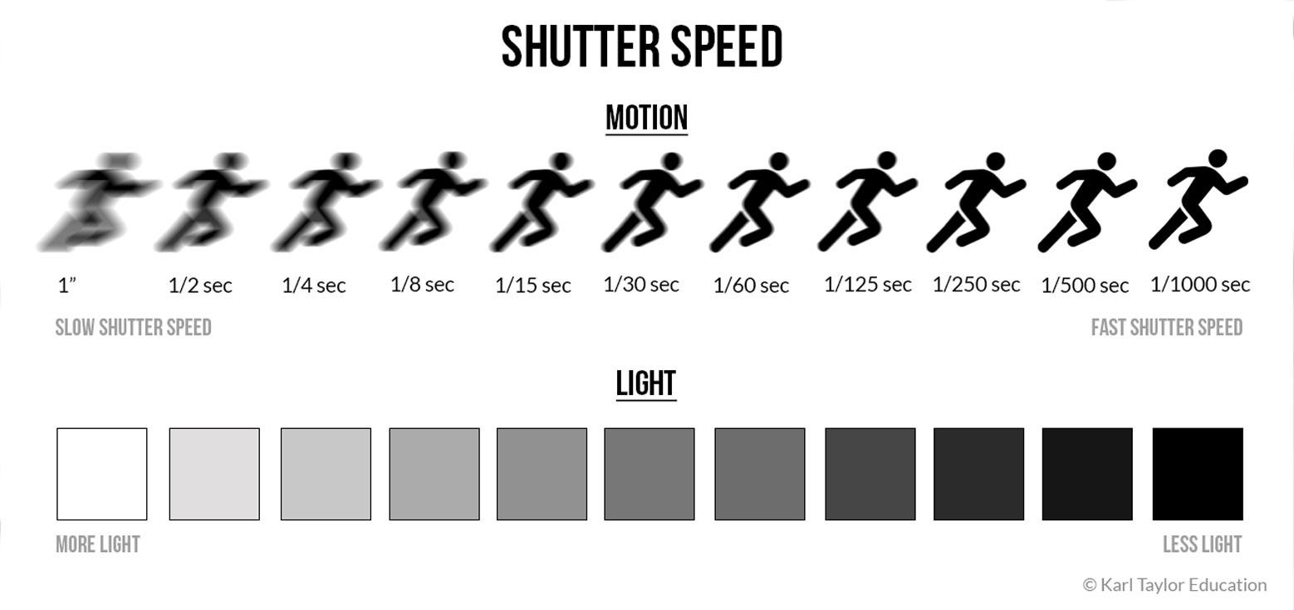

Slide 16
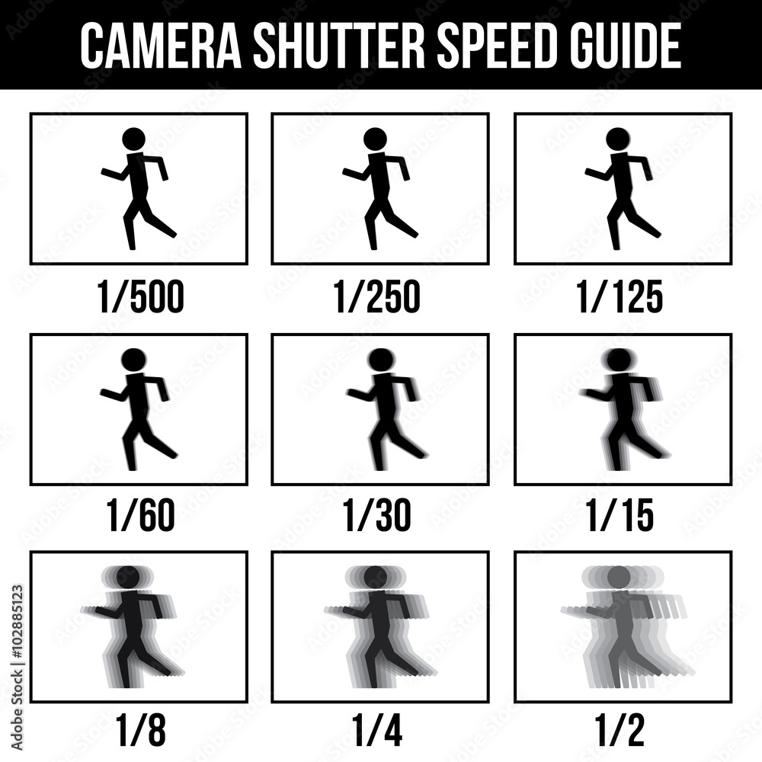

Slide 17
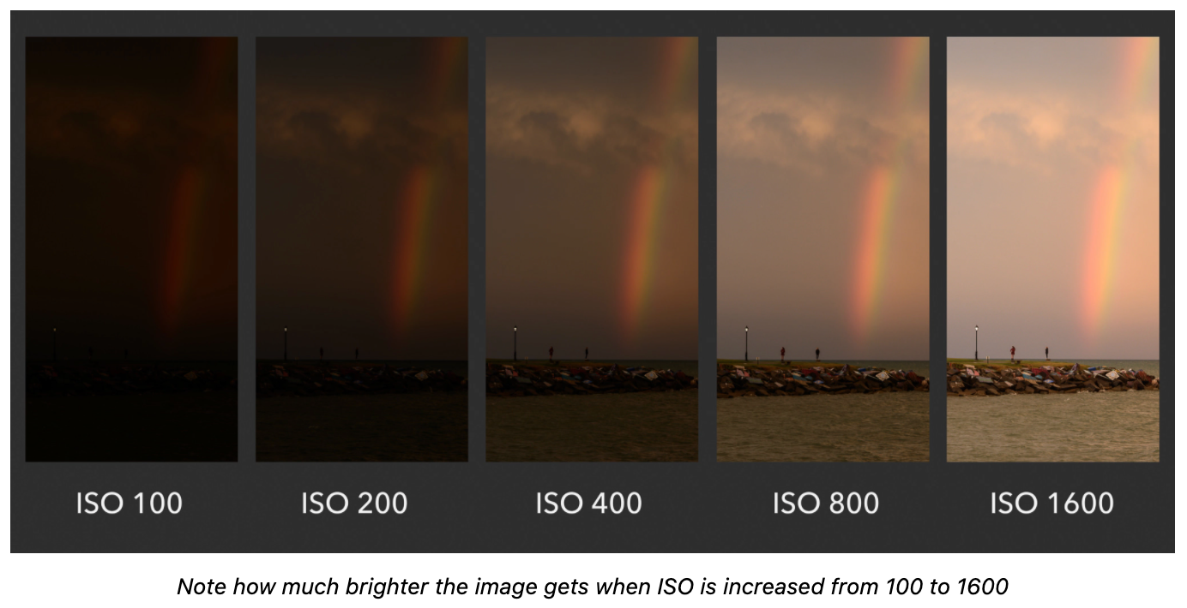
internal organization for standardization

Slide 18
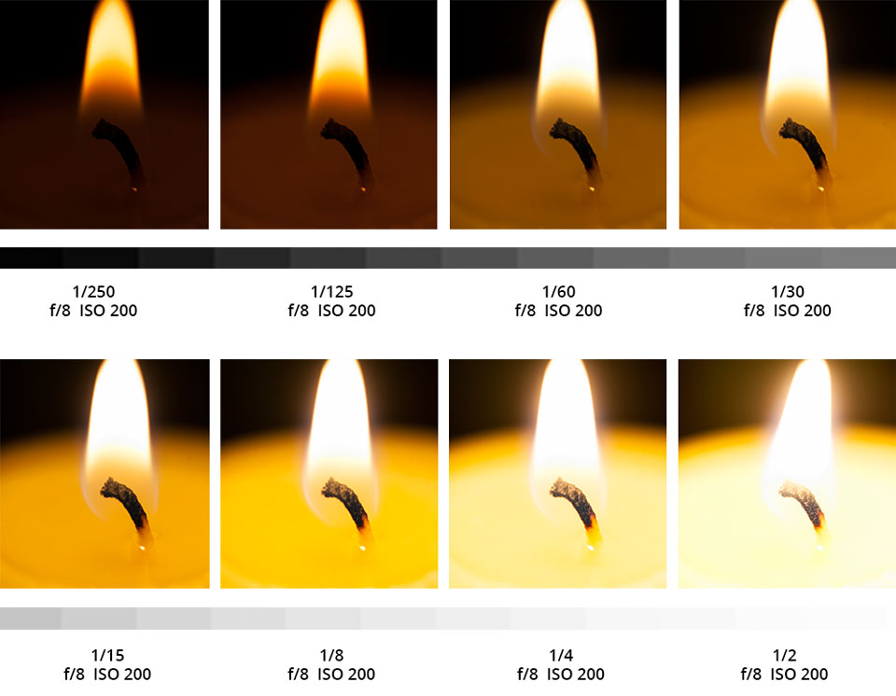
examples

Slide 19
30 Day project

Slide 20
decade challenge

Slide 21
cheat
sheets

Slide 22
