Slide 1
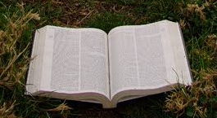
Literary Movements in American Literature
A brief overview of how we ended up with all these pieces of literature we have to study in school.

Slide 2
Overview
There are many different literary movements and not everyone agrees on what qualifies a movement.
There are also arguments as to where certain pieces of literature fit into the grand scheme of things.
We will look at several movements here along with information about some of the smaller movements.

Slide 3
Native American Lit 1490-1700’s
This movement is based on oral tradition – which can give us a hint as to why there is very little written material in comparison to other movements.
Native American stories, fables, tales, myths, and chants were written down later for preservation, not because that was typical for Native Americans of the time.
Orature- the preservation of oral tradition did not become a course of academic study for a long time.
Nature and elements of nature are the most common aspect of Native American writings.

Slide 4
Early Settlers 1500’s – 1670’s
This group of writings are from immigrants who were coming to America to settle a new land.
Most of the early settler literature is comprised of letters, diaries, journals, and histories.
The accuracy of these writings is often called in to question.
Authors include:
Christopher Columbus, John Smith, Lewis & Clark, and William Bradford

Slide 5
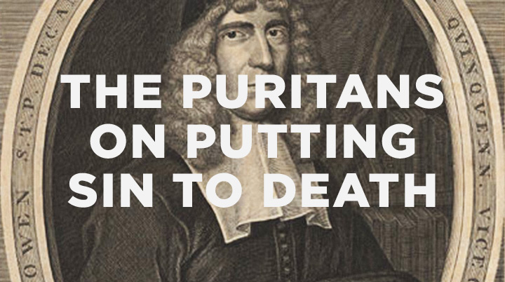
Puritanism 1620-1790
Written by those who were leaving Europe to find religious freedom.
This society was dominated by rules and a fear of sin, in addition to the eternity of hell.
Literature from this period is typically in the form of sermons, poetry, diaries, and moral based stories
Authors from this period include:
Anne Bradstreet, Edward Taylor, and Jonathon Edwards

Slide 6
American Enlightenment 1750-1800
Also known as Rationalism/Classicism & The Age of Reason
Best known for political and philosophical writings focusing on reason and common sense.
These writings contributed, in part, to the American Revolution.
Authors of this period include:
Benjamin Franklin, Thomas Jefferson, Thomas Paine, Patrick Henry, and Phillis Wheatly

Slide 7
Review
Here is a quick review of the literary periods so far...
Native American Literature
Early Settlers
Puritanism
American Enlightenment
So, what comes next?

Slide 8
Romanticism 1820-1860
A continuation of the same movement in Europe
Authors focused on individualism, idealism, imagination, & nature
Often set their works in distant times or places
This is the first movement to really produce a body of work that embodied the idea of America while rebelling against the Classicism movement
Not surprisingly, this is the largest body of work to this point in history and one that we spend a lot of time studying in school

Slide 9
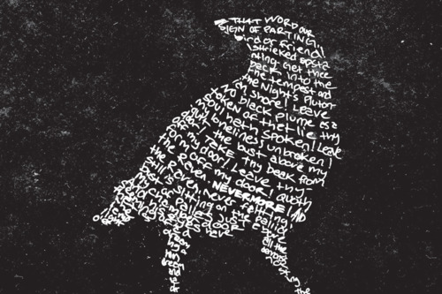
Romanticism part 2
Authors often associated with this movement include:
Edgar Allen Poe, Nathaniel Hawthorne, James Fenimore Cooper, Washington Irving, and Herman Melville
This movement contains several other movements (not confusing at all, is it?) For example, Dark Romanticism or American Gothic put a dark spin on romanticism.

Slide 10
FIRESIDE POETS – MID 19TH CENTURY
They were the first group of American Poets to become as well known as British poets.
The poets preferred classical form, but relied on American legends and life for subject matter.
Poets included:
Henry Wadsworth Longfellow, Oliver Wendell Holmes, John Greenleaf Whittier, and William Cullen Bryant

Slide 11
Transcendentalism 1830-1850
Transcendentalists believed that the basic truths of the universe transcend the physical world and lie beyond the knowledge that can be obtained from the senses. They feel that every individual has the ability to experience God firsthand in his/her intuition.
They value nature and believe in the spiritual unity of all life, stating God, humanity, and nature share a universal soul. They feel that nothing in nature is trivial or insignificant; all is symbolic and important.
They also promoted the belief that every human being is born inherently good.
Prominent authors include:
Ralph Waldo Emerson & Henry David Thoreau

Slide 12
Realism and Regionalism 1860-1914
Counter-movement response against Romanticism & Neoclassicism
Factual is more important than the intellectual or the emotional
Treats nature objectively & orderly
Tells the stories of everyday people
Use of details more important than plot
In diction, this movement seeks to use natural language
Mark Twain is known to be the “Father of the American Novel” from his book The Adventures of Huckleberry Finn
Authors include:
Willa Cather, Kate Chopin, Mark Twain

Slide 13
Naturalism – late 1800’s – early 1900’s
Naturalism is connected to realism but it focuses on social issues brought about by industrialization.
Shows the dark and ugly side of life
Shows man’s struggle to adapt to his environment and how the environment alters a person’s ability to make good decisions
Authors include:
Stephen Crane, Edith Wharton, Upton Sinclair Lewis, Jack London, and John Steinbeck

Slide 14
Modernism 1914 – 1945 “The Lost Generation”
A set of writers disillusioned by World War I (WWI), the Great Depression, and World War II (WWII).
Shifts in means of expression, writing style, and a greater use of symbols in writing.
Writings often reflect ideas of alienation, isolation, individual perception, and human consciousness.
Authors include:
F. Scott Fitzgerald, Ernest Hemingway, William Faulkner, Henry Miller and T.S. Eliot

Slide 15
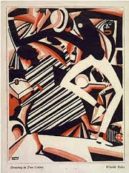
Harlem Renaissance 1920-1930
A period of outstanding creativity among African American writers.
Many of these works were explorations of black life and culture that revealed and stimulated a new confidence and racial pride.
Authors include:
Langston Hughes, Zora Neale Hurston, Countee Cullen, and Ralph Ellison

Slide 16
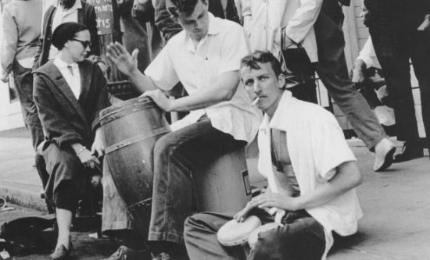
Beat Movement – 1950s
Centered in the bohemian, urban artists’ communities, the Beat movement emphasized its alienation from the conventional and its definition of “hip”, embracing jazz music, drugs, sex, and Buddhism.
Jack Kerouac and Allen Ginsburg are recognized as leaders in this movement

Slide 17
Post-modernism 1950 - on
Defined as having a relativistic view on reality
Interpretation is everything – our lives are defined only by our own interpretation of concrete experiences
Boundaries are blurred and popular culture becomes a driving force in literature and art
Authors include:
Arthur Miller, Kurt Vonnegut, Edward Albee, Ken Kesey, J. D. Salinger, and Truman Capote
Also includes the feminists:
Nikki Giovanni, Sylvia Plath, and Toni Morrison

Slide 18
Contemporary 1970’s - on
Concerned with relationships and connections between people
Emotion provoking story-telling
The value of media in culture is changing the way this movement is perceived.
Authors include:
Tim O’brien, Sherman Alexie, John Grisham, Tom Clancy, Barbara Kingsolver, Maya Angelou and Michael Crichton

Slide 19
Southern Gothic (1930-1940)
A subgenre of Gothic fiction unique to American literature that takes place exclusively in the American South.
Usually incorporates dark or creepy aspects in a Southern setting with an emphasis on the discrepancy between Southern charm and uncomfortable series of events.
Notable authors: William Faulkner, Tennessee Williams, and Flannery O’Connor

Slide 20
Pluralism – late 20th century
Realization that literature does not only come from dead white guys.
The idea of diversity and acceptance drives this movement.
Authors address universal themes seen through the eyes of their culture.
Authors include:
Amy Tan, Alice Walker, Sandra Cisneros

Slide 21
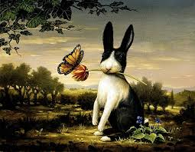
Magical Realism – late 20th century
A juxtaposition of the ordinary with magical elements
Fantastic elements are interwoven into realistic fiction.
Authors include:
Toni Morrison, Alice Sebold, Ally Condie, and Suzanne Collins
Yes, if J.K. Rowling were American Harry Potter would fit into this movement as well

Slide 22
One more review…
Which movement do you like the most?
Is there a movement you would like to learn more about?

