Slide 1
Literary Devices Terms 1-20
English & Such

Slide 2
Allegory
A story in which the characters or settings represent an abstract idea
For example, in Plato’s The Republic, he uses the allegory of a cave to explain the limiting nature of one’s environment when seeking new knowledge.
Another example would be in Bunyan’s Pilgrim’s Progress. The protagonist is not only named Christian, but is also representative of the “Christian” individual.

Slide 3
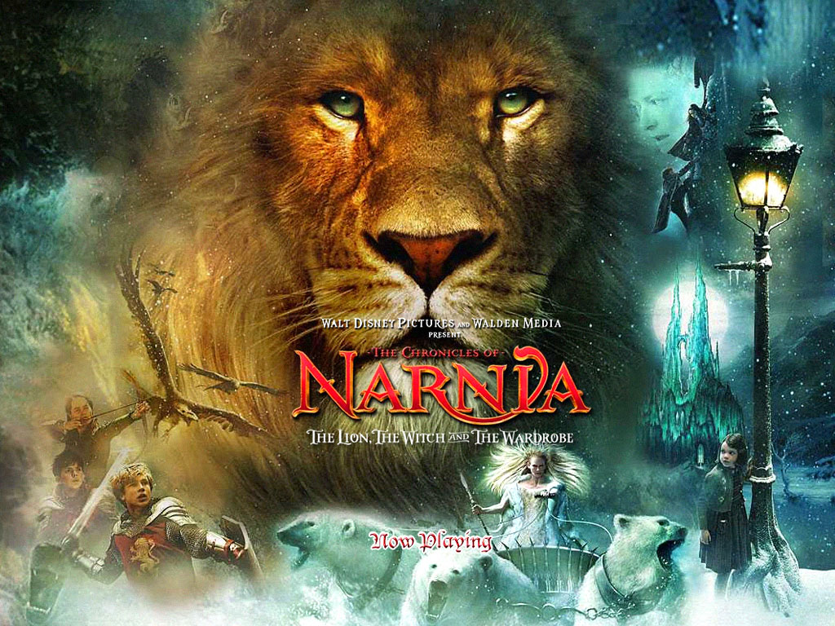
Allegory

Slide 4
Alliteration
The repetition of consonant sounds at the beginning of words
Chance could conquer the curious criticism continually.

Slide 5
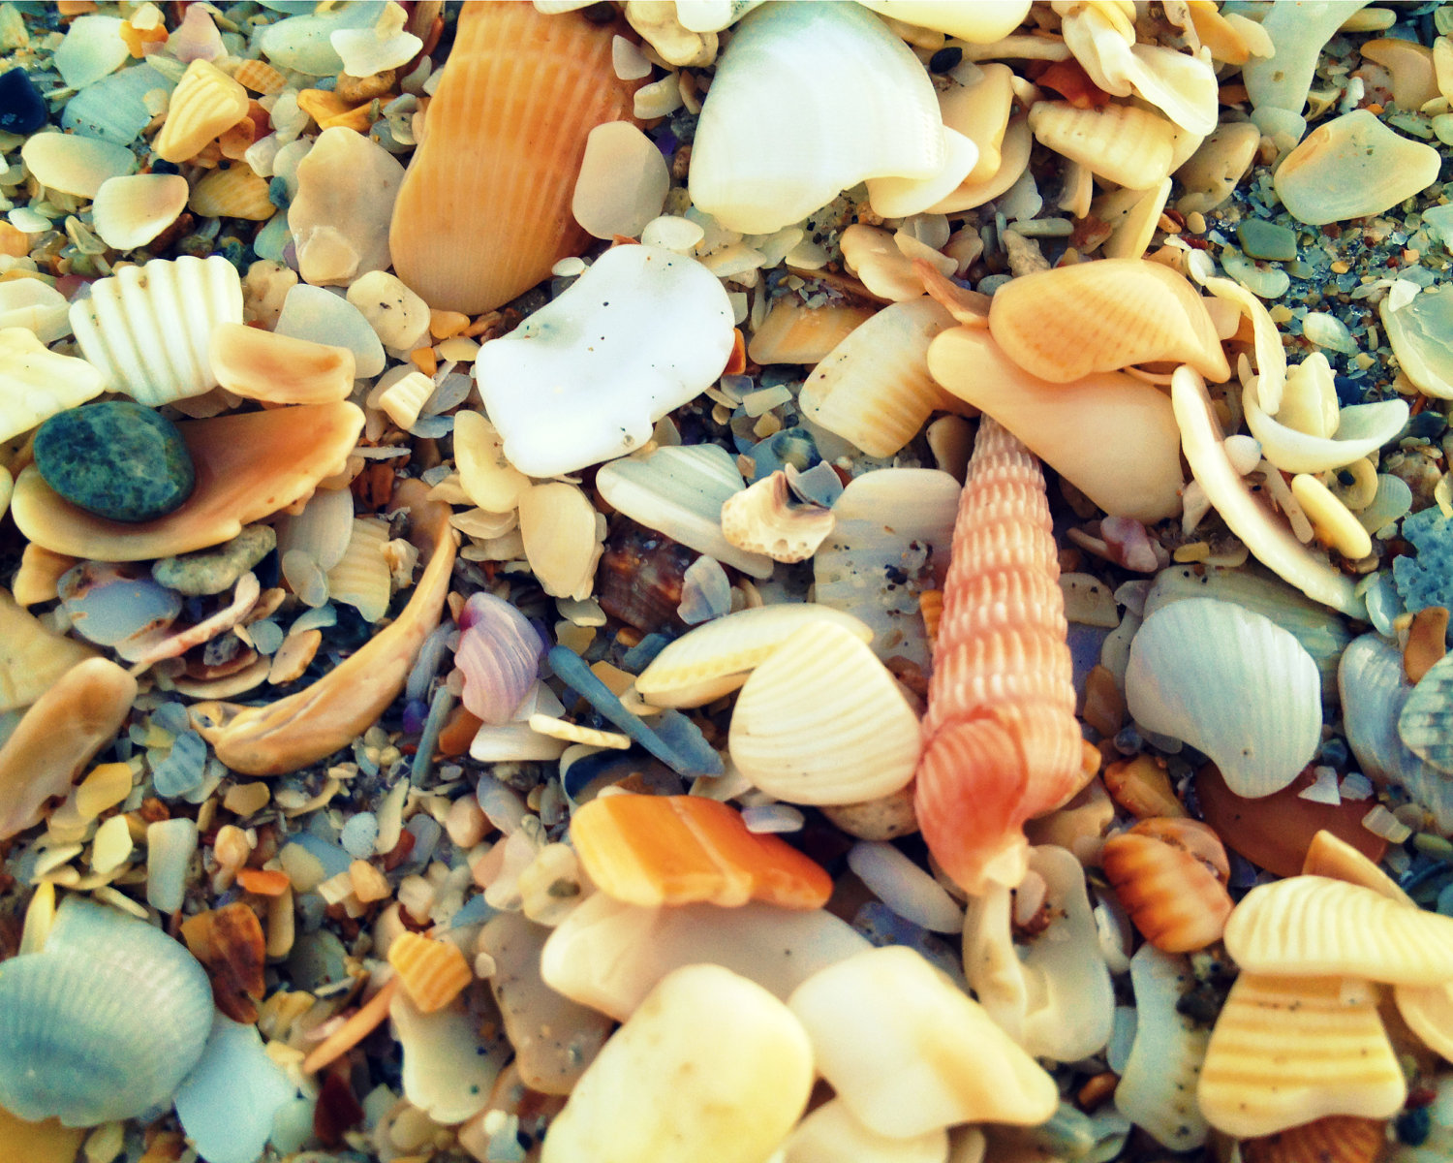
Alliteration

Slide 6
Assonance
The repetition of vowel sounds
Do you like blue stew or rather do you misconstrue the hue for the taste?

Slide 7
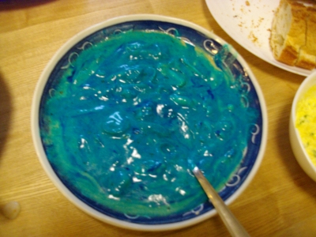
Assonance

Slide 8
Allusion
A reference to a well-known, literary, historical, or mythological person or event
In The Odyssey, Odysseus alludes to Athena by calling her the grey-eyed goddess.

Slide 9
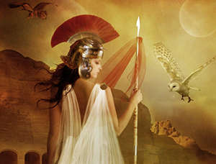
Allusion

Slide 10
Atmosphere
The emotional mood created by the text
“The Scarlet Ibis” by James Hurst created a somber and melancholy emotional mood.

Slide 11
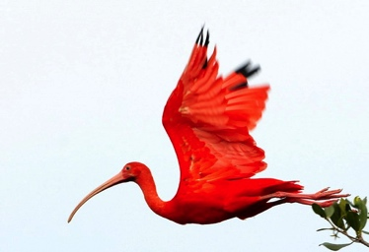
Atmosphere

Slide 12
Apostrophe
Used when speaking to someone dead, imaginary, or not present as if they will respond
When Simon and Garfunkel sing “Hello darkness, my old friend, I’ve come to talk to you again and when Juliet calls out to Romeo without knowing that he is there, an apostrophe is being used.

Slide 13
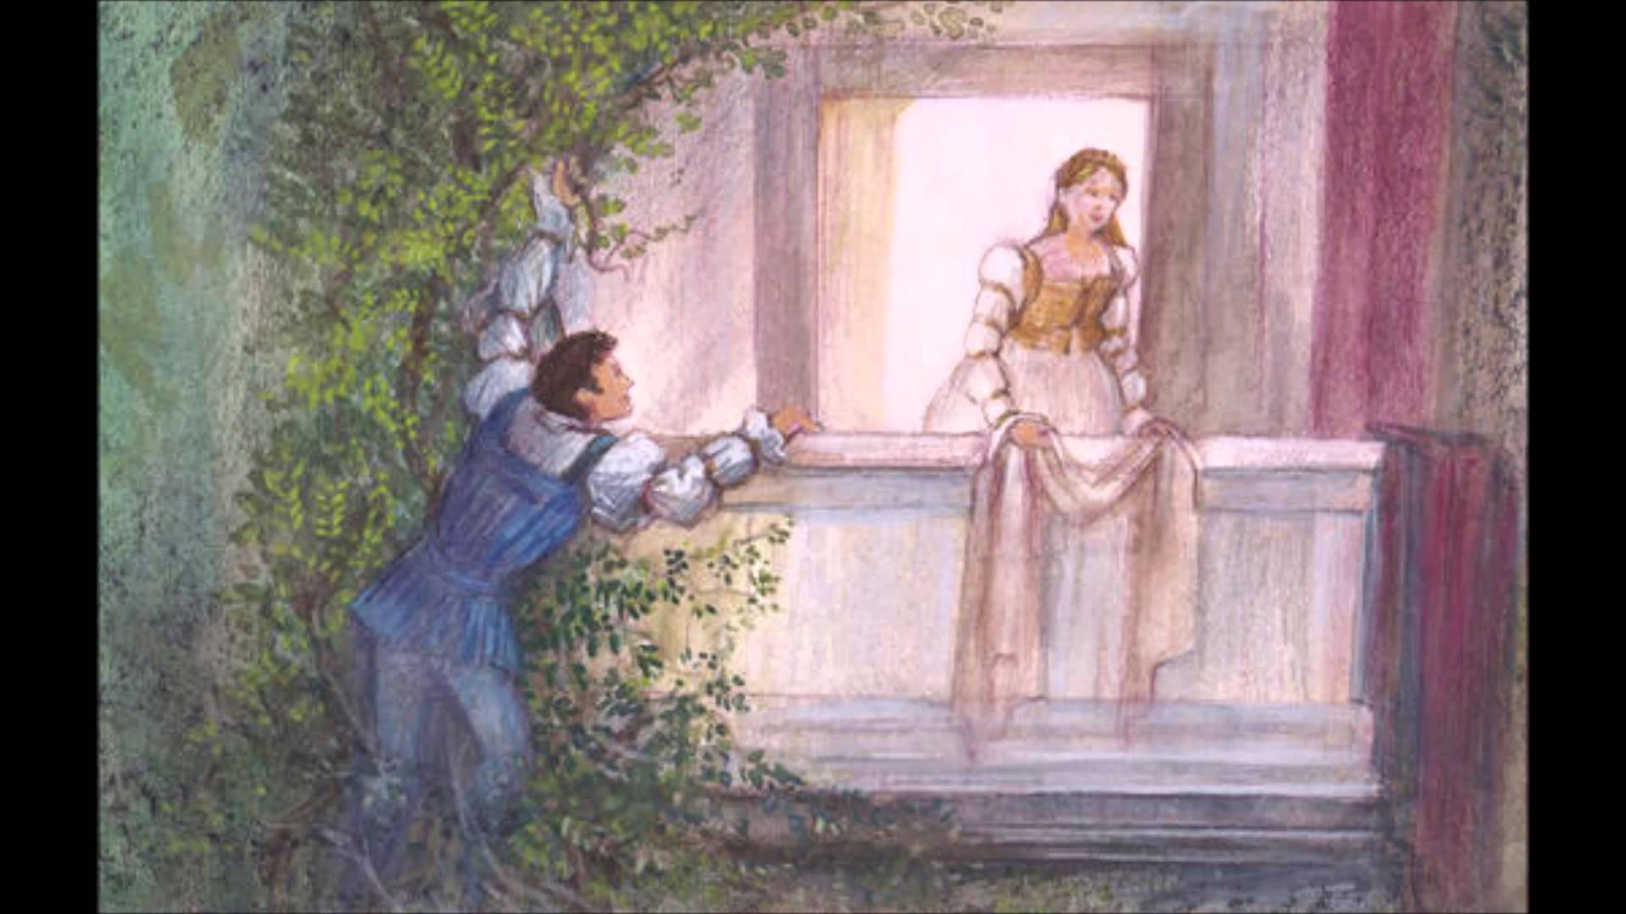
Apostrophe

Slide 14
Ballad
A poem that is meant to be sung
For example, “The Ballad of John and Yoko.” It was a poem that The Beatles turned into a song.

Slide 15
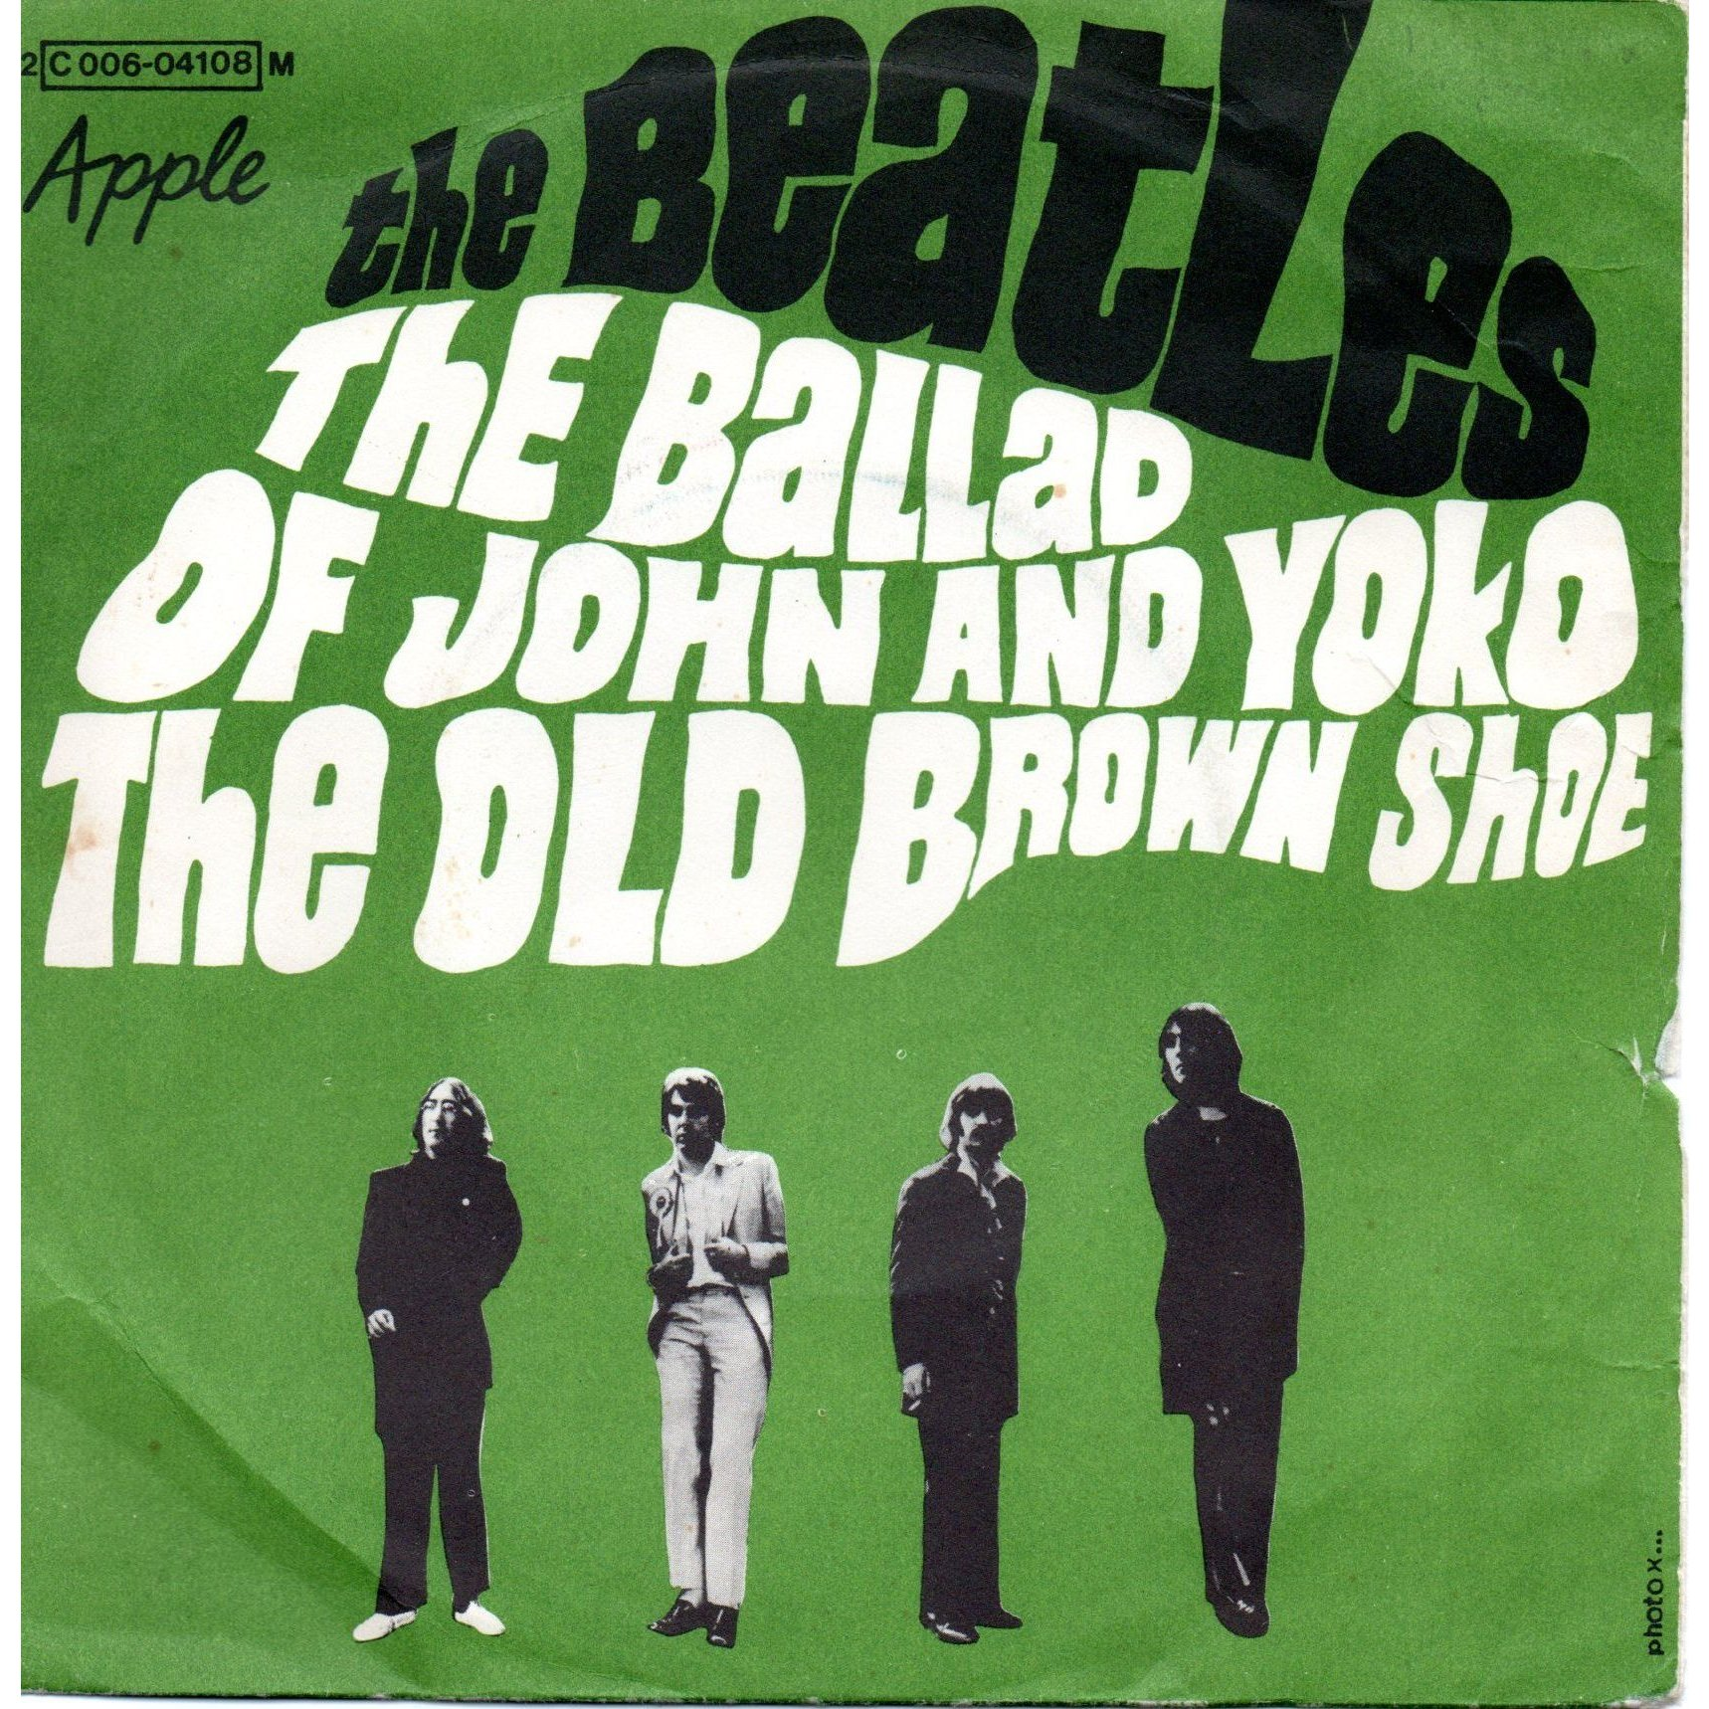
Ballad

Slide 16
Blank Verse
A poetic form that involves the implementation of unrhymed iambic pentameter
For example, when Shakespeare stops rhyming in A Mid-Summer Night’s Dream, he uses blank verse to emphasize the disorganization of the situation.

Slide 17
Blank Verse

Slide 18
Cacophony
Loud, harsh, or disagreeable sounds
For example, in “Jabberwocky,” the first few lines do not flow when reading: “Twas brillig and the slithy toves / Did gyre and gimble in the wabe”

Slide 19
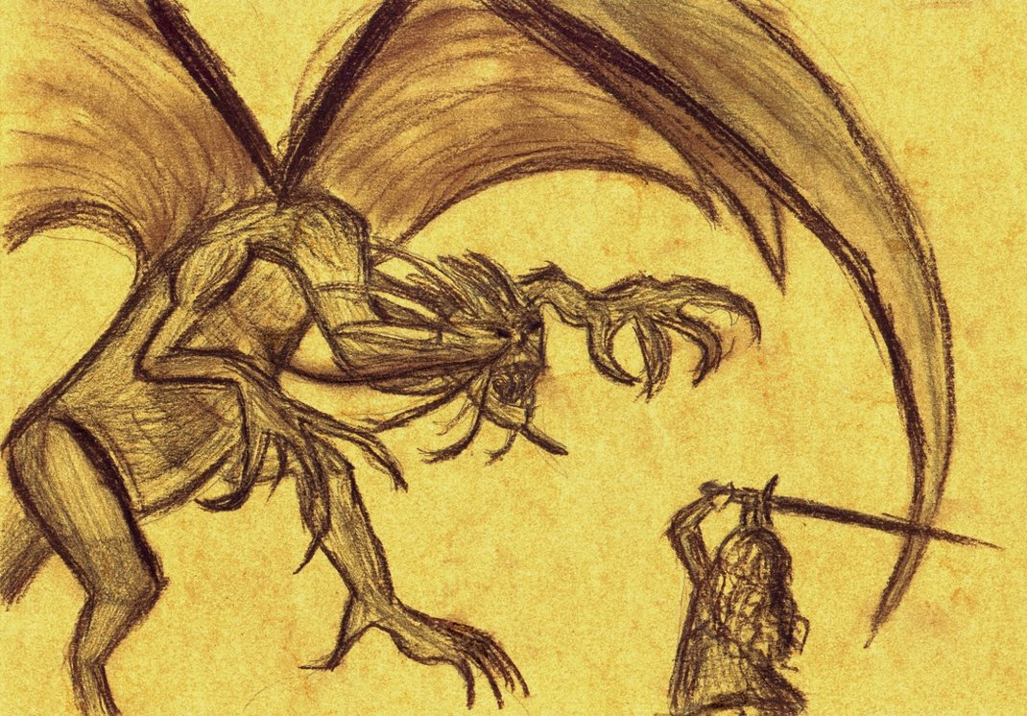
Cacophony

Slide 20
Caesura
An intentional pause in a line
For example:

Slide 21
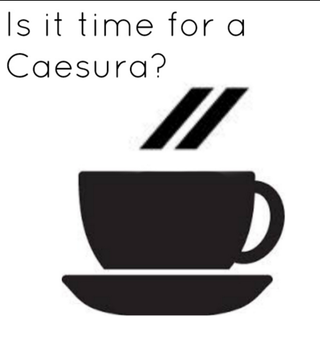
Caesura

Slide 22
Colloquial Language
Informal or conversational language
For example, slang terminology: “That’s petty” or “Whatcha wanna do?” “I dunno.”

Slide 23
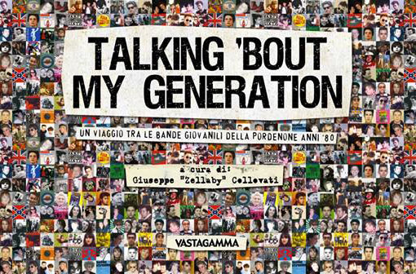
Colloquial Language

Slide 24
Consonance
The repetition of consonant sounds in the middle or at the end of words
I heard the pitter patter of raindrops falling on the roof.
Why is he so bent on getting the rent?

Slide 25
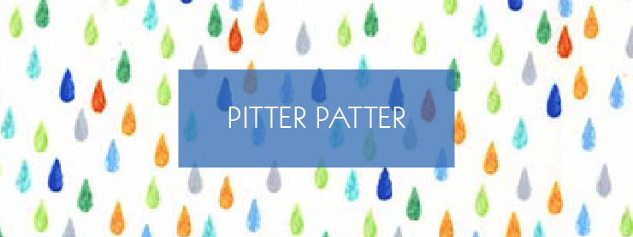
Consonance

Slide 26
Connotation
The social implications encompassing a word (society’s definition of a word)
For example: Redskins, Gringos, Curse Words, Hoosiers, etc.

Slide 27
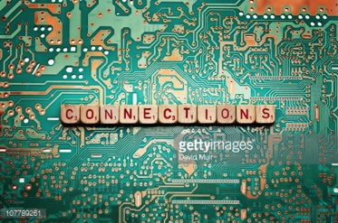
Connotation

Slide 28
Couplet
Two successive lines that rhyme
For example, in William Shakespeare’s “Sonnet 18,” the last two lines are: “So long as men can breathe and eyes can see / So long lives this and this gives life to thee.”

Slide 29
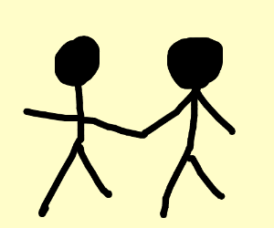
Couplet

Slide 30
Denotation
The actual (“dictionary”) definition of a word
For example, “petty” really means insignificant or miniscule… but many people use it in the wrong context.

Slide 31
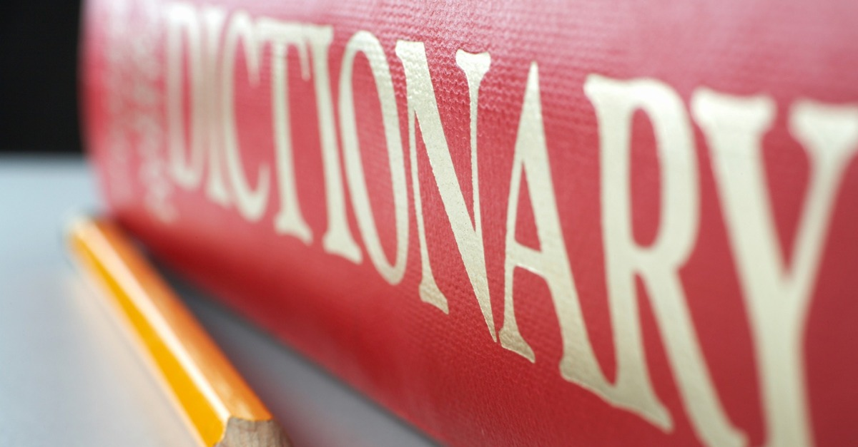
Denotation

Slide 32
Diction
The writer or speaker’s choice of words
For example, Zora Neale Hurston uses a Southern dialect in her short story “Sweat.”

Slide 33
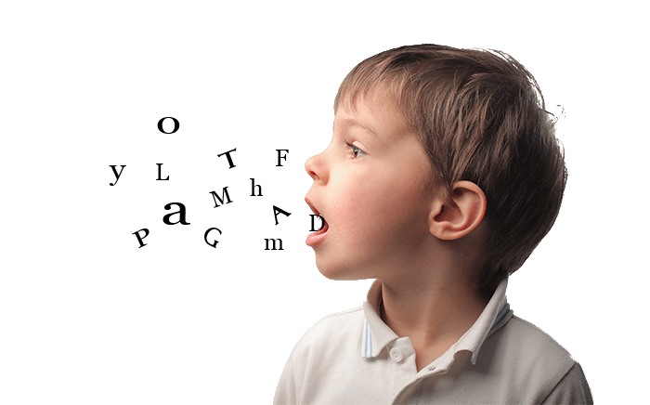
Diction
The writer or speaker’s choice of words

Slide 34
Elegy
A sad or mournful poem for the dead
An example would be: “O Captain! My Captain” by Walt Whitman would be an example of an elegy.

Slide 35
Elegy

Slide 36
End Rhyme
When two or more lines end in rhyme
Here we go again- the same flirt with the essence of “we”
The same question that begs- begs- who is “he.”
The redundant explanation of what we could once “be.”
All seems mundane and faded out, you see?
So announce it to the world and write out the decree.
It is not until you are alone that you realize the tragedy of free.
It creeps up on you like degrees or the rings of the trunk of a tree.
And crashes down- forgotten- like a storm of debris.

Slide 37
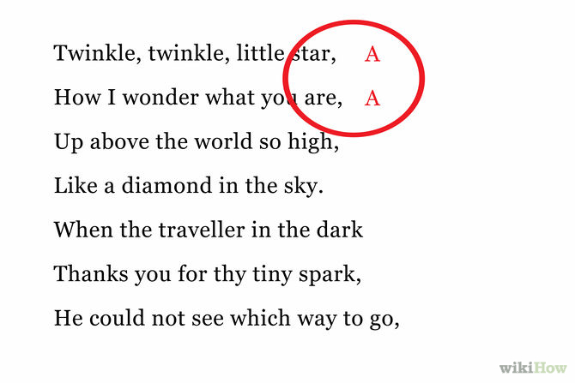
End Rhyme

Slide 38
Enjambment
The intentional break in a line for emphasis or to make a point
An example of enjambment:
It is like writing the line
Without ever having to live
It’s routine linear vibe.

Slide 39
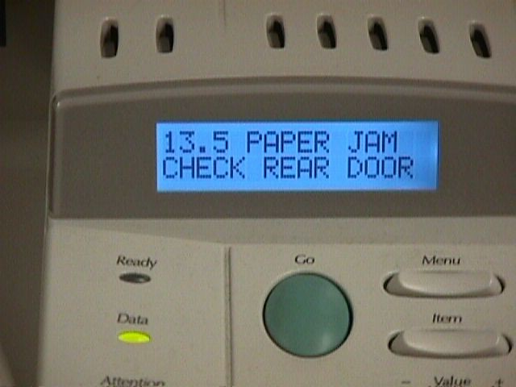
Enjambment

Slide 40
Epiphany
A great moment of insight
Planck’s Theory of Photoelectric Effect.

Slide 41
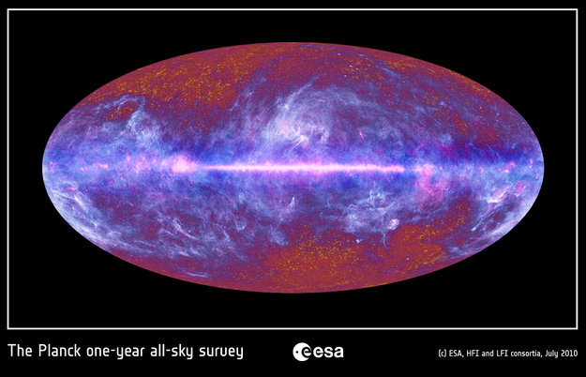
Epiphany

