Slide 1
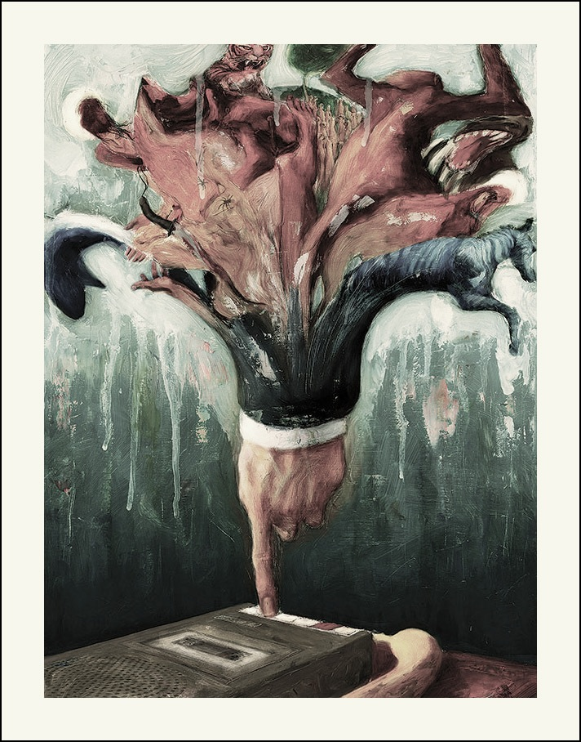
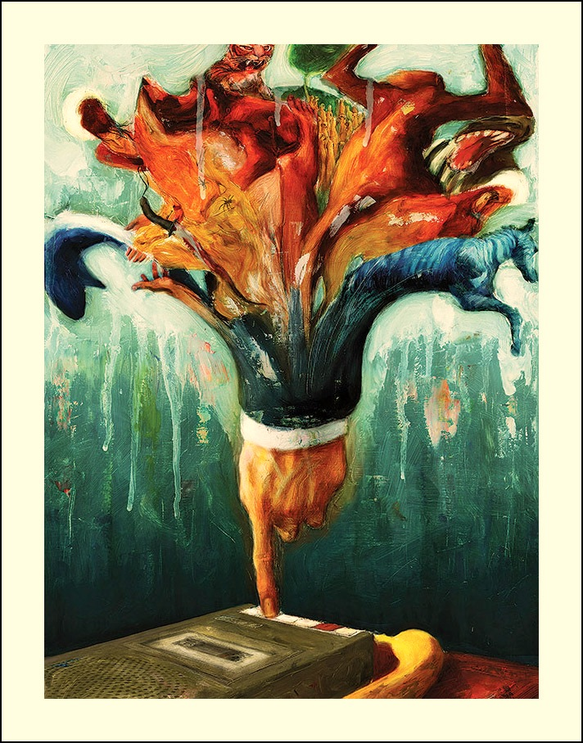
Life of Pi
Allegory & Symbolism

Slide 2
Magical Realism
A literary (and artistic) movement that integrates fantastical elements into a real-world setting causing the reader to decipher “reality.”
As we read Life of Pi, the story continuously became more fantastical… less “real.” It began to defy logic, which was precisely the point. How far will reason take you before faith kicks in?

Slide 3
Symbolism
A literary device employed to show a relationship between an object or living thing and a greater idea or abstract concept.
Conventional Symbols- something that is recognized by many people to represent certain ideas (through connotations).
Literary/Contextual Symbols- surpasses the traditional, public meanings; cannot be summarized in a word or two; results when the author or poet creates a deeper and more expansive definition of the symbol employed.

Slide 4
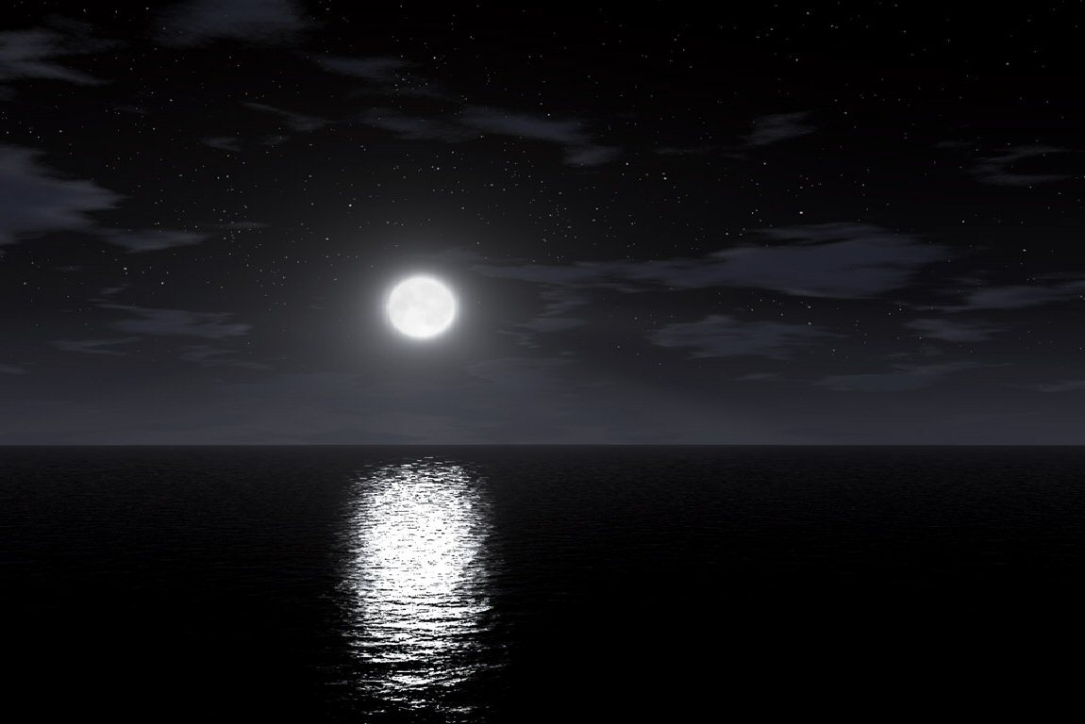
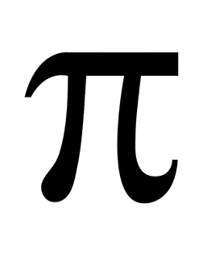
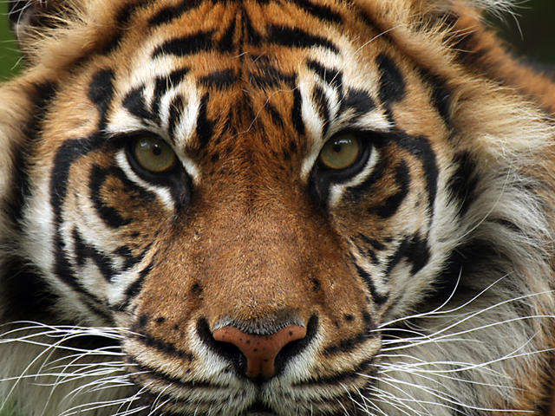
Conventional Symbols
Mainstream; status quo symbols

Slide 5
Interpretation
Denotation: the dictionary definition (the historically prescribed definition)
Connotation: the definition given by context, cultural quirks, and society.
Connotations include the stigmas, biases, emotions, viewpoints, imaginative perspectives, and feelings that accompany particular words.
Example: queer, Nemo, P.B.R., babe, mustang, Midwest, winter, etc.

Slide 6
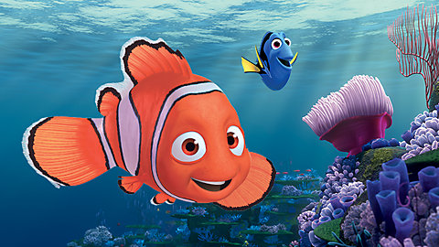
Nemo
“No one” in Latin
Connotations?

Slide 7
P.B.R.
Connotations?

Slide 8
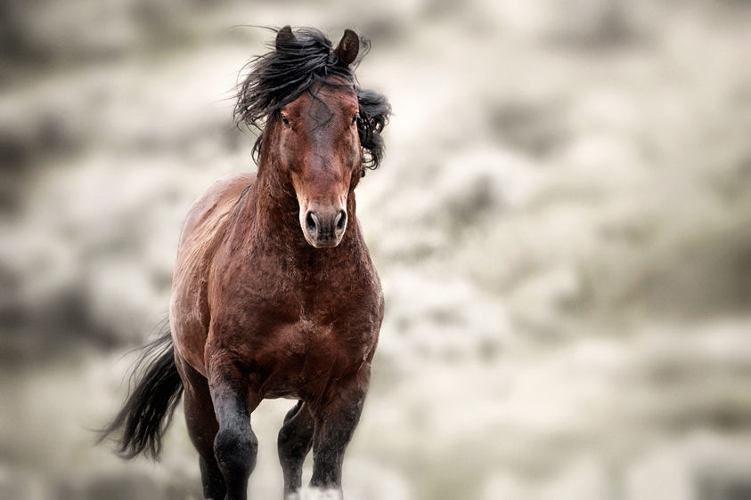
Connotations?
Mustang

Slide 9
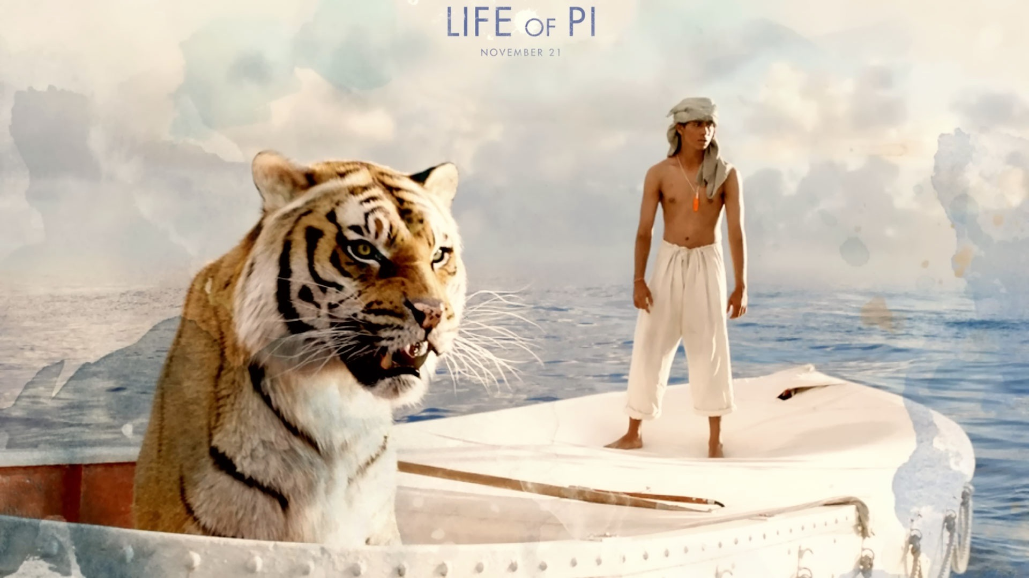
The Tiger
A tiger typically represents “raw” feelings or intense emotions. The tiger symbolizes “primal instincts, unpredictability, and the ability to trust oneself.” Source: http://www.spiritanimal.info/tiger-spirit-animal/
=

Slide 10
Others…
Colors (traditionally & culturally)
Seasons (and associated weather)
Animals (and their natures & abilities)
Elements of Nature (earth, air, fire, water)
Night or Day (and weather during each)
Shapes (Octagons, hearts, diamonds, etc.)
Icons (Logos, Religious Symbols, etc.)

Slide 11
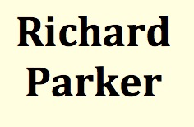
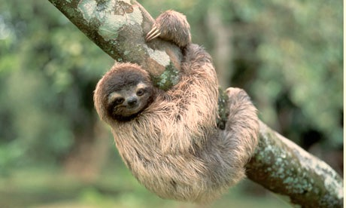
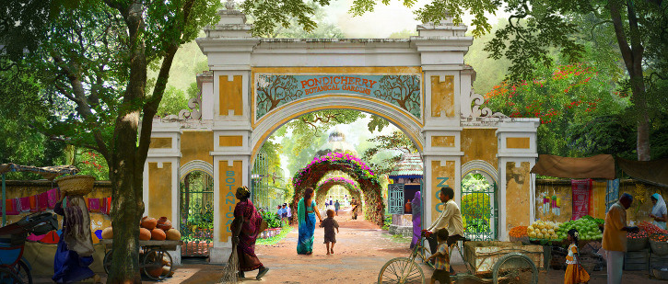
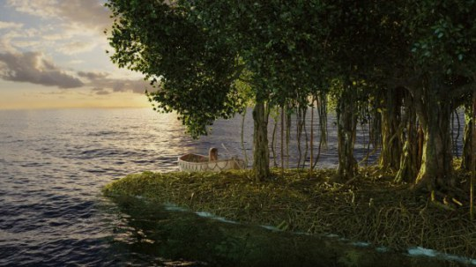
Literary Symbols
“Alternative” symbols; artistic divergence

Slide 12
Richard Parker
First Encounter (1830s): The Narrative of Arthur Gordon Pym by Edgar Allan Poe: Richard Parker= character eaten when Pym is lost at sea
Second Encounter (1870s): yacht broke apart, four scrambled to a dingy. On day seventeen, they ate the cabin boy (Richard Parker). They were rescued three days later.
Third Encounter (Year Not Stated): another ship wreck hosting a Richard Parker

Slide 13
Allegory
A literary device in which each person, place, or thing is a symbol, which collectively works to make a distinct statement about specific abstractions, conventions, processes, or ideas in society at large.
Limited interpretation
Associated with didactic poetry
Example in Life of Pi: the second story

Slide 14
Symbolism versus Allegory
Symbolism: more freedom in interpretation (due to both conventional employment and literary employment of symbols)
Allegory: less freedom in interpretation; there is one intended statement being made
Symbolism: more ambiguous
Allegory: less ambiguous

Slide 15
Pinch of Allegory
Richard Parker (Tiger)= Pi = Internal struggles
Orange Juice (Orangutan)= Pi’s Mother = The power of maternal instincts
Zebra= Sailor = The innocent that suffer
Hyena= The French Cook = Disgusting & disgraceful people
Blind Frenchman= The French Cook = Self-interested people

