Slide 1
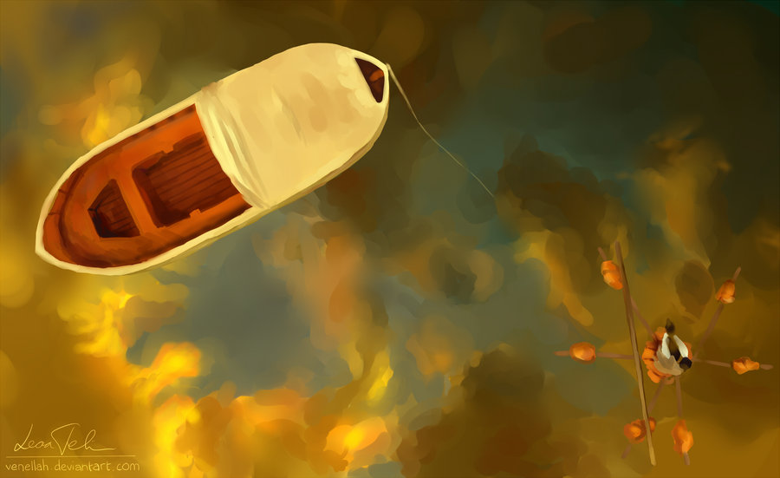
Life of Pi
Confusion is the highest form of consciousness.

Slide 2
Why? Just Why.
The reason that I am making you slogfest through this novel:
1. It exemplifies pluralism. It delves into theory and questions the influence of culture, society, personality, life, etc.
2. It is pouring with deeper meaning- the kind of deeper meaning that I want you to begin to notice more and more as we continue through this school year.
4. It demonstrates a narrative text.
3. Sink or swim philosophy. Go big or go home approach. This is a hard (sometimes boring) text. I know- that is why I picked it.

Slide 3
The Title
What is culture? Let’s create a working definition of culture.
Create a graphic organizer
What is life? How does it correspond with culture?
What is Pi in mathematics?
Why would the marriage of our understanding of life and the mathematical symbol Pi be so significant?
What does “of” mean?

Slide 4
Frame Story
Frame story= story within a story
(like a dream within a dream- a form of inception)
Life of Pi= story within a story within a story
(three tiers)
First Story: The author is telling a story about an old man he meets in India. (Yann talking about Pi)
Second Story: The older version of Pi recounts his memories of the younger Pi.
Third Story: The story from the younger Pi.

Slide 5
Psychological Criticism
There are different lenses through which people analyze a text.
One lens is psychological.
Through this lens, the reader (the analyst) examines the author’s influence on the text.
If an author includes himself in the text… it is not too far-fetched to assume that he endorses the critiques and ideas that are inherent in the text.

Slide 6
What were some facts about Yann Martel that you have seen in play in Life of Pi already?

Slide 7
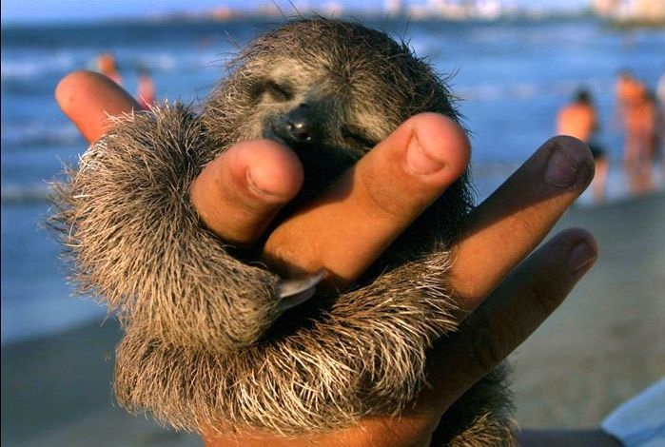
What’s With the Sloths?
Spoiler Alert: There will be a ship accident. The result will be expected. Pi will be stranded at sea. There will be a tiger involved.
So, logically, let’s think this through. If you had been stranded at sea and the preciousness of life had been magnified to you (because it became more than a plethora of repetitive first world problems), how would you feel coming back to the fast-paced (often times petty) world of civilization? Maybe someone with PTSD?
Enter Scene: Sloths
Enter Scene: Religious Studies
Enter Scene: Zoology

Slide 8
Deeper Meaning
Sloths=
Abnormal amount of details about sloths=
Religious Studies=
Zoology=
What is the difference between religion and science? Are they alike? Are they different?
Subjectivity versus Objectivity

Slide 9
Other Symbols
Being named after a pool
Pool=
Being raised in a zoo
Zoo=
Studying sloths
Sloths=
Watching a tiger destroy a goat
Tiger=
Goat=
Father once working in a hotel
Hotel=
Setting in Pondicherry
Pondicherry=
Father calling the mother “little bird”
Bird=
Zoo trainer analogy
Shifting between French & English & Arabic
Language=

Slide 10
The Zoo & Such
The zoo is a metaphor.
If we are reading/studying the life of pi, the life of a number that mathematicians seek to understand and learn more about, then every story in this book gives insight into this mystery.
The Zoo= a model of boxed in nature. The elements of altruism and survival of the fittest can be manipulated. As see in the seen with the tiger.
Why a tiger? Foreshadowing. Look at the cover of the book.

Slide 11
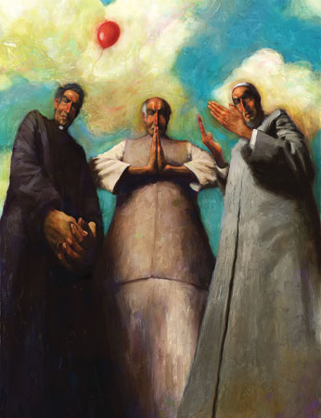
Religions All Over the Place
What are the three religions that we talked about before we began reading the novel?
https://www.youtube.com/watch?v=Fya6Ig9E80s

Slide 12
I was born a…
Hinduism is Pi’s first religious affiliation. He says, “The universe makes sense to me through Hindu eyes” (Martel 60).
Brahman (the world soul)
Brahman nirguna= beyond understanding
Brahman saguna= available to human comprehension (when Brahman soul manifests in something humans can relate to: Shiva, Krishna, Shakti, Ganesha). Vishnu, Rama, etc.
Atman= spiritual force inside one (human connection to Brahman)

Slide 13
When I was 14…
Christianity (Catholicism) is Pi’s second religion discovered when on holiday. He says, “[I offered] thanks to Krishna for having put Jesus of Nazareth, whose humanity I found so compelling, in my way” (Martel 73).
God the Father (the creator)
Jesus Christ= the son of God, in human form, who undergoes adversary, humiliation, crucifixion, and death (like the Christian God’s avatar)
One big story
A doctrine of love
Swift & Urgent (pg. 72)
Mary, the Virgin Mother

Slide 14
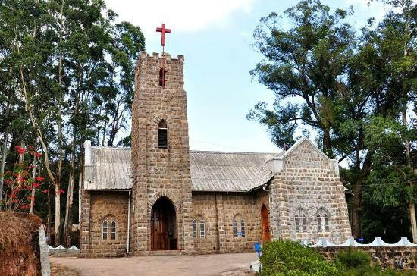
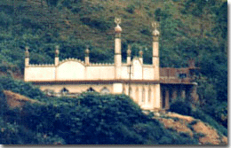
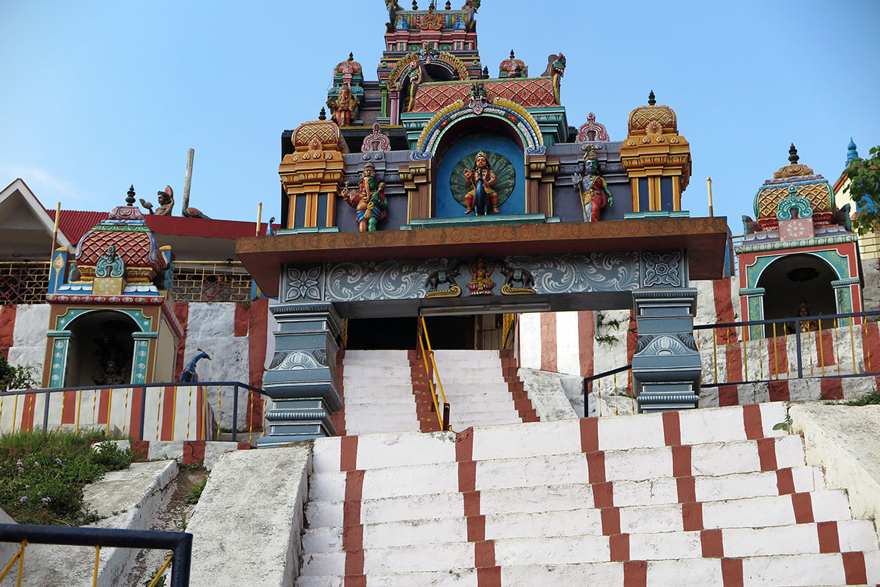
The 3 Hills in Munnar
Left= Christian Church
Middle= Mosque
Right= Hindu Temple

Slide 15
When I was 15…
Islam is Pi’s third religion discovered in his hometown one day while exploring. “It is a beautiful religion of brotherhood and devotion” (Martel 77).
Allah, “Beloved” (the creator)
Mr. Kumar= Hafiz (a scholar of the Qur’an) and a Sufi (Muslim mystic)
Prayer is an essential practice (four cycles)
Fana= union with God
Dhikr= recitation of 99 revealed names of God

Slide 16
Significance? Reference Page 88

Slide 17
Distinction
Mr. Kumar, biology teacher, from Petit Seminaire (inspired zoology studies)
Atheist and communist
Mr. Satish Kumar from the Muslim Quarter of Pondicherry (inspired religious studies)
Hafiz and Sufi

