Slide 1
Life of Pi
English 10H

Slide 2
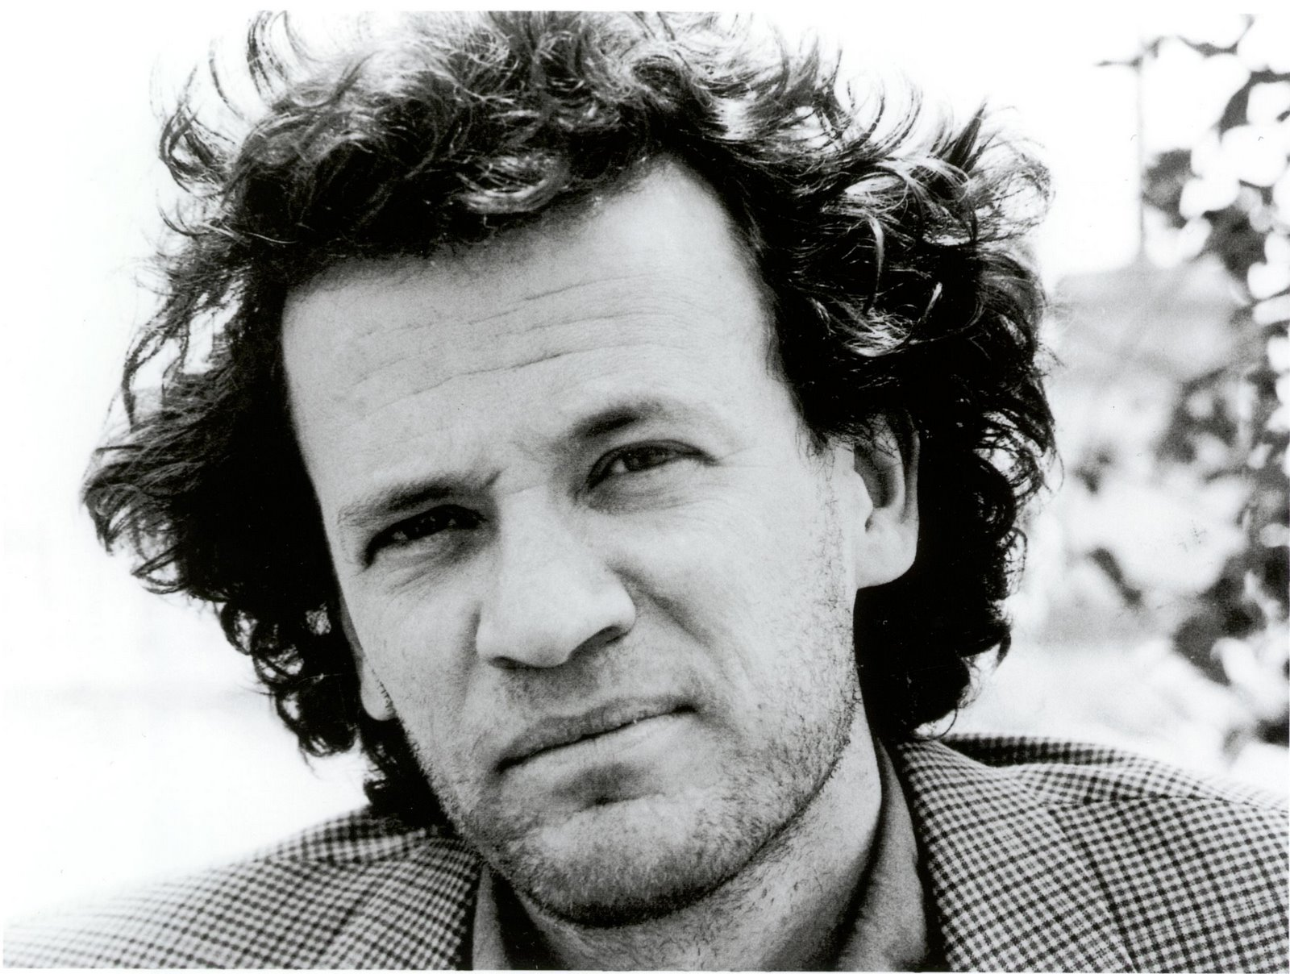
Background Knowledge
https://www.youtube.com/watch?v=5BzqsKLbGpM
As we watch the video, jot down two things that really stand out to you in the interview with Yann Martel
Yann Martel lived in India for a year (well… 13 months)

Slide 3
A Note on Colonialism
British colonialism was the act of Great Britain claiming territories outside of Europe and colonializing the territories
Results= more goods, increased transportation & trade, increased educational opportunities, increased health care
HOWEVER… loss of native culture, inequity in health care, only partial citizenship, no voice in government policy, corruption
Years (ish): 1781-1800s (up to 1947)

Slide 4
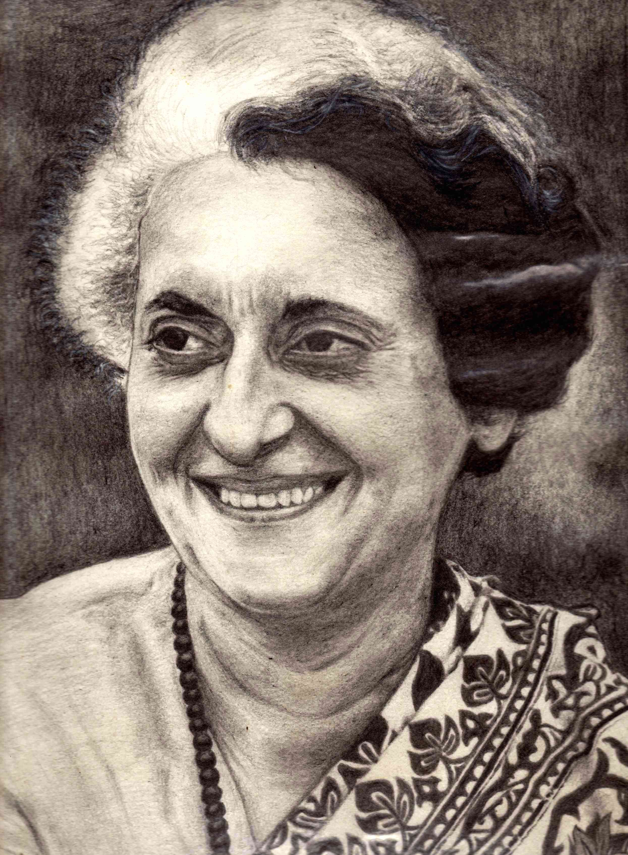
Indian Emergency
Timeframe: June of 1975 to March of 1977 (21 months)
Place: India
Prime Minister: Indira Gandi: passed controversial laws
President Fakhruddin Ali Ahmed
Constitution suspended; police given more power; corruption prevailed; suspended elections & civil liberties

Slide 5
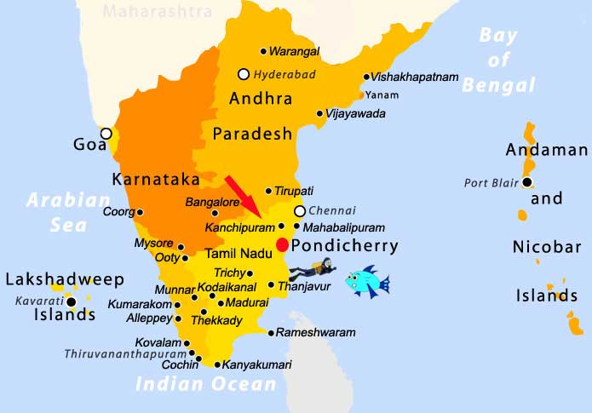
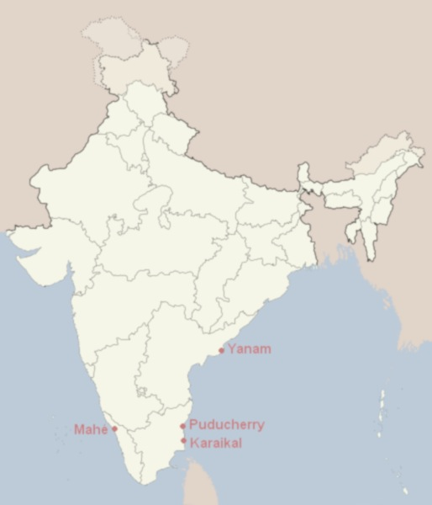
Pondicherry

Slide 6
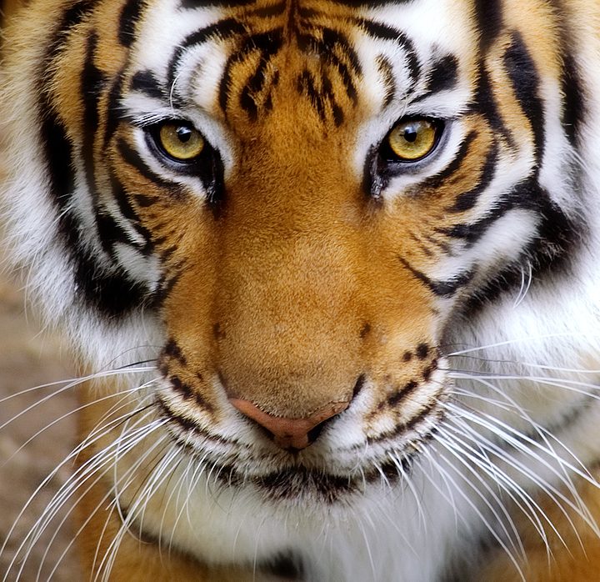
Symbolism
As we begin reading, be sure to see if anything in the text gives insight into the political state of India at that time.
Also pay attention to all other people and animals in the text. How might this text be read as an allegory.

Slide 7
Versus Points
Literal Versus Figurative Interpretation
(The animals)
Faith Versus Organized Religion
(The three religions)
Survival of the Fittest Versus Altruism
(Richard Parker)
Collectivism Versus Individualism
(Interpretations of the novel)

Slide 8
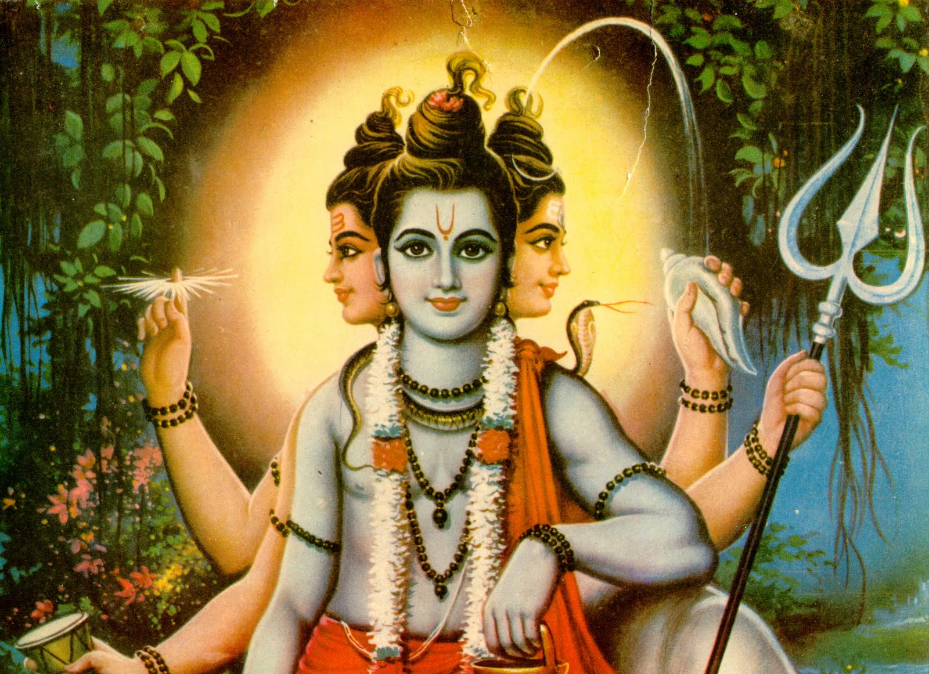
Hinduism (Hindus)
World’s 3rd largest religion
“Oldest Religion”
Henotheistic (devotion to a single god, but acknowledging other gods)
One creator, divine many, the universe as God
Krishna (avatar of the god, Vishnu)
Based on eternal duties (dharma (ethics), artha (work), kama (emotions), moksha (freedom), karma (moral cause & effect), samsara (reincarnation), and yoga)

Slide 9
Christianity (Christians)
World’s largest religion
Many denominations
Monotheistic (one creator God- three parts)
Follows the teachings of Jesus Christ, son of God, as documented in the New Testament
Belief in forgiveness and afterlife; unconditional love is the biggest pillar of the doctrine

Slide 10
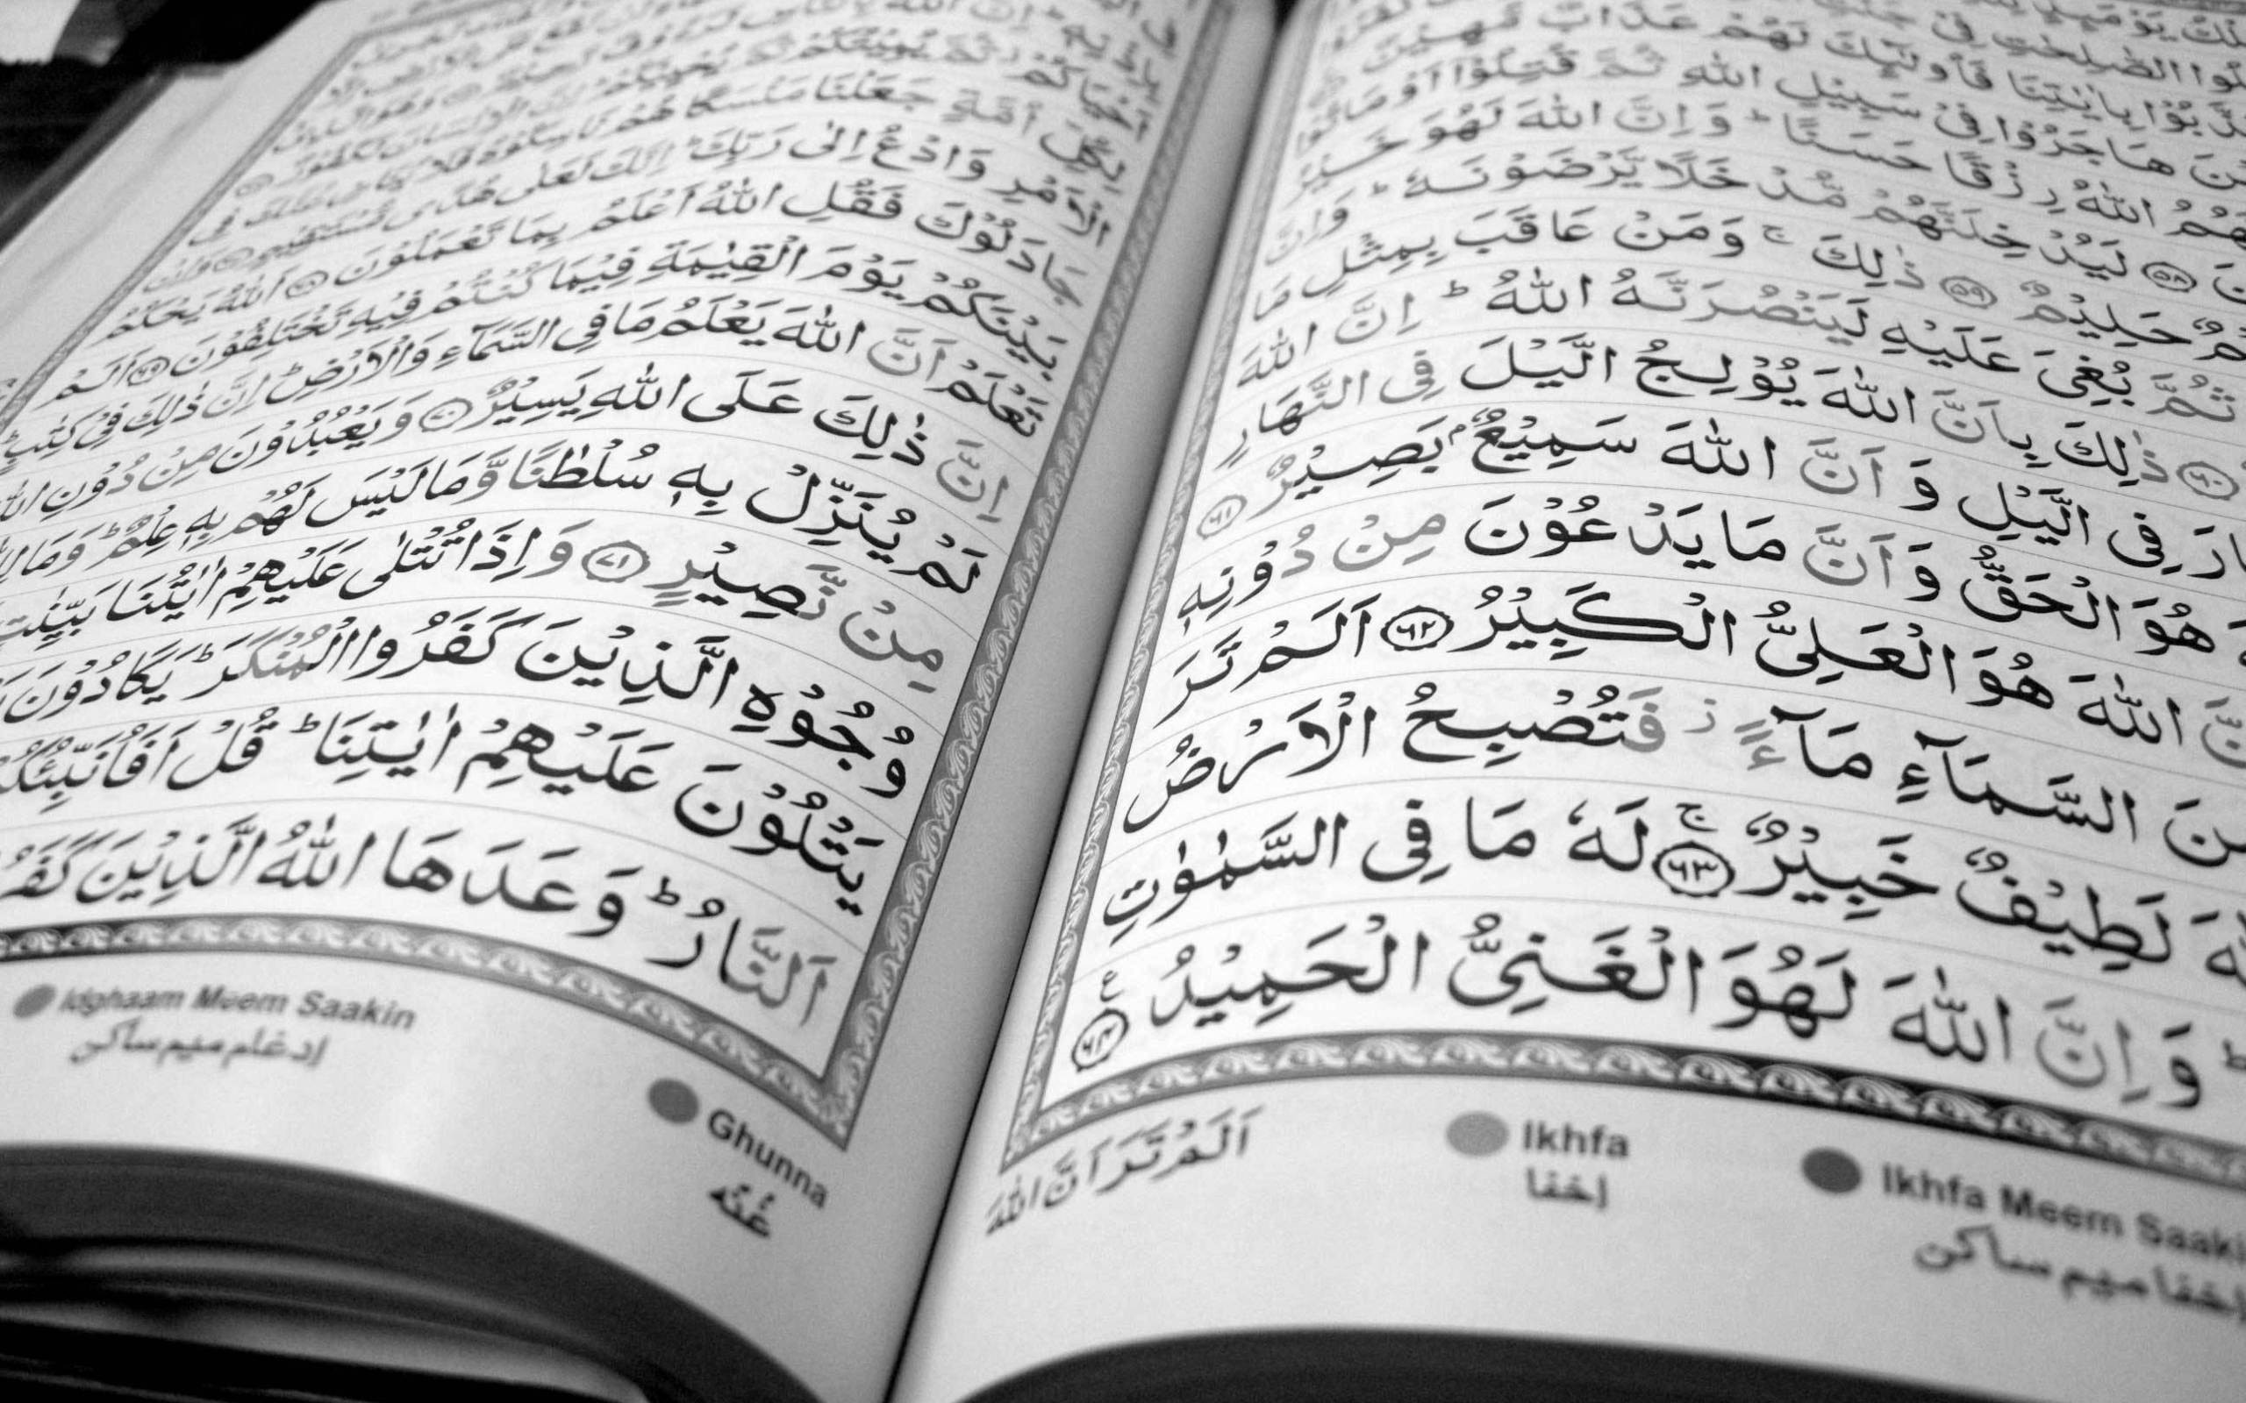
Islam (Muslims)
World’s 2nd largest religion
Adherent of Islam= Muslim
2 denominations: Sunni & Shia
Monotheistic (one creator, Allah)
Followings the teachings of Muhammad- the last prophet- and the Qu’ran
Belief in predestination, devotion, and pilgrimage to the Holy City, Mecca

