Slide 1
Introduction to Rhetorical Fallacies
AP Language & Composition | Unit 3 The Art of Argumentation

Slide 2
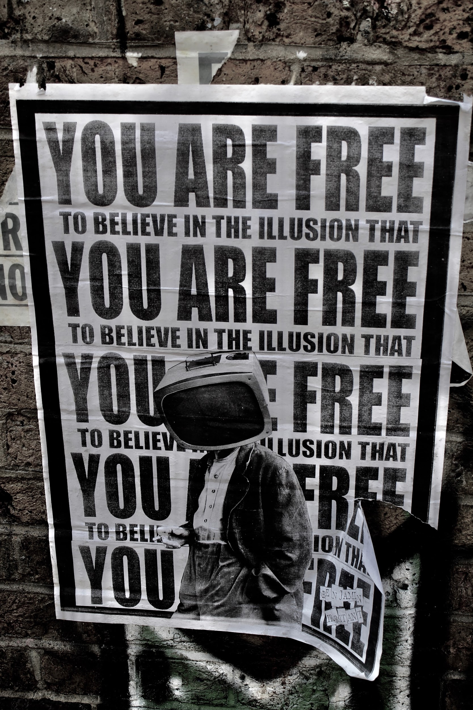
Rhetorical Fallacies.
Based on the term and what you know, what might be some rhetorical fallacies?

Slide 3
Argument Defined.
An argument is comprised of at least one premise and a subsequent conclusion.

Slide 4
Those Types.
There are two broad categories of rhetorical fallacies: (1) Fallacies of Composition and (2) Fallacies of Reason. Fallacies of Composition include both informal and formal fallacies.

Slide 5
Modus Ponens.
P1 (Premise One) If X, then Y.
P2 (Premise Two) X.
C (Conclusion) Therefore, Y.
This is a valid logical argumentative structure.

Slide 6
Terminology.
Valid argument- refers to the structure of the argument
True argument- refers to the truth of the conclusion
Sound argument- refers to the content of the argument

Slide 7
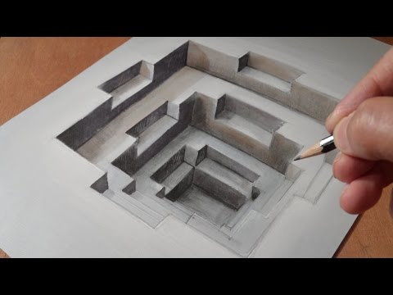
Formal Fallacy.
A formal fallacy occurs when there is a defect or flaw in the structure/form of the argument. Formal aspects deal with the validity of the structure of logic.
Compositional Fallacy

Slide 8
Formal Fallacy.
P1 (Premise One) If X, then Y.
P2 (Premise Two) Y.
C (Conclusion) Therefore, X.
This is an invalid structure of logic. Plugging anything into this would result in a formal fallacy.

Slide 9
Informal Fallacy.
An informal fallacy occurs when there is a defect or flaw in the content/meaning of the argument. Informal aspects deal with the truth and soundness of the logic.
Compositional Fallacy

Slide 10
Informal Fallacy.
P1 (Premise One) X has properties A, B, & C.
P2 (Premise Two) Z is part of X.
C (Conclusion) Therefore, Z has properties A, B, & C.
This is called the Fallacy of Division.

Slide 11
Fallacious Reasoning.
The Categories of
Appeals of the Mind
Appeal to Emotions
Faulty Deduction
Manipulating Content
Garbled Cause & Effect
On the Attack
Questions at this point?

