Slide 1
Introduction to Rhetoric
English 10

Slide 2
Meanings of Rhetoric
The meaning of the word "rhetoric" seems to differ depending on how the word is used and who is using it.
You have probably heard politicians some time or another dismiss the positions of their opponents as "mere rhetoric."
You are probably also familiar with the idea of a rhetorical question—a question that is meant to make a point and not meant to be answered.

Slide 3
Rhetoric is the ways in which we try to persuade a given audience, for a given purpose.
Here are some classic examples of rhetoric:
When a politician tries to get you to vote for him, he is using rhetoric.
When a lawyer tries to move a jury, she is using rhetoric.
When a government produces propaganda, it is using rhetoric.
When an advertisement tries to get you to buy something, it is using rhetoric.
When the president gives a speech, he is using rhetoric.

Slide 4
Rhetoric… Subtle Level
When someone writes an office memo, he is using rhetoric.
When a newspaper writer offers her depiction of what happened last night, she is using rhetoric.
When a scientist presents theories or results, she is using rhetoric.
When you ask your mom or dad for gas money, you are using rhetoric.
And yes, when I'm trying to explain about rhetoric, I'm using rhetoric.

Slide 5
Orature & Rhetoric
Rhetoric throughout most of history referred to the arts of speechmaking and oratory.
In this class, we will use it to refer to persuasion that occurs through any medium, not just text or speech.
Eventually, I hope you start to see all communication as rhetorical—that is, as a set of deliberate, strategic decisions that someone made to achieve a certain purpose with a certain audience.

Slide 6
The Rhetorical Triangle
Writer/Speaker
Purpose/Message
Audience

Slide 7
Rhetorical Appeals
Aristotle (an ancient Greek philosopher) identified three major tactics that we use when we go about persuading people. We call these tactics rhetorical appeals.
Aristotle taught that a speaker’s ability to persuade an audience is based on how well the speaker appeals to that audience in three different areas:
ethos
logos
pathos

Slide 8
Appeal to Ethos
Like Ethics…
Ethos refers to the character or authority of the speaker/writer.
Our perception of the speaker/writer's ethos is what leads us to trust what they are saying.
Credibility of writer

Slide 9
Examples of Appeals to Ethos:
In many cases ethos is pretty transparent: if Rachel Ray wanted to tell us how to make Chicken Marsala, we would probably just implicitly assume that she knew what she was talking about. After all, she has built her ethos in the sense of authority by demonstrating her cooking abilities every day on nationwide television, in her cookbooks, and through other media. She has also built her ethos in the sense of her character by appearing to be a friendly, savvy, and admirable person. However, if a random person on the street wanted to tell us how to make Chicken Marsala, we would probably first want to know what gave him the authority to do so: did he cook a lot? Does he make chicken marsala often? Why was he qualified to show us? In addition, such a person would probably lack the character component of ethos—being a stranger we would have no connection to him and we would have no sense of who he was as a person. In fact, we'd probably be creeped out by his unsolicited cooking lesson. Ultimately, we would have no reason to trust him.

Slide 10
Appeal to Pathos
An Emotional Appeal
Appeal to human emotions (such as desire, passion, or patriotism) within the audience/reader
Includes considerations of the values and beliefs in the audience that will ultimately move them to action.

Slide 11
Examples of Appeals to Pathos:
Home security companies appeal to our fears of violent crime, carbon monoxide, fire, etc. in order to convince us to buy their home monitoring systems.
Personal hygiene products appeal to our fears of social rejection and to our desire to fit in with others.
Charities appeal to our emotions by showing us images of people that we will empathize with.
Casinos appeal to our sense of greed when they try to get us to gamble.
And of course, countless advertisements use sex to convince us to buy their products (this is technically eros, but we'll file it under pathos for the sake of simplicity).

Slide 12
Appeal to Logos
Logical argument
Appeal to reason or logic
Frequently includes the use of data, statistics, math, research, order, and realms of perceived "objectivity."

Slide 13
Examples of Appeal to Logos:
When advertisements claim that their products are “37% more effective than the competition,” they are making an appeal to logos.
When a lawyer claims that her client is innocent because he had an alibi, that too is an appeal to logos because it is logically inconsistent for her client to have been in two places at once.

Slide 14
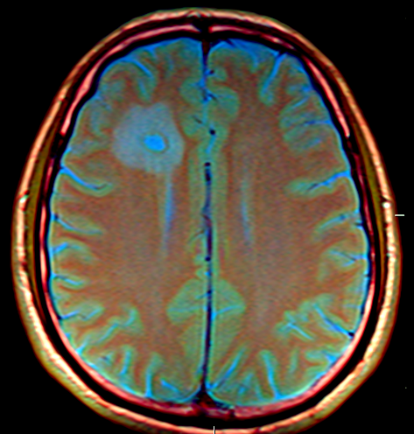
Formative Assessment

Slide 15
Formative Assessment

Slide 16
Formative Assessment

Slide 17
Example of Combination of Appeals:
For instance, appeals to logos by themselves are rare and seldom effective—they invariably rely on appeals to pathos and ethos as well.
If I wrote an essay that included the statement "five people die of AIDS every minute," it doesn't just convey an appeal to logos in the form of a statistic.
It also includes an implicit appeal to pathos: a sense of the emotional tragedy that is AIDS and a sense of the ferocity and terribleness of the disease.
It also includes an implicit appeal to ethos: it establishes my belief in the moral unacceptability of the disease and it may establish admiration in the eyes of my audience for holding such a stance.

Slide 18
Let’s Review: Rhetorical Triangle
Writer/Speaker
Appeal to Ethos (Credibility of Writer)
Audience
Appeal to Pathos
(Emotions, Beliefs,
and Values)
Purpose/Message
Appeal to Logos
(Facts, Research, Data)

