Slide 1
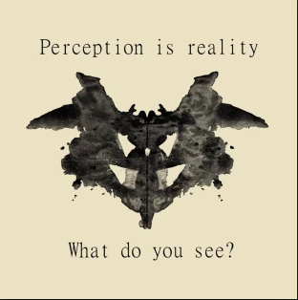
Inkblot Tests

Slide 2
Psychoanalytic Theory & Inkblots
A branch of literary study (inspired by research in psychology) that investigates modes of consciousness and their role in the interpretation of literacies.
Freud and whatnot.
Rorschach or inkblot tests were created by Swiss Freudian psychologist Hermann Rorschach to assess the subconscious mind and detect mental illness.
They were published in 1921. However, they gained prominence in the sixties with a second wave of interest in psychoanalysis.

Slide 3
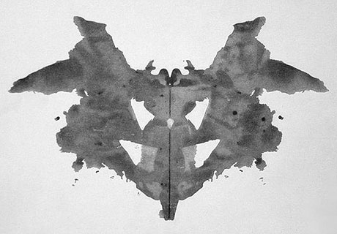
Card No. 1

Slide 4
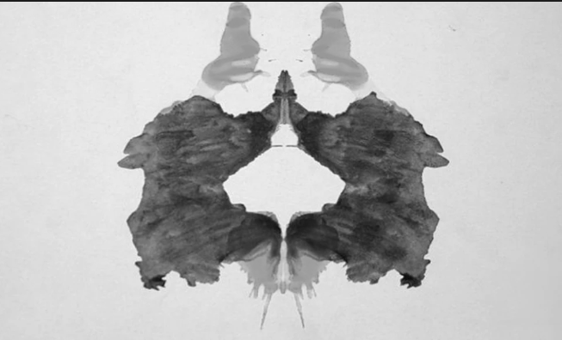
Card No. 2

Slide 5
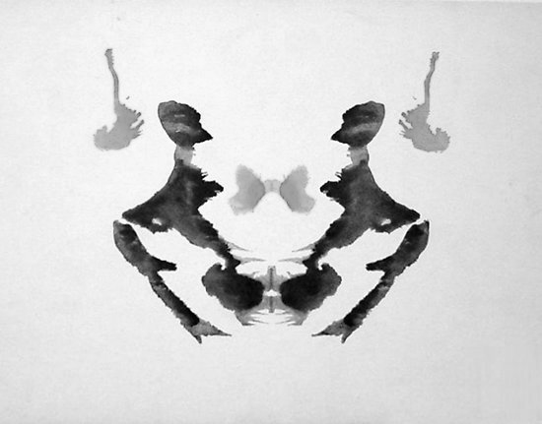
Card No. 3

Slide 6
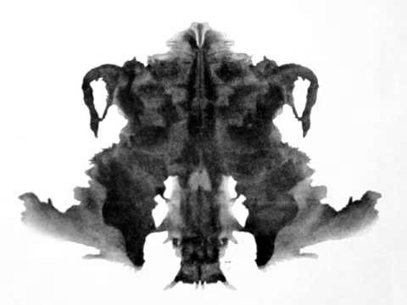
Card No. 4

Slide 7
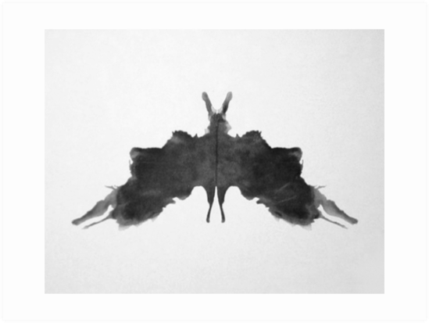
Card No. 5

Slide 8
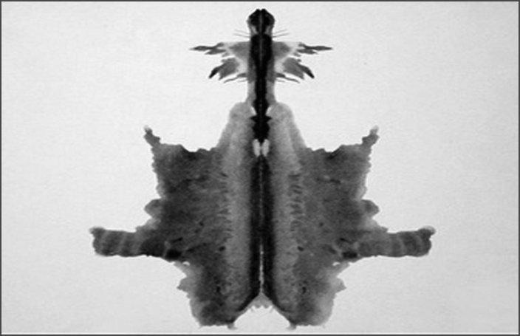
Card No. 6

Slide 9
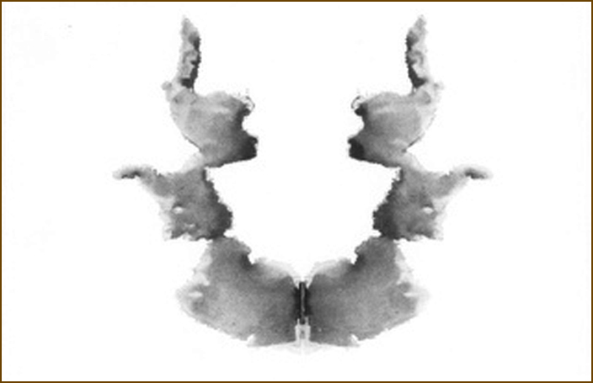
Card No. 7

Slide 10
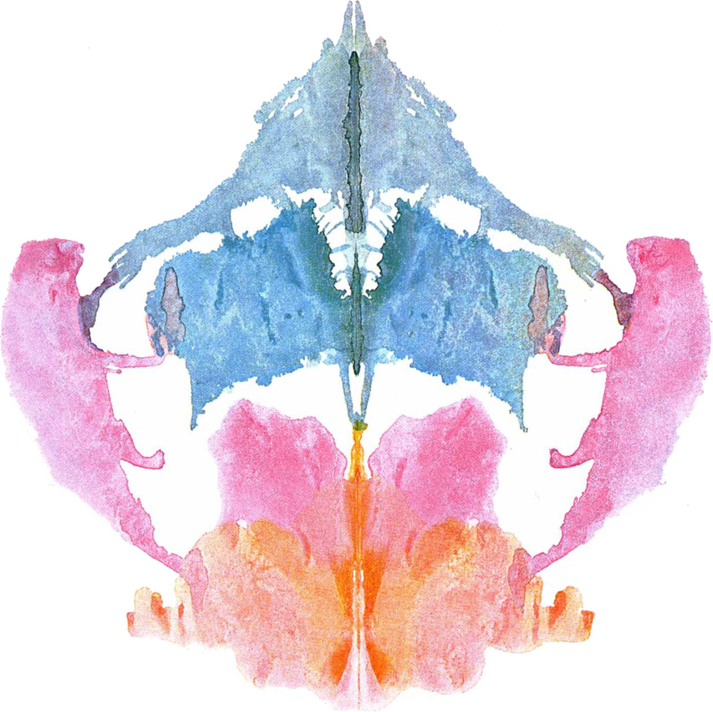
Card No. 8

Slide 11
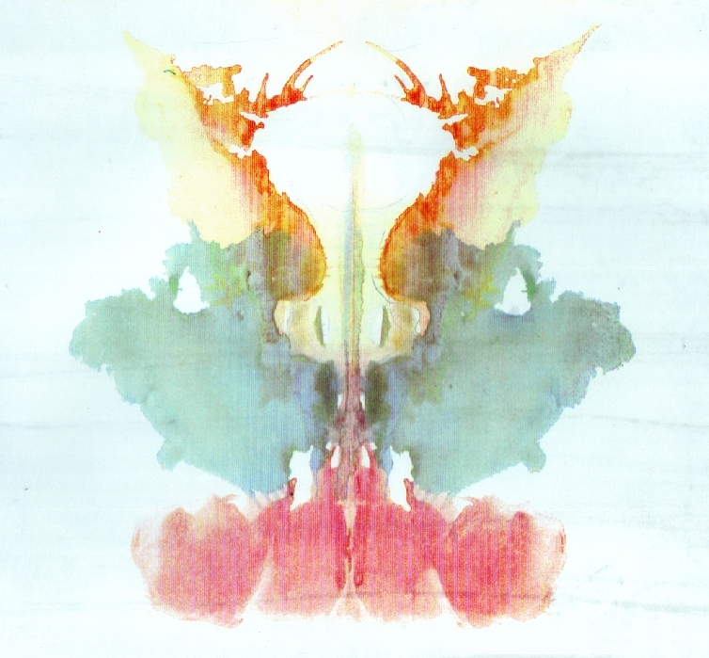
Card No. 9

Slide 12
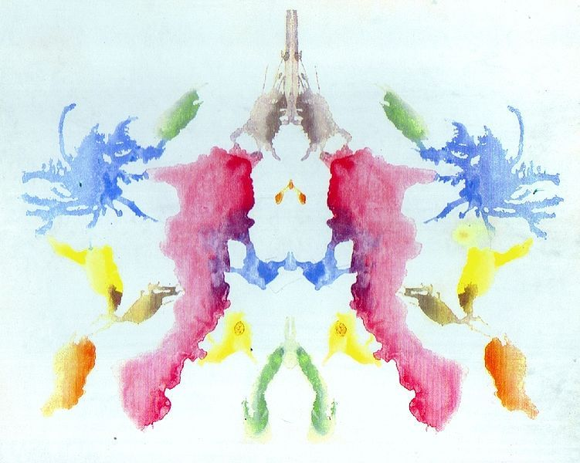
Card No. 10

Slide 13
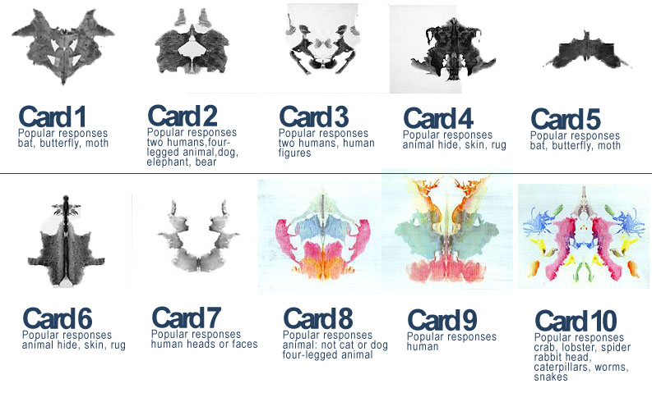
Common Interpretations

