Slide 1
Vocabulary Unit
13
English AP & 10H

Slide 2
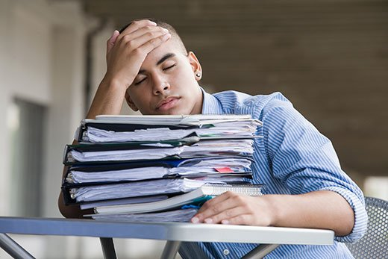
Antipathy
A strong dislike or hostile feeling

Slide 3
Applicable
Capable of being applied

Slide 4
Asset
Something of value

Slide 5
Beset
To attack from all sides

Slide 6
Compassion
Sympathy for another’s suffering

Slide 7
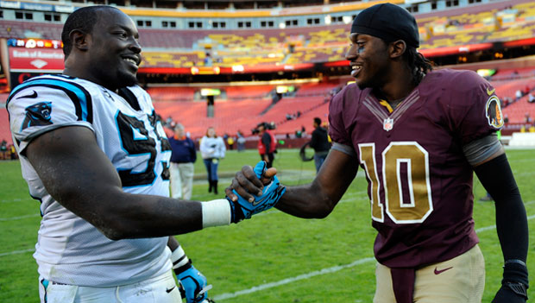
Decorum
Proper behavior

Slide 8
Duress
Compulsion by threat

Slide 9
Exuberant
High-spirited; enthusiastic

Slide 10
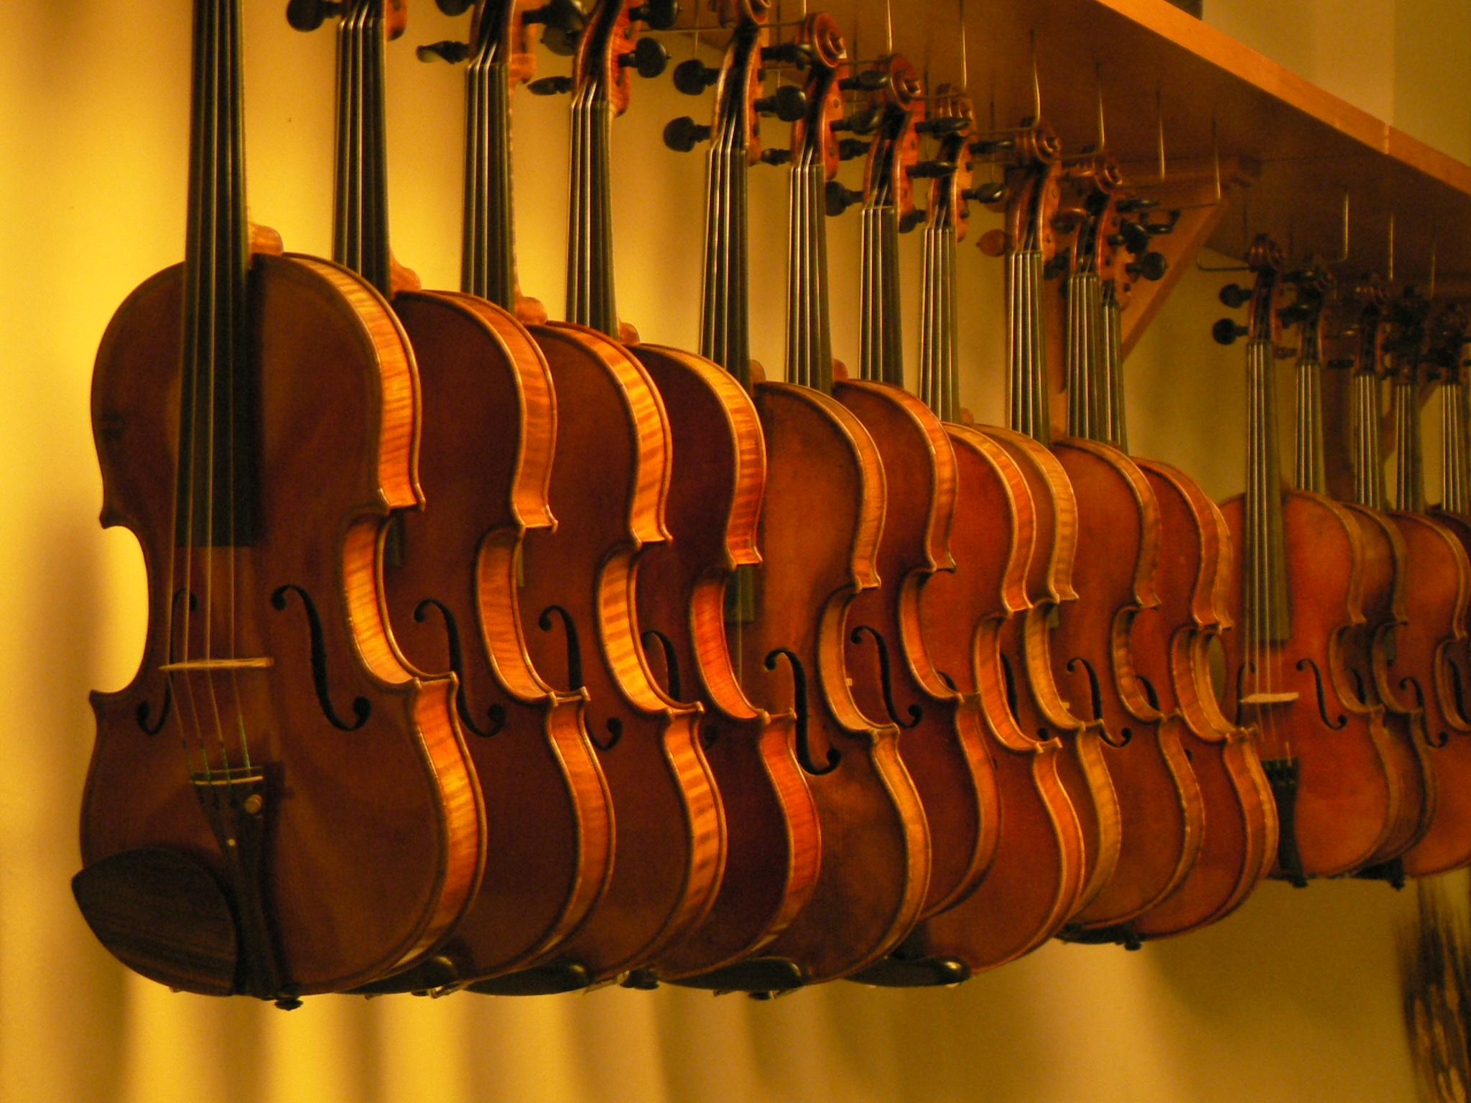
Facsimile
An exact copy

Slide 11
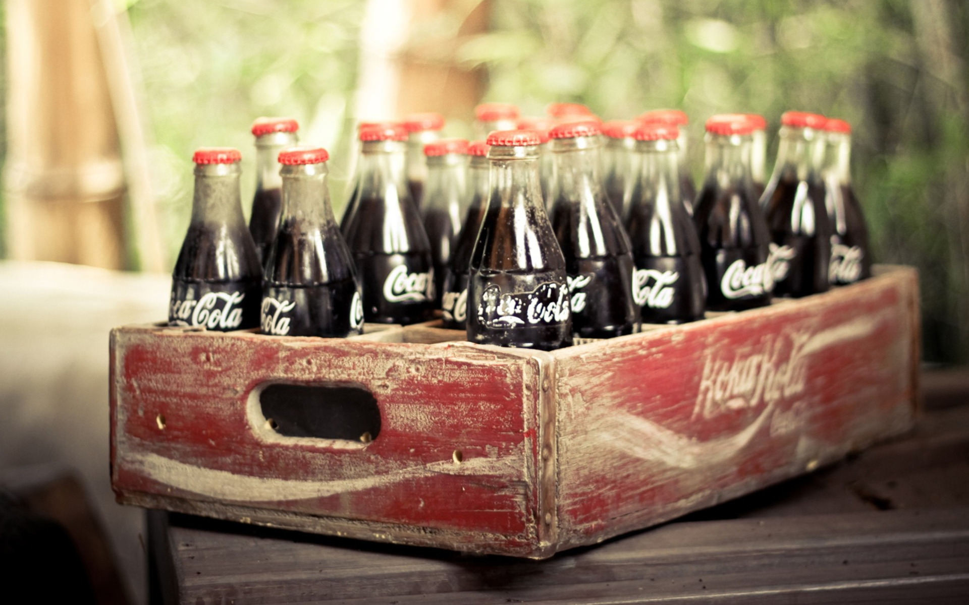
Imbibe
To drink

Slide 12
Implacable
Not to be satisfied or pacified

Slide 13
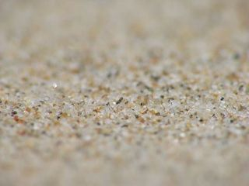
Infinitesimal
To small as to almost immeasurable

Slide 14
Innocuous
Harmless, inoffensive

Slide 15
Militate
To have an effect or force on or against someone or something

Slide 16
Patent
Exclusive rights over an invention

Slide 17
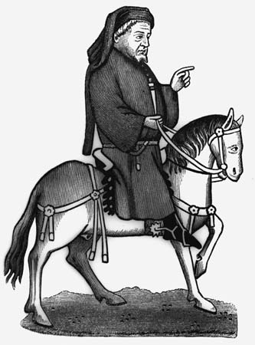
Prowess
Superior skill or ability

Slide 18
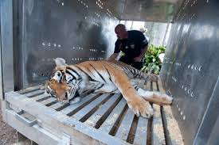
Sedate
Quiet, settled, sober

Slide 19
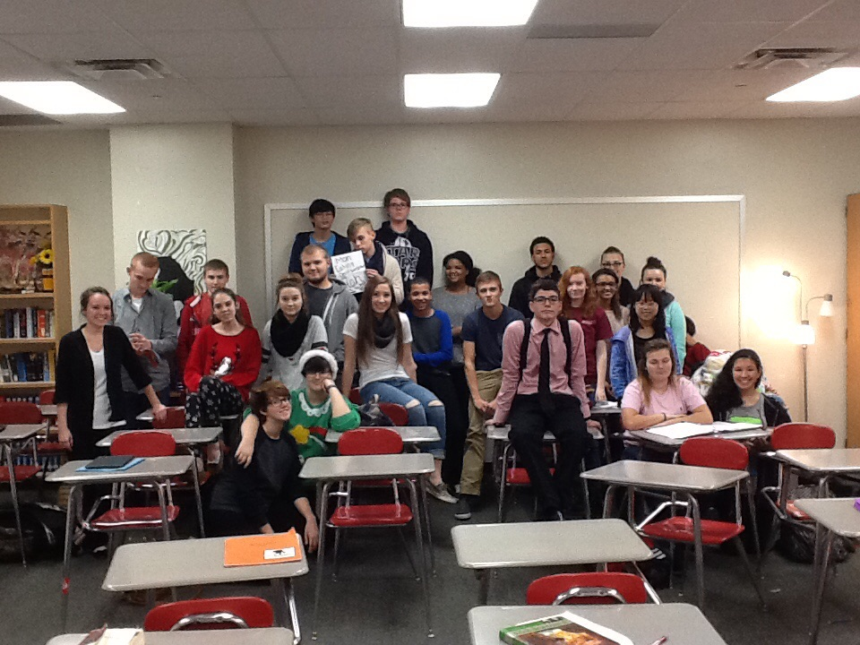
Stentorian
Extremely loud
5th Period….

Slide 20
Stipulate
To arrange specifically

Slide 21
Ultimatum
A final proposal or statement

