Slide 1
Vocabulary Unit 3
English 10

Slide 2
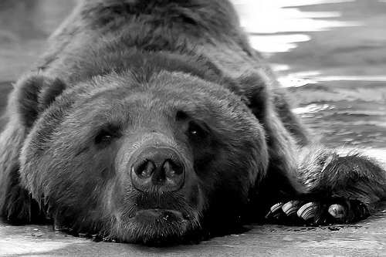
Sullenly
Resentfully; gloomily

Slide 3
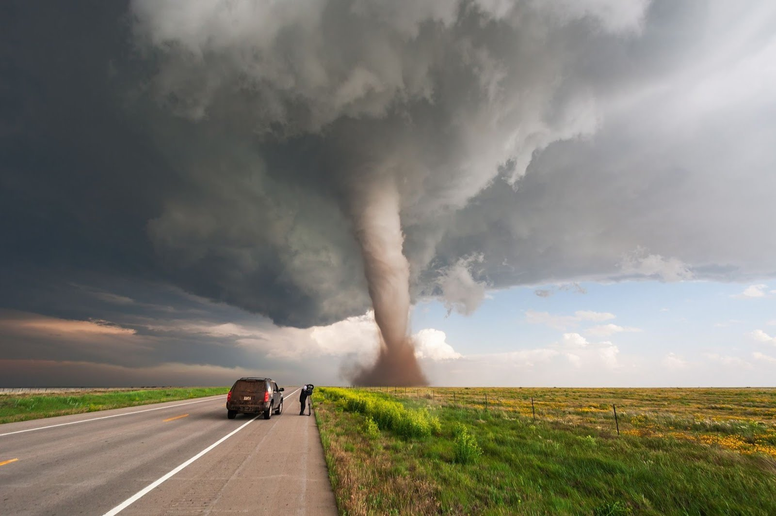
Imminent
Almost immediate; about to happen

Slide 4
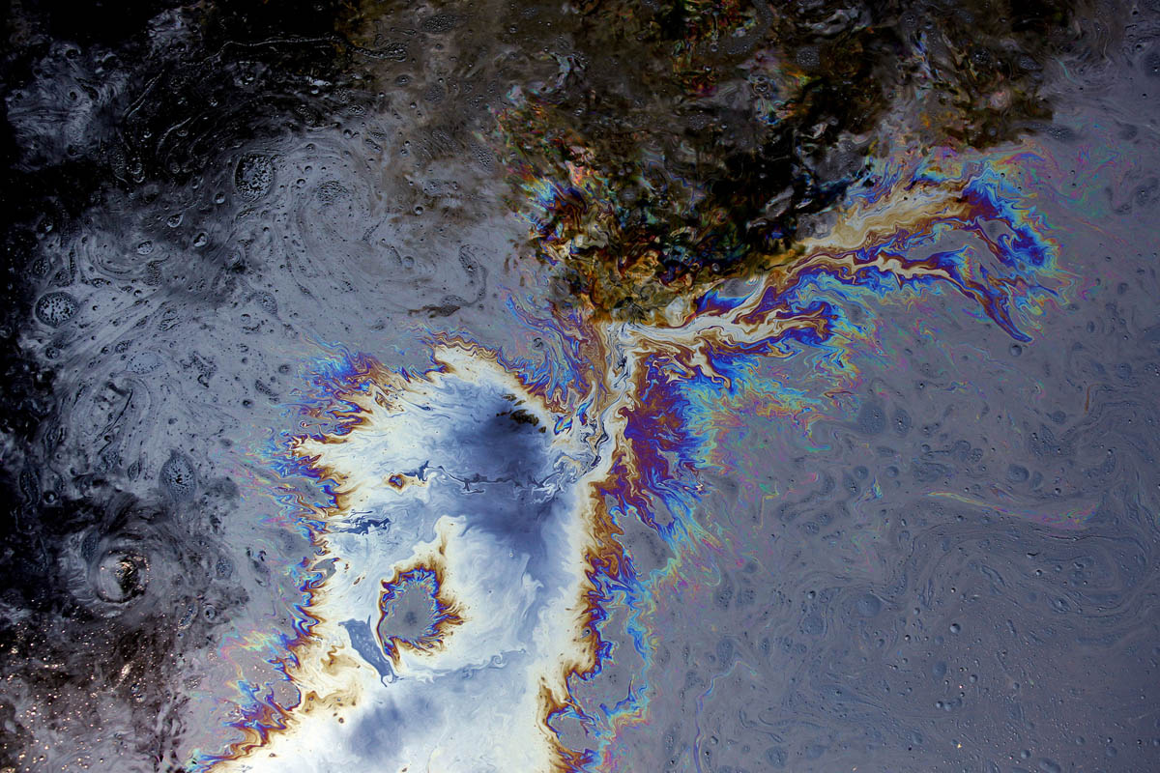
Iridescent
Rainbow-like; displaying a shifting range of colors

Slide 5
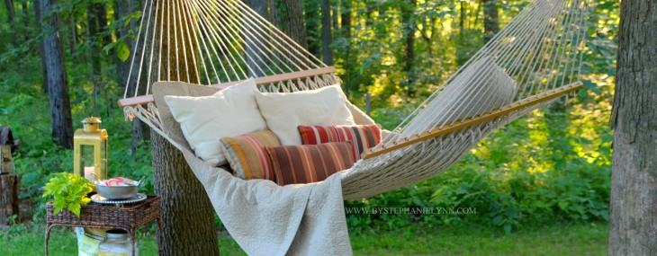
Serene
Peaceful; calm

Slide 6
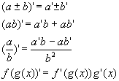
Infallibility
Inability to make a mistake

Slide 7
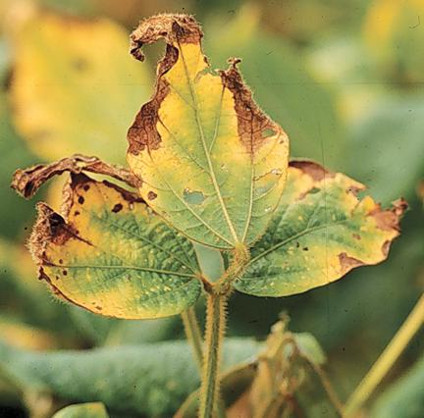
Blighted
To suffer from conditions that destroy & prevent growth

Slide 8
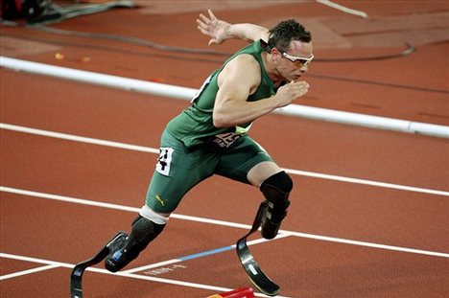
Doggedness
Stubbornness; persistence

Slide 9
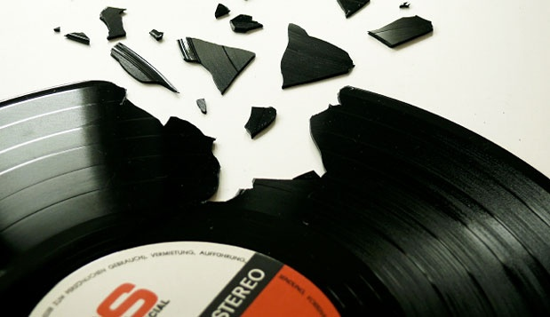
Reiterate
To repeat again and again

Slide 10
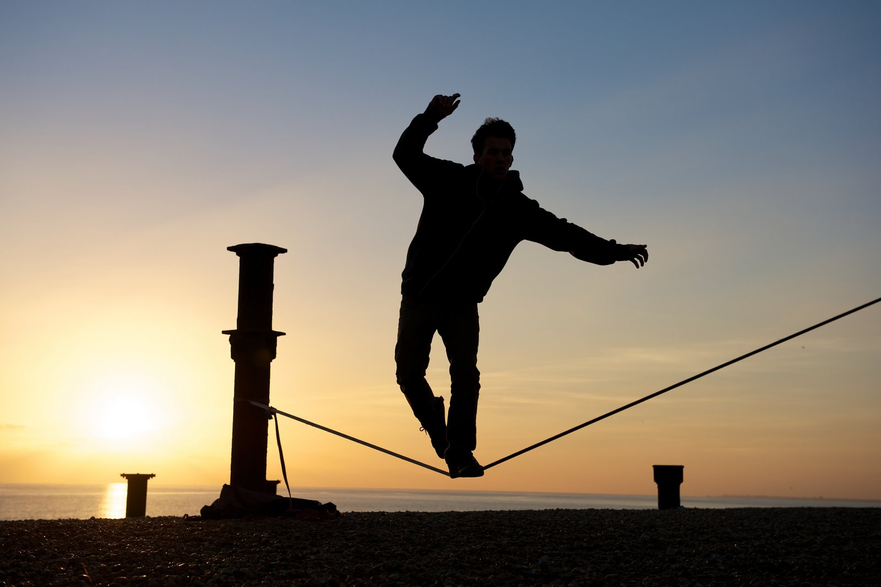
Precariously
Unsteadily; insecurely

Slide 11
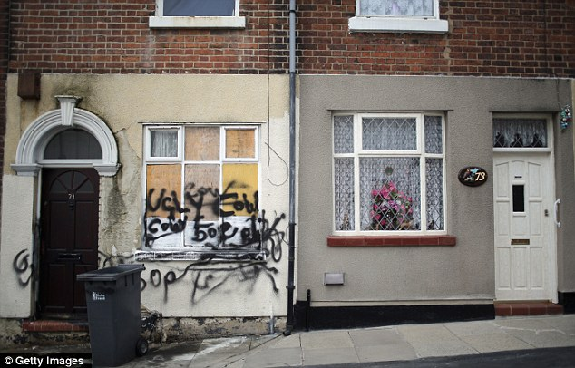
Mar
To damage or spoil

