Slide 1
Vocabulary Unit
English 10H

Slide 2
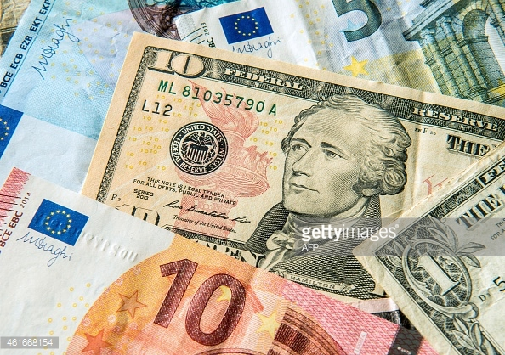
Adulterate
to corrupt, make worse, by the addition of something of lesser value

Slide 3
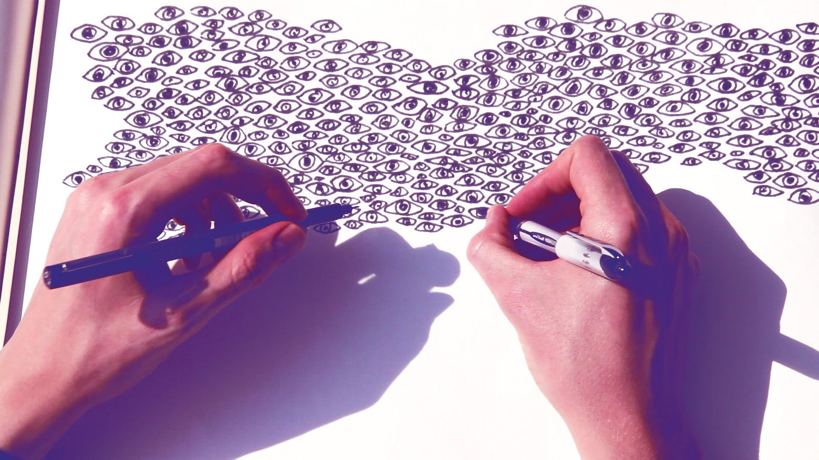
Ambidextrous
able to use both hands equally well; very skillful; deceitful, hypocritical

Slide 4
Augment
to make larger; to increase

Slide 5
Bereft
deprived of; made unhappy through a loss

Slide 6
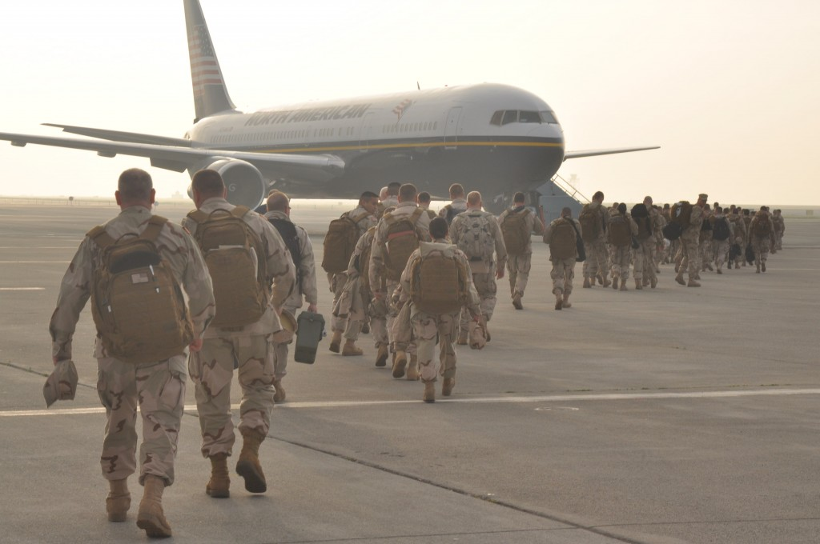
Deploy
to position or arrange; to utilize; to form up

Slide 7
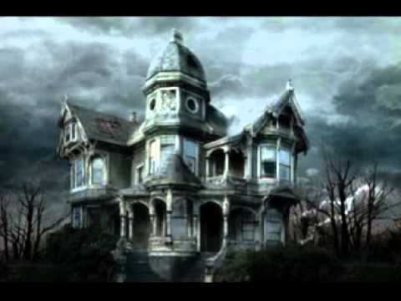
Dour
stern, unyielding, gloomy, ill-humored

Slide 8
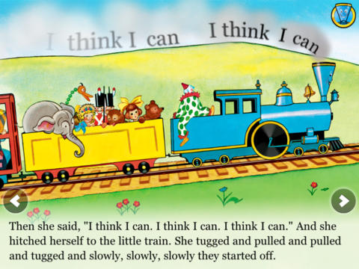
Fortitude
courage in facing difficulties

Slide 9
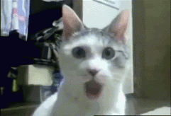
Gape
to stare with open mouth; to open the mouth wide; to open wide

Slide 10
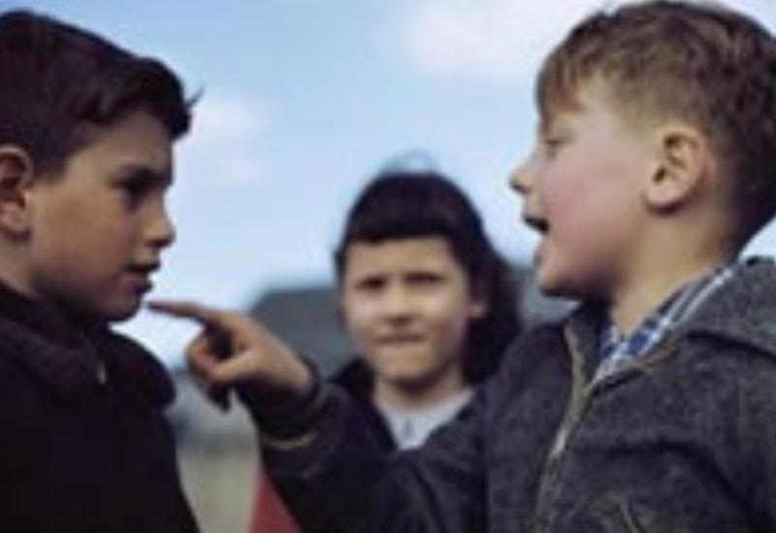
Gibe
to utter taunting words; an expression of scorn

Slide 11
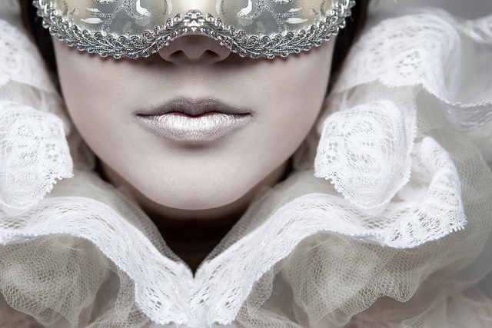
Guise
an external appearance, cover, mask

Slide 12
Insidious
intended to deceive or entrap; sly; treacherous

Slide 13
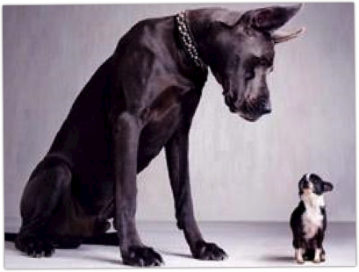
Intimidation
a hint or indirect suggestion

Slide 14
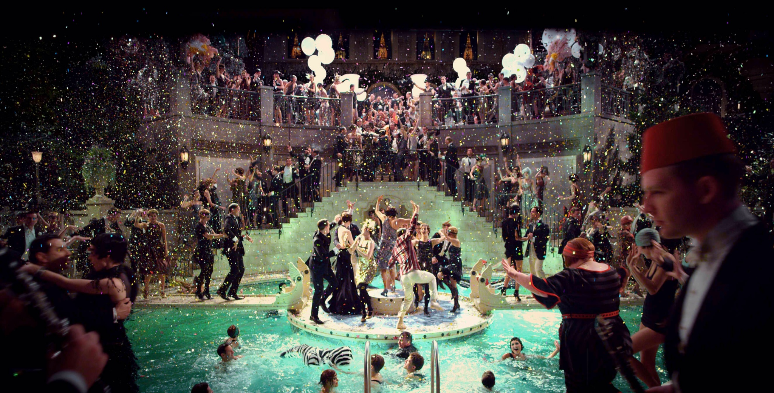
Opulent
wealthy, luxurious; ample; grandiose

Slide 15
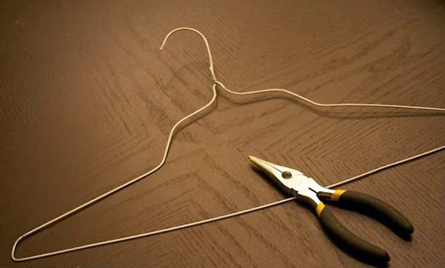
Pliable
easily bent, flexible; easily influenced

Slide 16
Reiterate
to say again, repeat

Slide 17
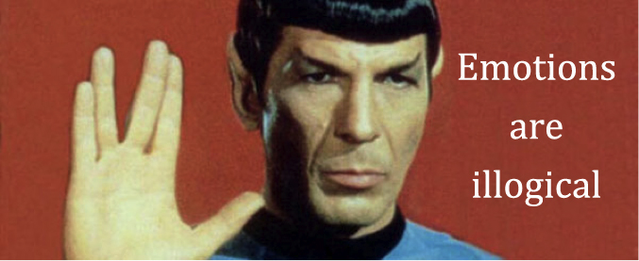
Stolid
not easily moved mentally or emotionally; dull, unresponsive

Slide 18
Tentative
experimental in nature; uncertain, hesitant

Slide 19
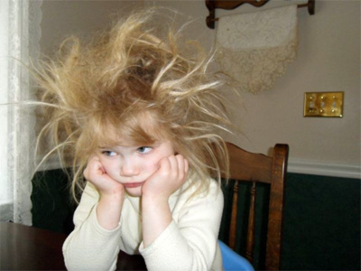
Unkempt
not combed; untidy; not properly maintained; unpolished rude

Slide 20
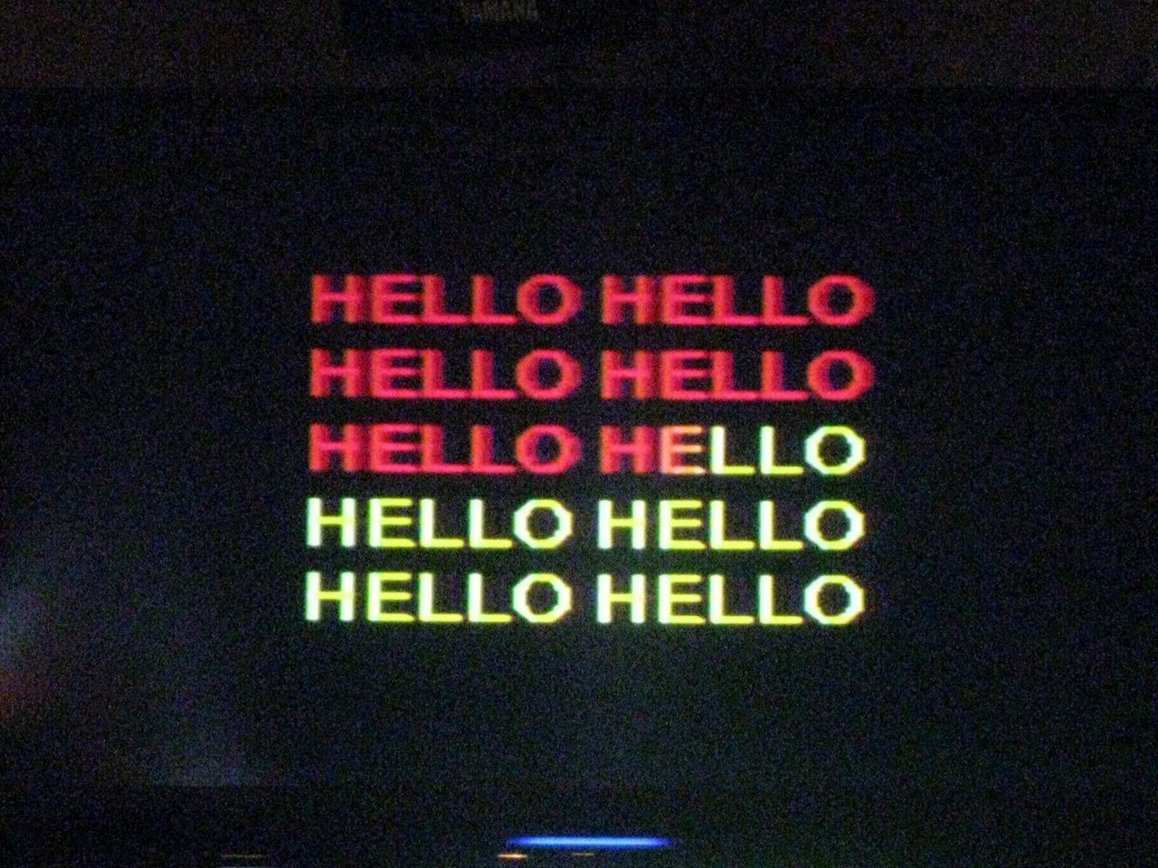
Verbatim
word for word; exactly as written or spoken

Slide 21
Warily
cautiously, with great care

