Slide 1
English 10 Vocabulary
Unit One

Slide 2
Vernacular
Common or everyday language

Slide 3
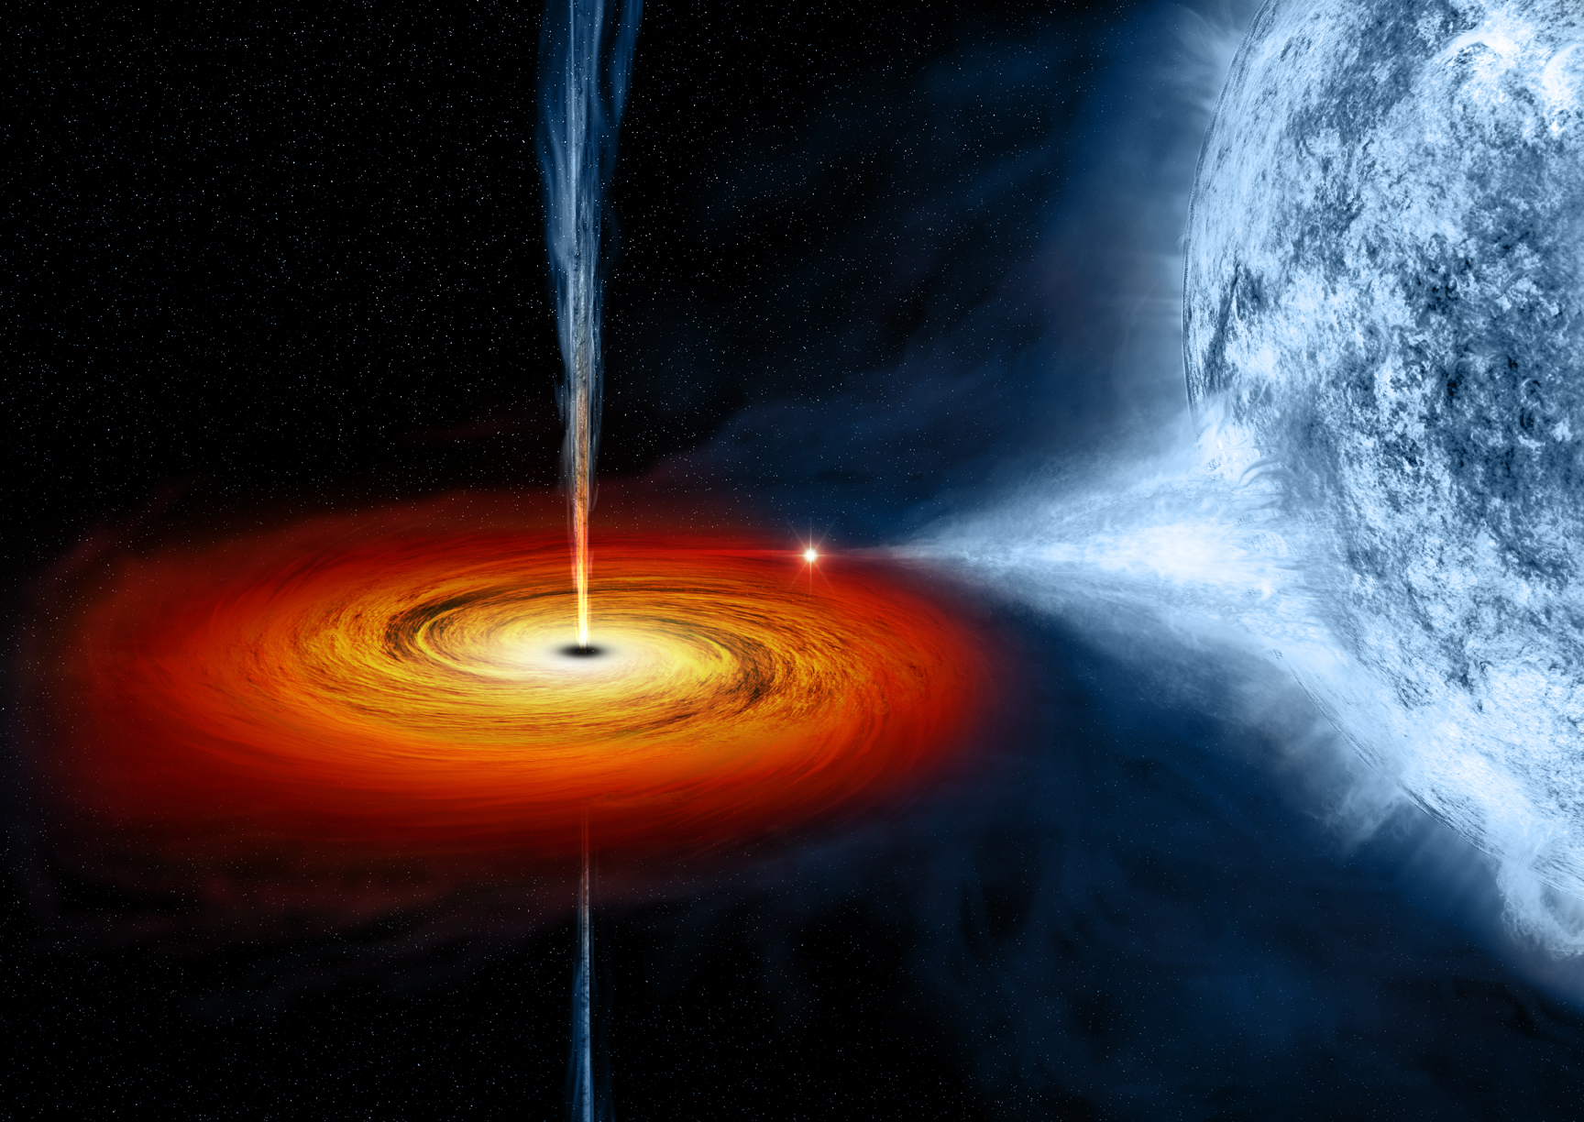
Abyss
The unknown

Slide 4
Collective
Formed or done as a group together

Slide 5
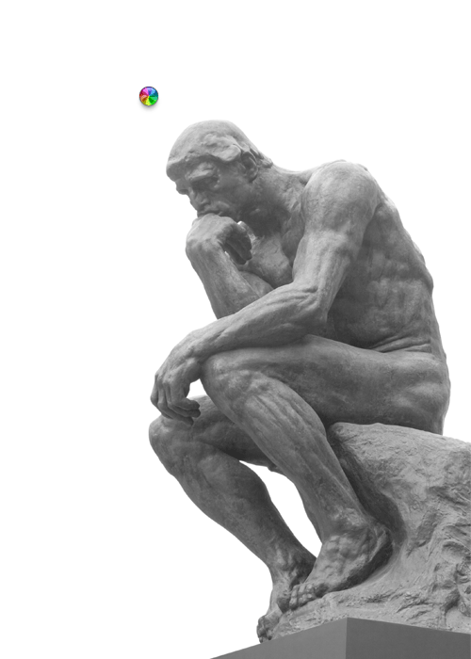
Postulate
To think about

Slide 6
Amorphous
Having no definite form or distinct shape

Slide 7
Articulate
To explain or speak about something

Slide 8
Tome
A large and scholarly book

Slide 9
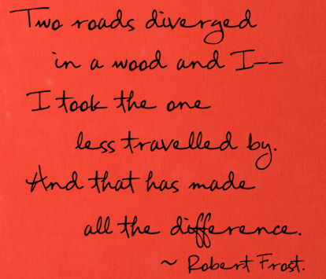
Divergent
Drifting from the norm, average, or status quo

Slide 10
Anomaly
Unique; different from the rest

Slide 11
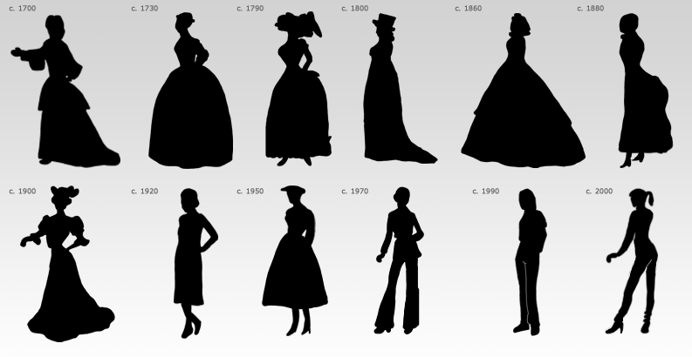
Paradigm
A standard or typical example

