Slide 1
Vocabulary Unit 7
English 10

Slide 2
Façade
an outward appearance used to conceal a less pleasant reality

Slide 3
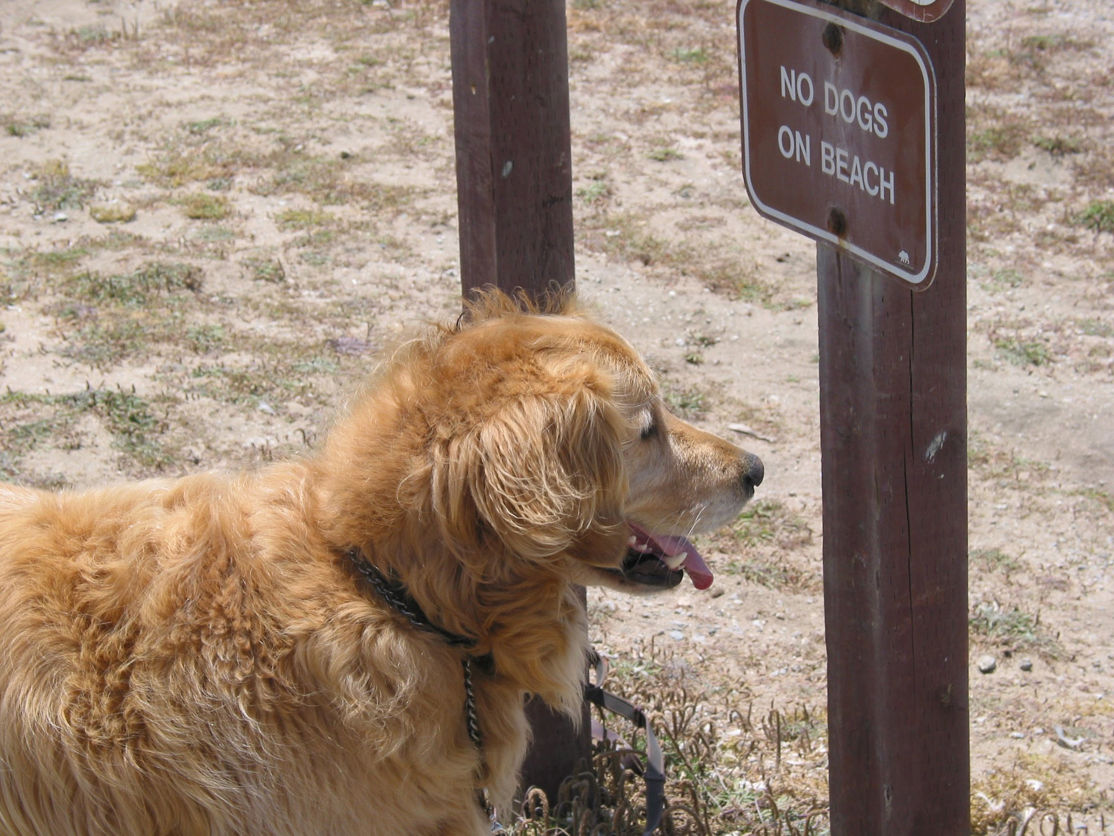
Acquiescence
occurs when a person knowingly stands by without raising any objection to the infringement of their rights

Slide 4
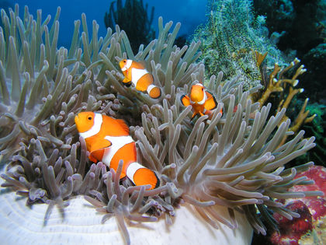
Mutual
held in common by two or more parties

Slide 5
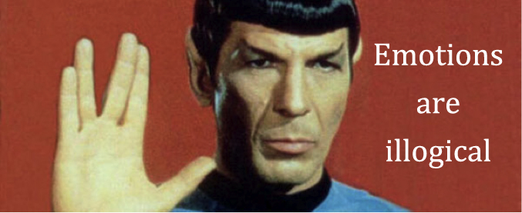
Impassive
not feeling or showing emotion

Slide 6
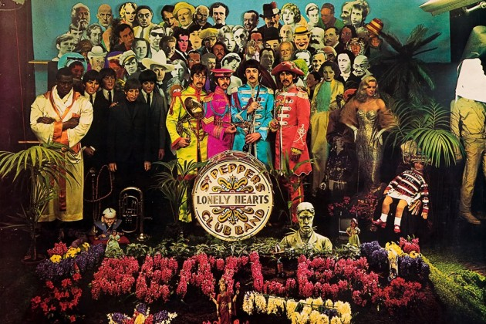
Prominent
well-known; projecting from

Slide 7
Elucidate
to explain or elaborate for clarity

Slide 8
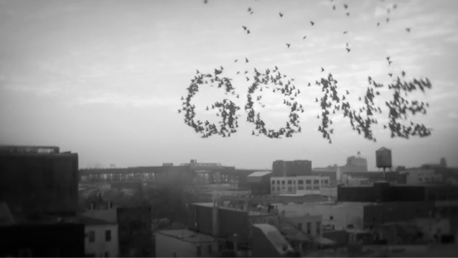
Dispel
to make a doubt, feeling, or belief disappear

Slide 9
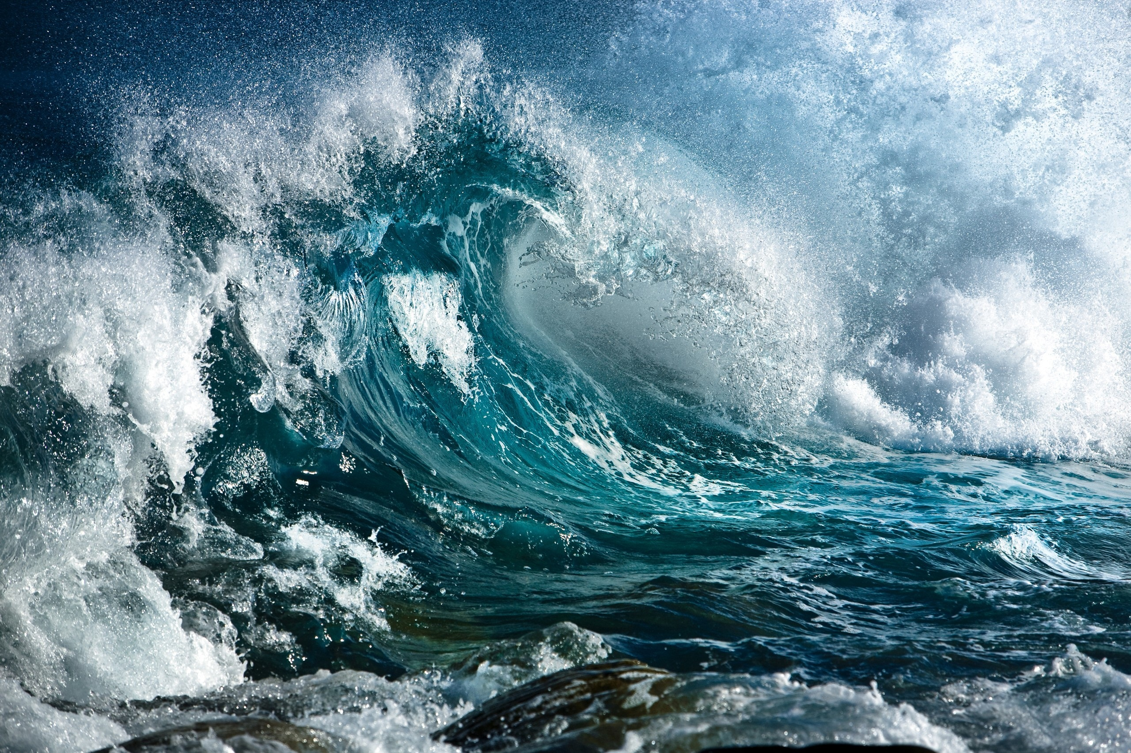
Turbulent
characterized by conflict, disorder, or confusion

Slide 10
Earnest
resulting from or showing sincere and intense conviction

Slide 11
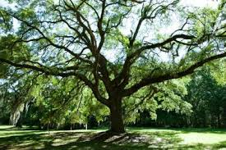
Vigorous
strong, healthy, and full of energy

