Slide 1
Vocabulary Unit
12
English AP & 10H

Slide 2
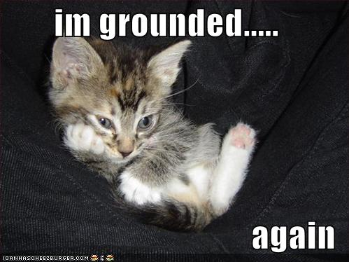
Abjure
to renounce

Slide 3
Acrid
harsh in taste or odor; sharp in manner or temper

Slide 4
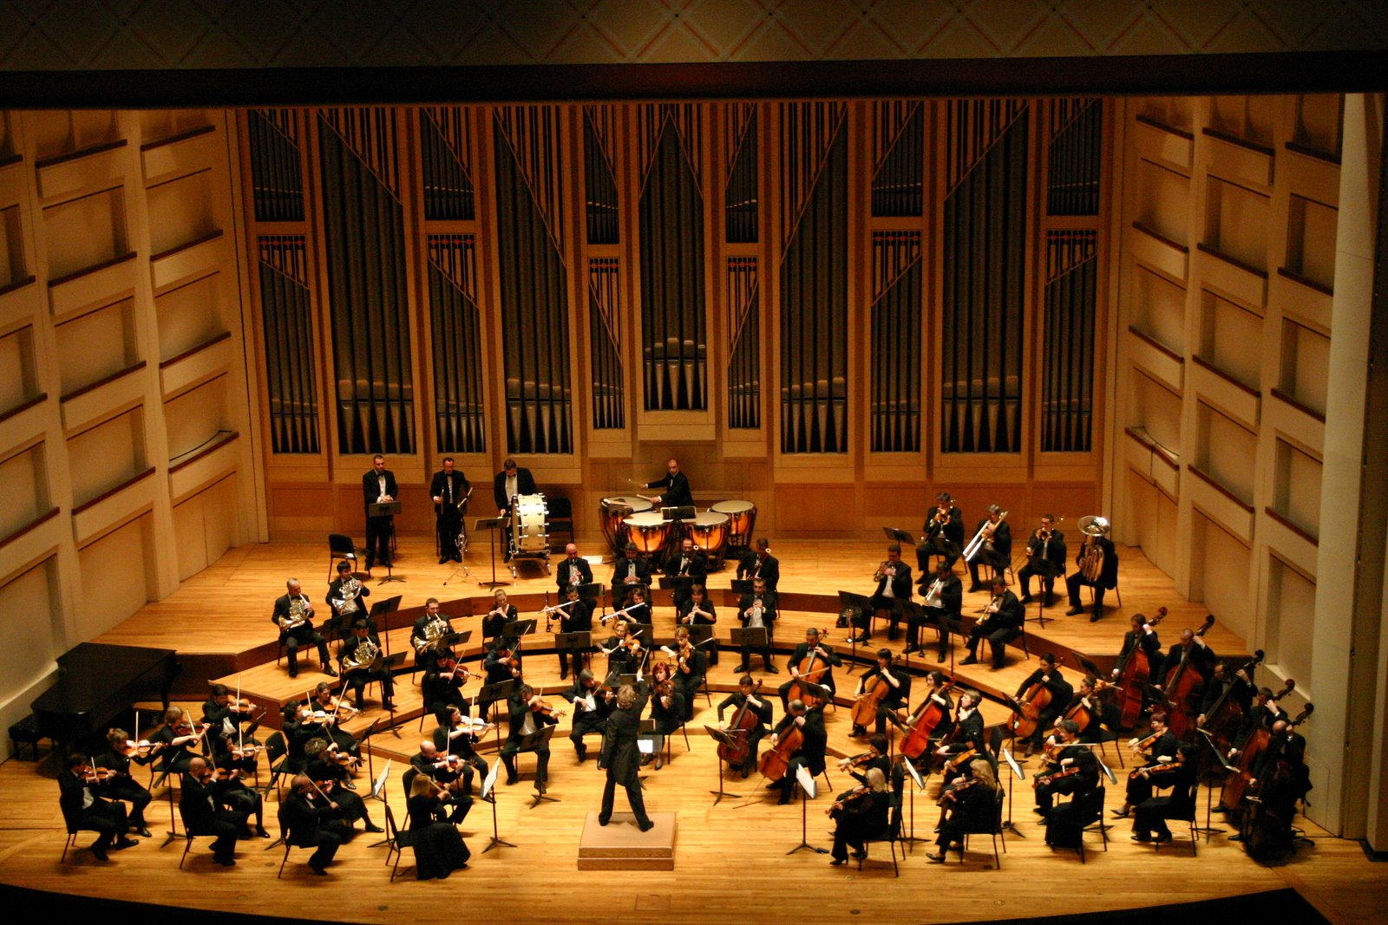
August
majestic, inspiring admiration and respect

Slide 5
Callous
emotionally hardened

Slide 6
Clandestine
secret, concealed

Slide 7
Compunction
remorse or regret

Slide 8
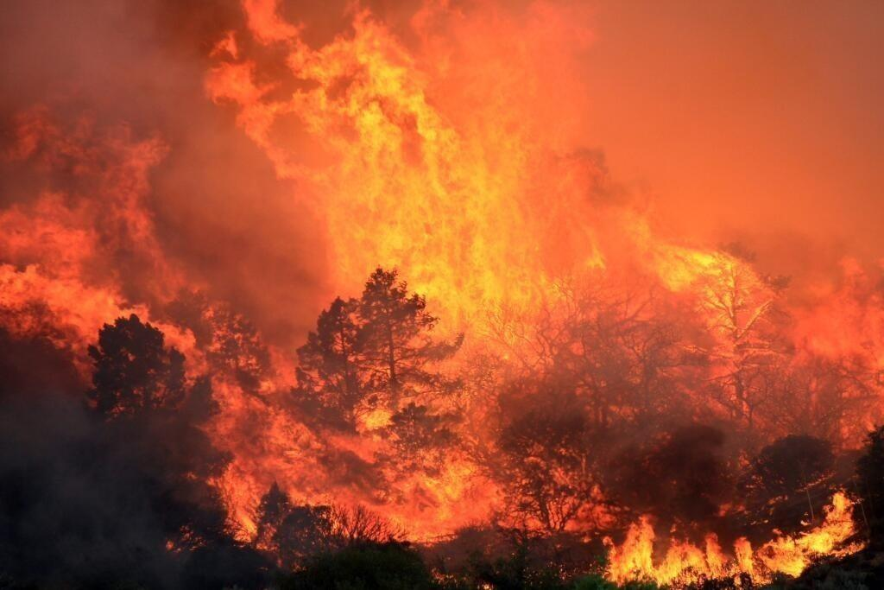
Conflagration
a large destructive fire

Slide 9
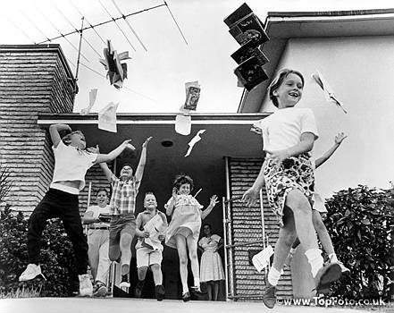
Elated
in high spirits

Slide 10
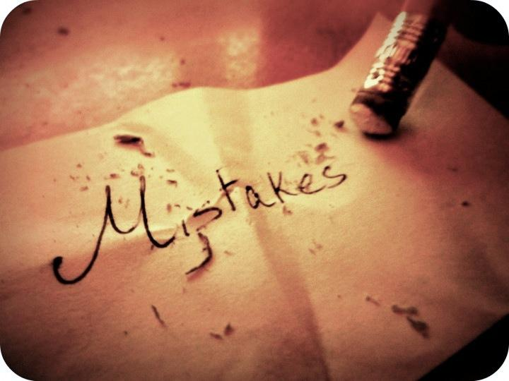
Indelible
not able to be erased

Slide 11
Indulgent
yielding to the wishes or demands of others

Slide 12
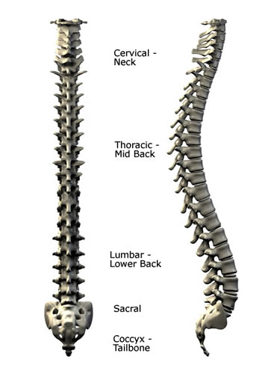
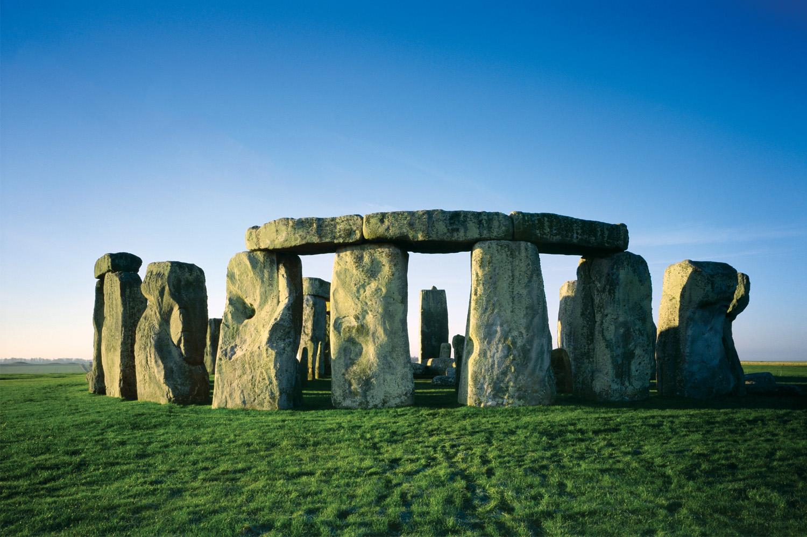
Inveterate
firmly established

Slide 13
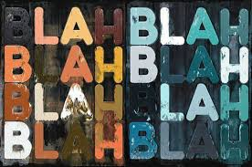
Irrelevant
not to the point, not applicable or pertinent

Slide 14
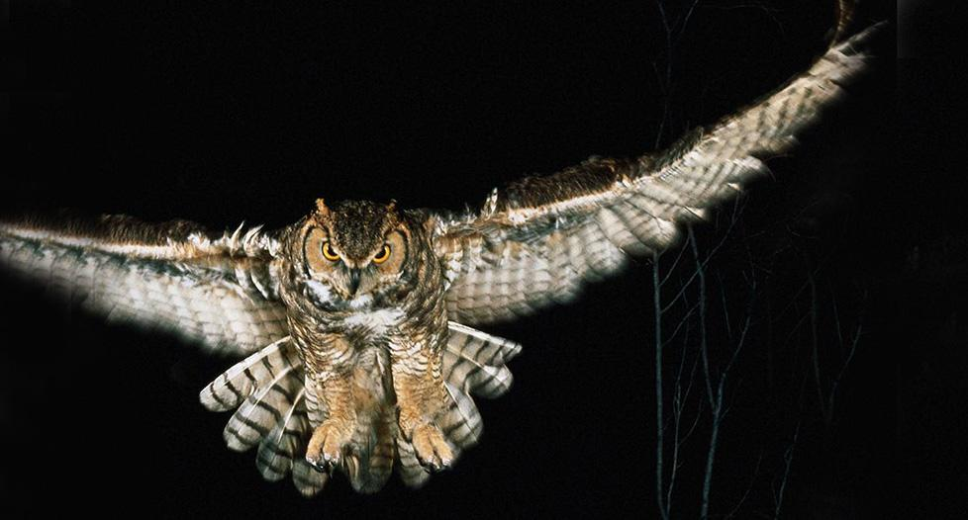
Nocturnal
of or occurring at night

Slide 15
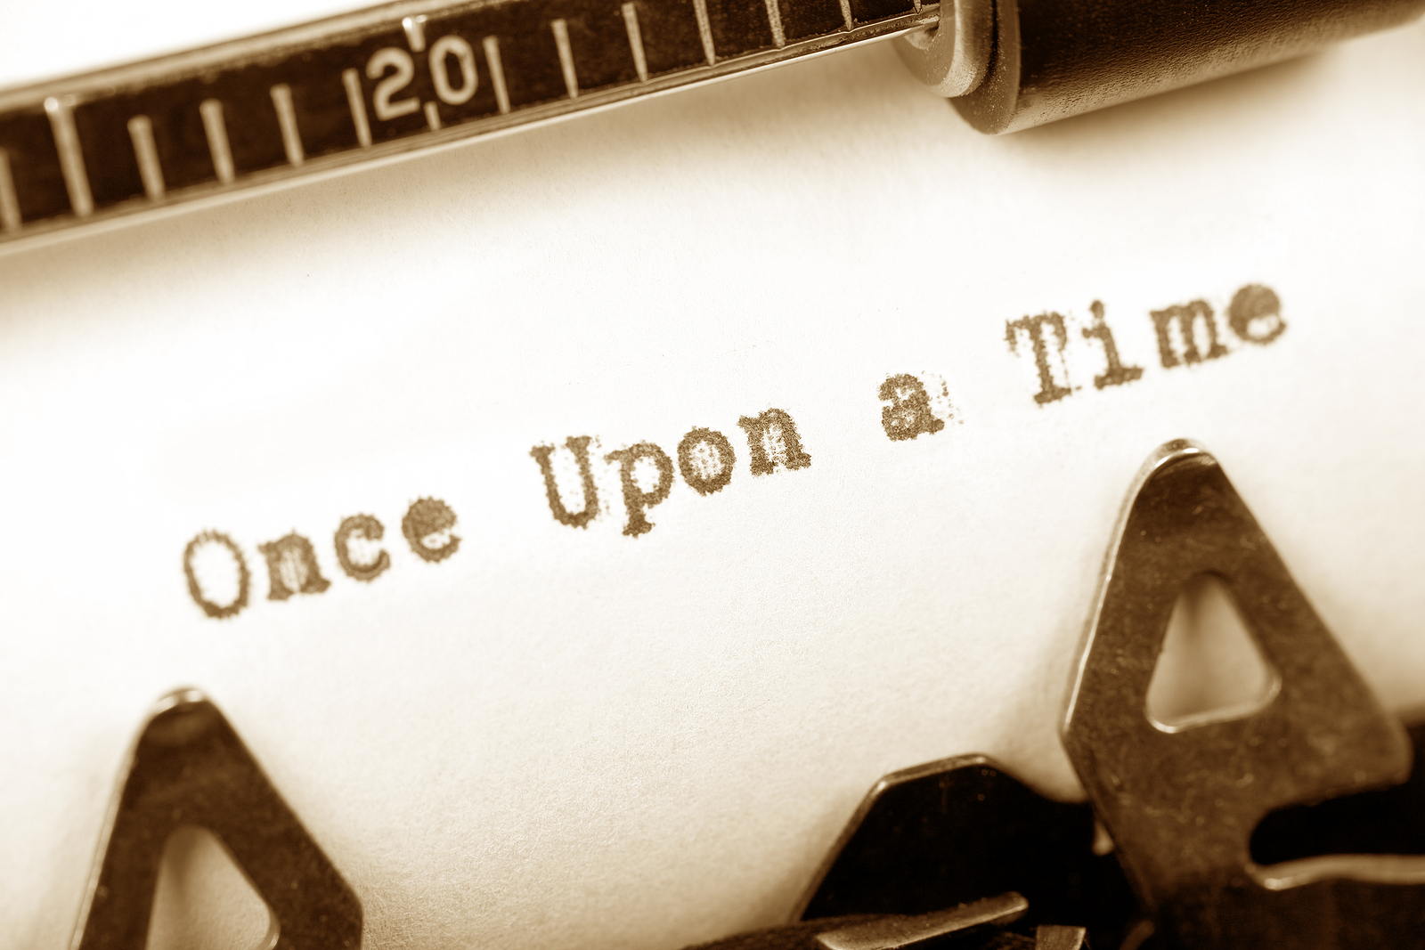
Platitude
a commonplace, stale, or trite remark

Slide 16
Quell
to subdue

Slide 17
Quiescent
inactive; at rest

Slide 18
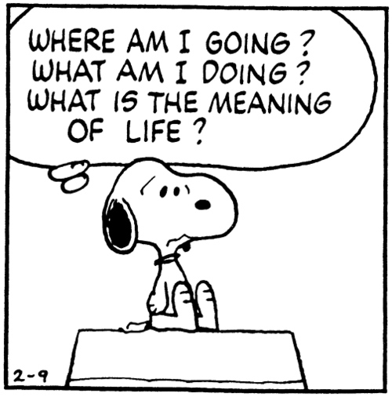
Ruminate
to meditate or think about at length

Slide 19
Tacit
unspoken; silent; implied; inferred

Slide 20
Tangible
capable of being touched

Slide 21
Trenchant
incisive, keen; forceful, effective; clear-cut

