Slide 1
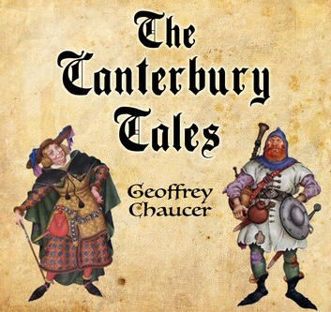
Canterbury Tales Character Descriptions
By Grace Isley & Others

Slide 2
Knight
Loved chivalry
He fought in many battles for country and faith
He was truly a perfect, noble night
He is dressed in rags
He is very humble

Slide 3
Squire
A bachelor
Around 20 years old
Able bodied
Courteous, humble, and willing to serve
Lives a comfortable life

Slide 4
Yeoman
Archer - carried a bow and arrow
Dark complexion
Woodworker
Good with weapons

Slide 5
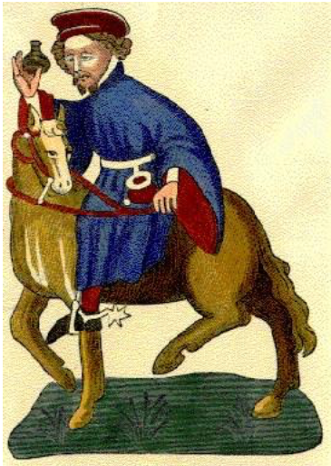
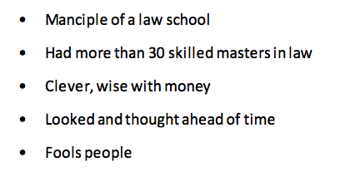
Manciple

Slide 6
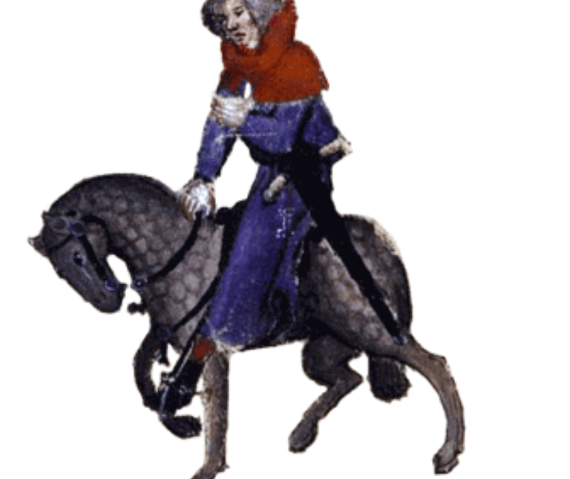
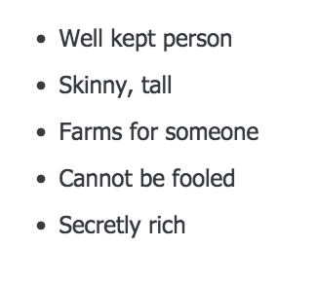
Reeve

Slide 7
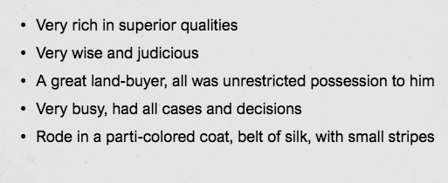
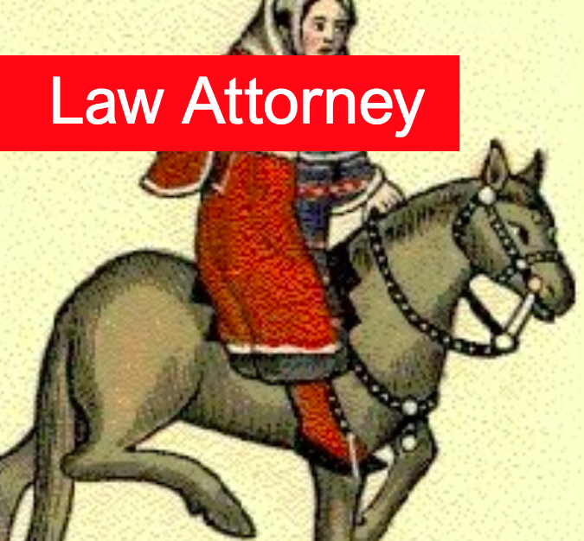
Law Attorney

Slide 8
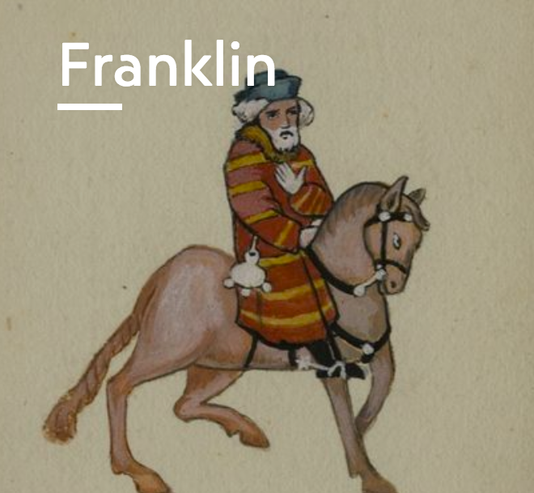
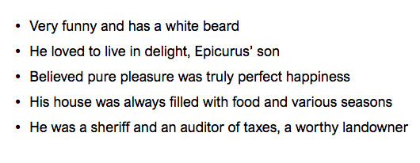
Franklin

Slide 9
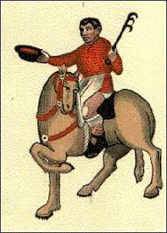
Plowman
He was a brother
He was a true and good worker
He loved God with his whole heart
He loved all of his neighbors
He rode on a horse

Slide 10
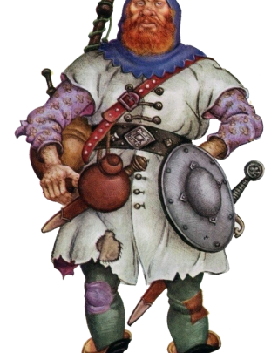
Miller
He was a stout fellow
He was very strong and would always win when wrestling
He had a red beard and a wart on his nose
He was a loud mouth and a buffoon
He knew how to play bag pipes

Slide 11
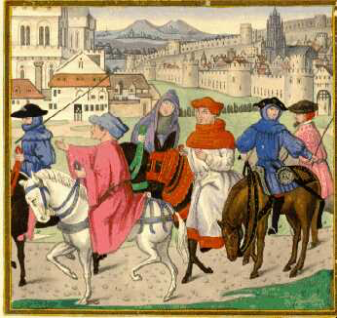
Haberdasher, Carpenter, Weaver, Dyer, & Tapestry Maker
Their equipment was fresh and new and nice
They all had good silver knives
They were all good citizens
They were all wise for alderman
They all had ladies

Slide 12
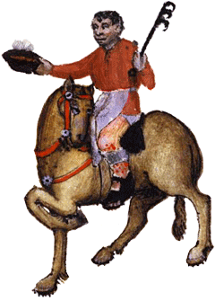
Cook
He knew how to roast, and boil, and broil, and fry
He knew how to make stews and bake pies
He made the best quality food
He had an open sore on his shin
He knew how to judge a draft of London ale

Slide 13
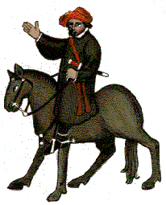
Shipman
He rode up on a cart horse
He had a dagger on a necklace
He always had the upper hand in a fight
He was unkempt
His ships name was Maudelayne

Slide 14
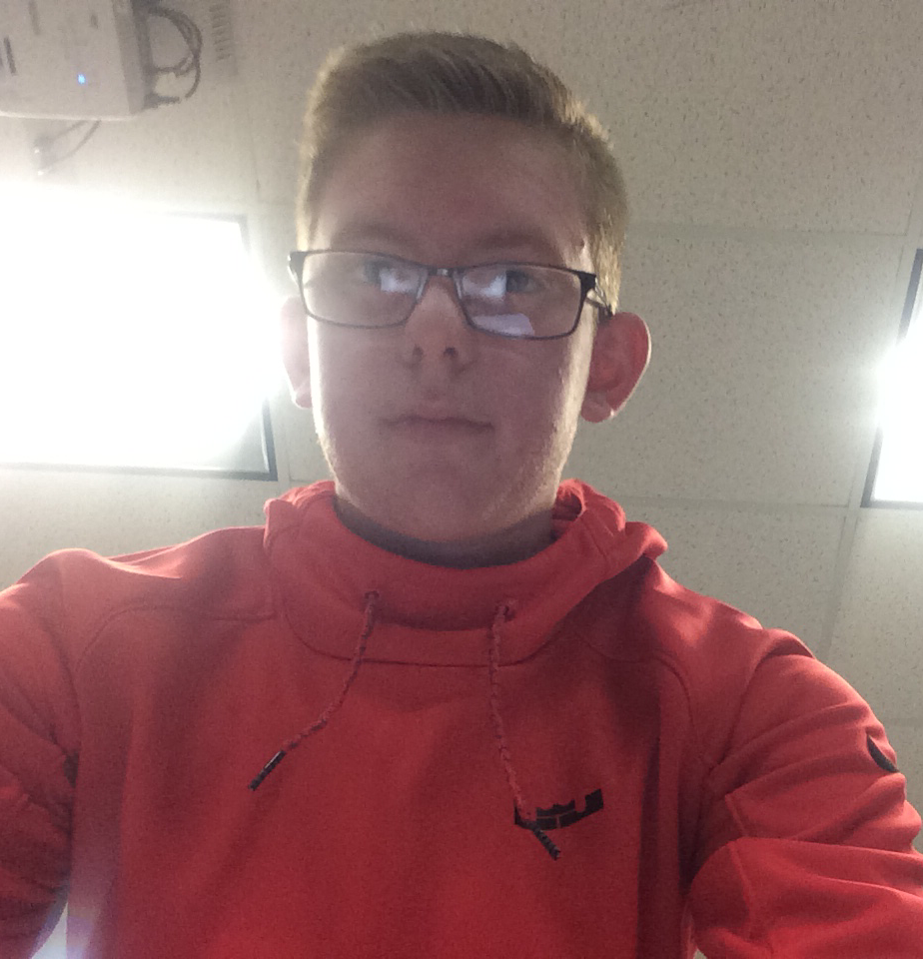
Host: Harry Bailey
Large man
Prominent Eyes
Best business man in Cheapside
Always a merry guy
Very proper

Slide 15
Narrator- Chaucer
Goal to keep the story as truthful as possible
Religious man
Wants the others to be merry
Is an actual character in the story, but is quiet and to himself
Worries he can’t recount the story correctly

