Slide 1
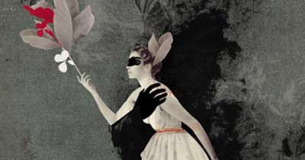
A Mid-Summer Night’s Dream
Background Act I

Slide 2
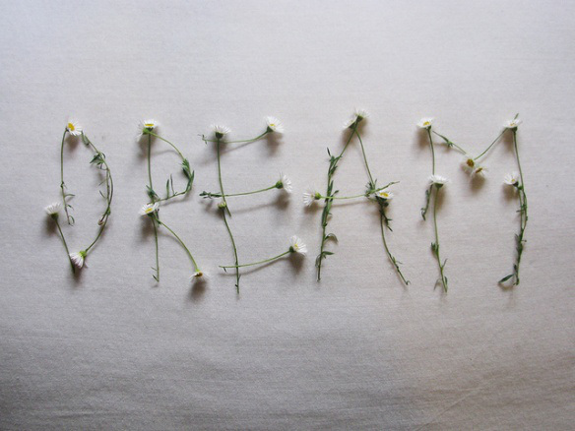
Three Sets of People
The Athenian Court
The Workmen
The Fairies

Slide 3
Athenian Drama: Diana Reference
Borrowed from “The Knight’s Tale” in The Canterbury Tales written by Chaucer
There were three temples to one god and two goddesses: Mars (God of War), Venus (Goddess of Love), & Diana (Goddess of Chastity) in Chaucer’s piece. Emelye in the Knight’s tale appeals to Diana.
Diana: Goddess of the Hunt, the moon, and chastity.
Theseus gives Hermia an ultimatum: nun, marriage, or death.

Slide 4
Athenians: Theseus & Hippolyta
Theseus kills this half-man, half-bull creature called minotaur. He is also pretty good friends with Hercules.
Hippolyta is the Queen of the Amazons. The Amazon was a tribe comprised of women warriors. Hercules’ ninth labor was to steal her girdle (given to her by Aphrodite, the goddess of love). He succeeded in stealing the girdle.
Some versions say Hercules killed her. Others say that Theseus tag teamed and abducted her.

Slide 5
The Work Men: Pyramus & Thisbe
Two neighbors grew up together.
Families do not like one another.
The two children fall in love. Yet, they are separated.
There is an Earthquake that results in a crack in the wall.
They speak to one another through the crack of the wall.
They make a game plan to escape to and meet under the Mulberry Tree.
Thisbe leaves first, but forgets her jacket. She goes back to get her jacket. Then, under the Mulberry Tree she sees a lioness with blood around its mouth. In fear, she runs away leaving behind her coat.
The lion sniffs the coat getting blood on Thisbe’s coat.
Pyramus sees Thisbe’s bloody coat &the lion. He the lion killed her.
He kills himself under the Mulberry Tree.
Thisbe thinks the coast is probably clear… She goes back and sees Pyramus dead. So, she kills herself as well.
The mulberry tree berries turn a dark purple like the lovers blood.

Slide 6
A Mid-Summer Night’s Dream
Background Act II

Slide 7
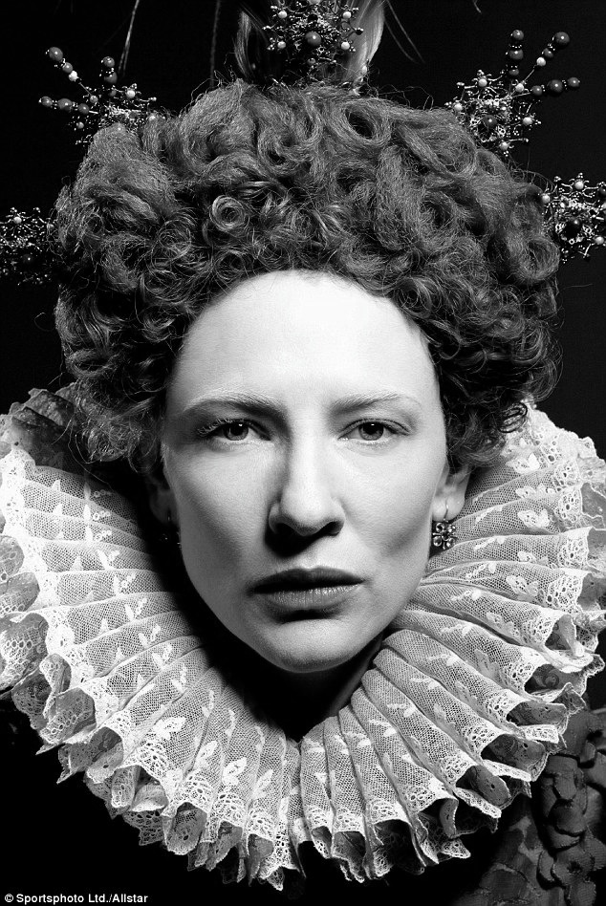
Queen Elizabeth (& Dudley)
https://www.youtube.com/watch?v=0wNboYbgYjo
As you watch the trailer, jot down three important points that you think would have been gossip-quality in Elizabethan society regarding the Queen’s life.

Slide 8
Mermaid on a Dolphin
Queen Elizabeth remained a virgin queen. However, she did love one man who was the fifth son of a disgraced duke, Robert Dudley. Therefore, a marriage would have been improbable.
She did however give him a royal estate called Kenilworth.
Her last visit was in July of 1575. It was Robert Dudley’s last attempt to convince Elizabeth to marry him.

Slide 9
Mermaid on a Dolphin & Love Potion
The Royal Progress was a reason for the Queen and her court to leave London and see the country side and for her people to see her.
William Shakespeare was 11 years old at this time and was probably present in the crowd with his father (the then Mayor of Stratford) when she passed through. He was only 12 miles away from the estate.
The land was flooded creating an artificial lake. An entertainment piece was a model dolphin with a singer on its back.
http://www.pbslearningmedia.org/resource/shak15.ela.lit.lovepo/a-midsummer-nights-dream-the-love-potion-shakespeare-uncovered/

Slide 10
Poetic Form & Tension
Scene two is written in verse with end-rhymed couplets. The dialogue is in poetry, not prose.
However, when Helena thinks she is betrayed and turns against Hermia, the rhyming stops, the rhythm is interrupted and it goes to blank verse.
Why do you think Shakespeare would change the poetic form in this scene?

