Slide 1
Vocabulary Unit One
AP English Courses
Quizlet Review: https://quizlet.com/410317335/ap-vocabulary-unit-1-flash-cards/

Slide 2
Greek & Latin Roots
FAC (Latin) “to make; to do”
OPUS (Latin) “work” or “wealth, power, resource”
ERG (Greek) “work”
LABOR (Latin) “work”
STA, STI (Latin) “to stand” “to stay”
POS (Latin) “to put” “to place”
STAS, STAT (Greek) “standing”
ENT, ESS (Latin) “to be”

Slide 3
Apropos
(prep.) With regard to

Slide 4
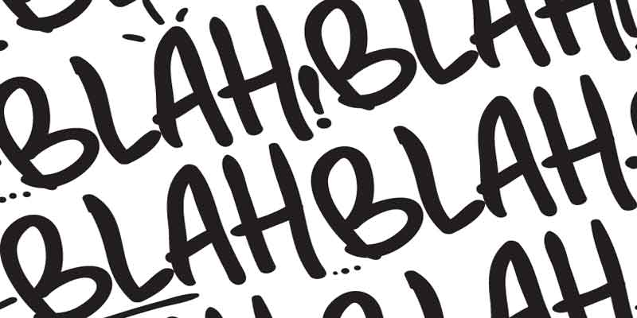
Belabor
(v.) To discuss in too much detail; to attack

Slide 5
Caprice
(n.) A sudden and unaccountable change in mood or behavior

Slide 6
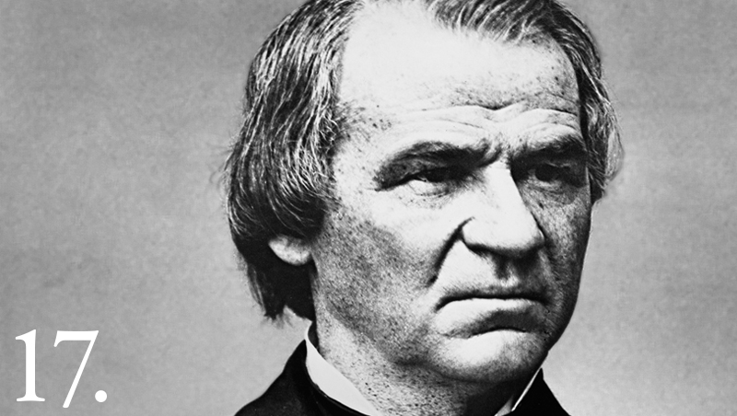
Depose
(v.) To remove from office or power

Slide 7
Discomfit
(v.) To embarrass or confuse

Slide 8
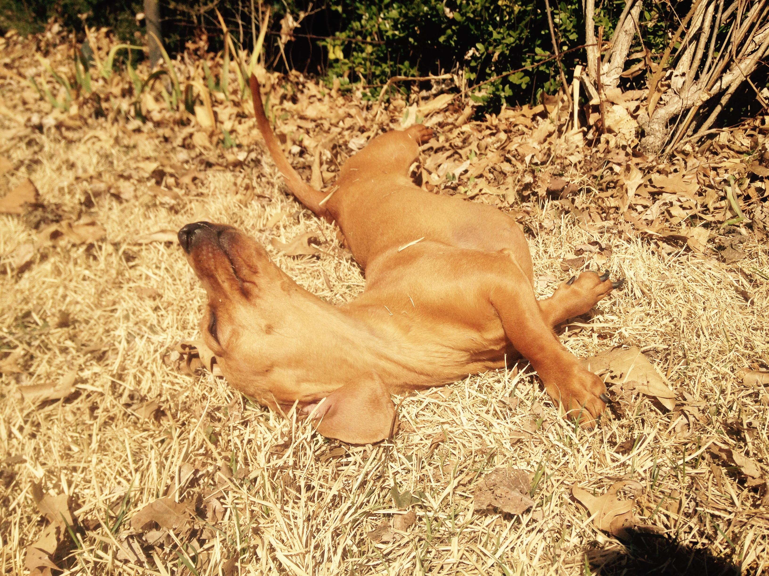
Ecstasy
(n.) An intense joy or delight

Slide 9
Edification
(n.) An improvement or an enlightenment

Slide 10
Entity
(n.) A being

Slide 11
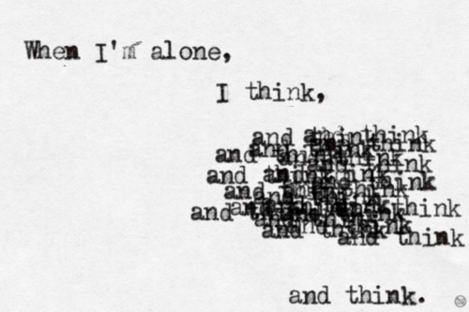
Laborious
(adj.) Requiring mental and physical effort

Slide 12
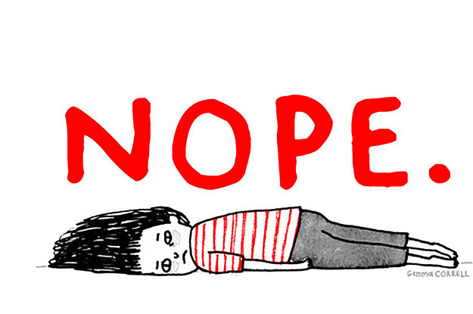
Lethargy
(n.) A state of sluggishness, inactivity, and apathy

Slide 13
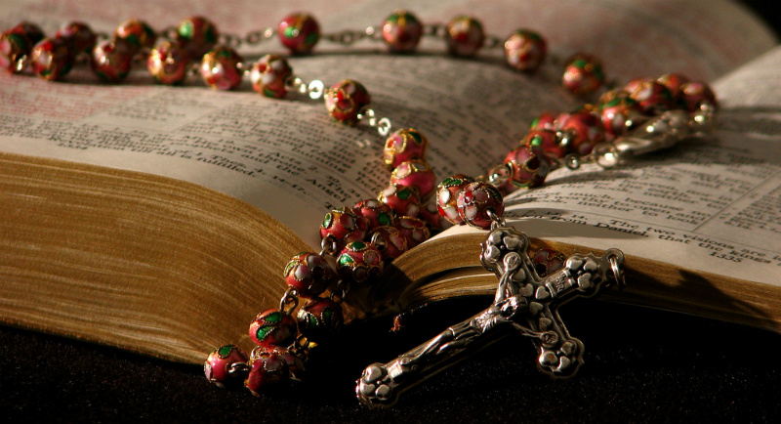
Liturgy
(n.) A pattern of prayer or worship

Slide 14
Magnum Opus
(n.) Greatest work of an artist, writer, or composer

Slide 15
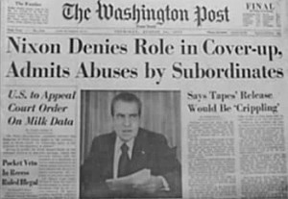
Malfeasance
(n.) Misconduct or wrongdoing, especially by a public official

Slide 16
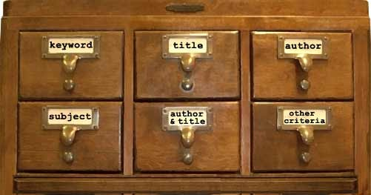
Modus Operandi
(n.) A specific manner of working

Slide 17
Rapport
(n.) a positive relationship

Slide 18
Restive
(adj.) Resisting authority; difficult to control; restless; fidgety

Slide 19
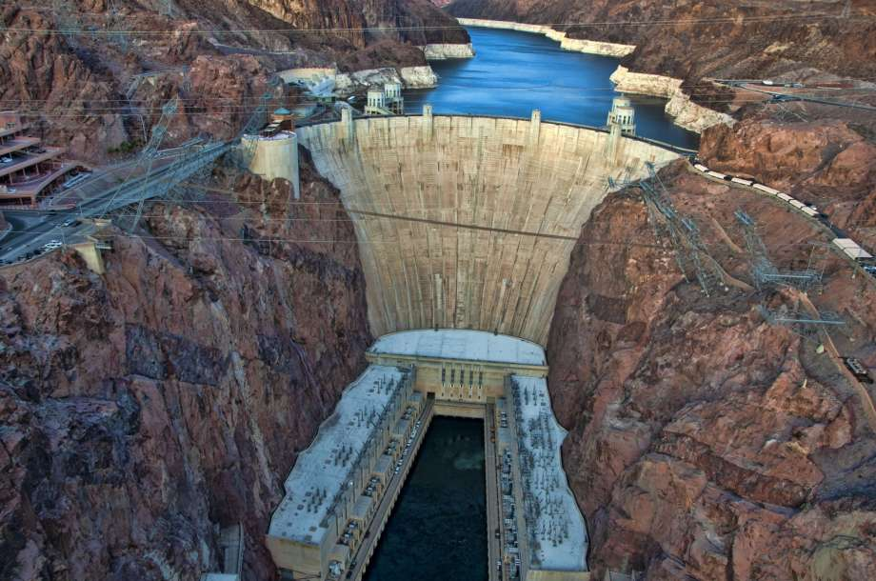
Stanch
(v.) To stop the flow of

Slide 20
Stasis
(n.) A condition in which there is no change

Slide 21
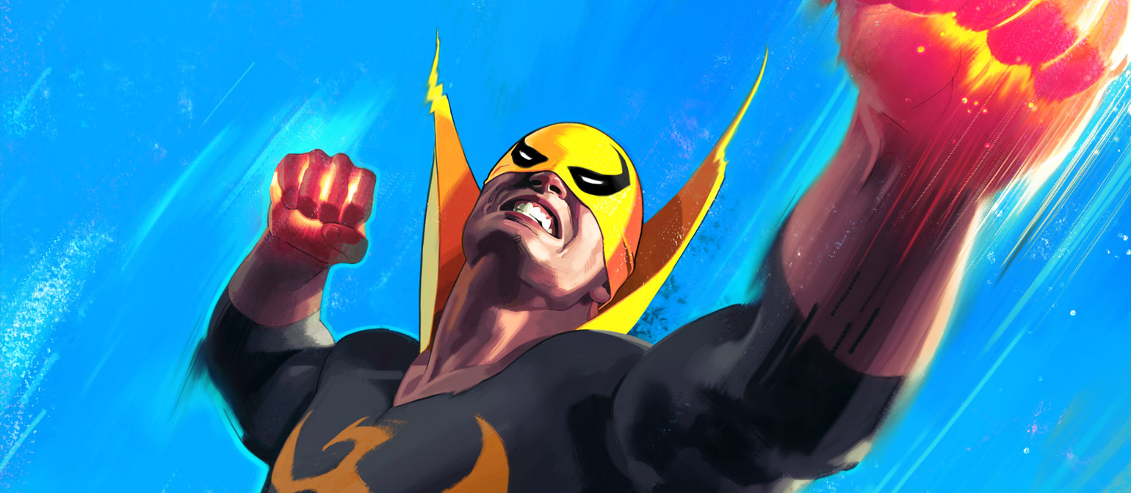
Staunch
(adj.) Firm and steadfast

Slide 22
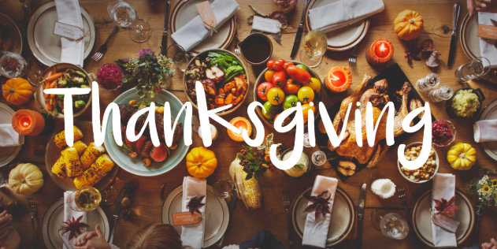
Surfeit
(n.) The condition of being too full; an overabundance

Slide 23
Synergy
(n.) The power that results from the combination of two or more forces

