Slide 1
AP Vocabulary Unit 3

Slide 2
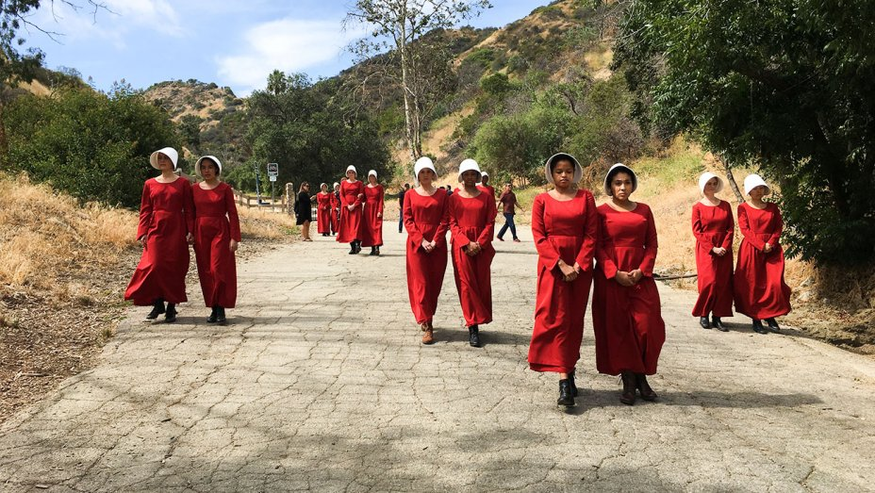
Acquiesce
(v.) to give in

Slide 3
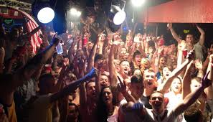
Bacchanal
(n.) a drunken party or celebration

Slide 4
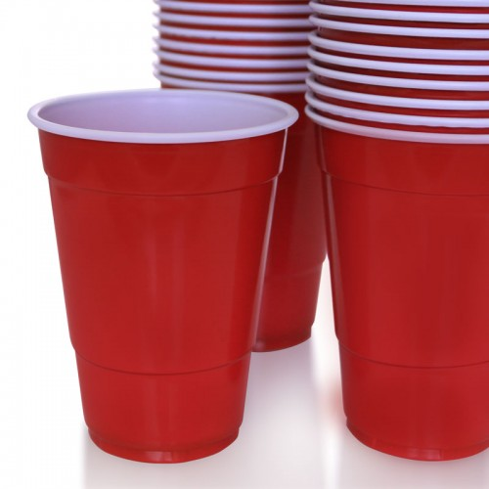
Bacchic
(adj.) of or related to a wild celebration

Slide 5
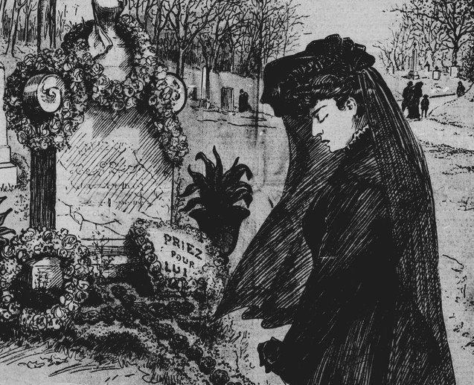
Elegiac
(adj.) mourning that which is lost or past; sorrowful

Slide 6

Elegy
(n.) a song or poem memorializing something or someone

Slide 7
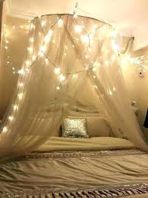
Festoon
(v.) to drape or adorn festively

Slide 8
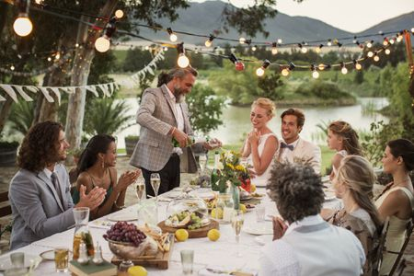
Fete
(v.) to honor with a banquet or feast

Slide 9
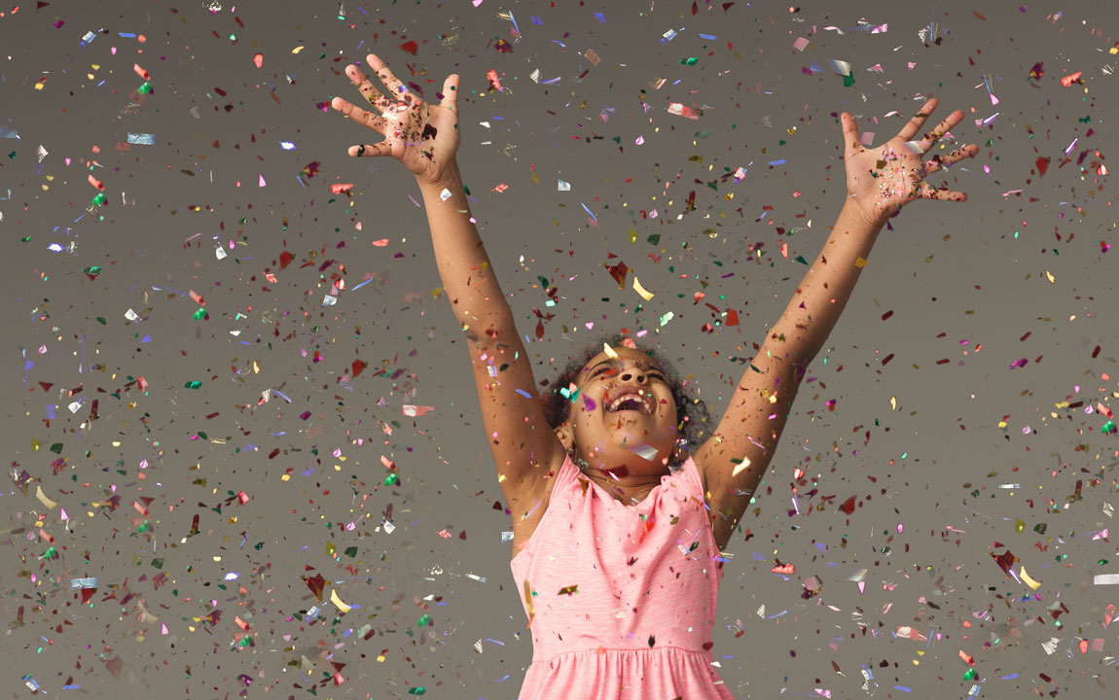
Jocose
(adj.) cheerful; merry

Slide 10

Jocular
(adj.) characterized by joking

Slide 11

Languid
(adj.) lacking energy; weak

Slide 12
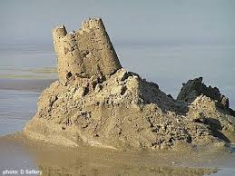
Languish
(v.) to waste away

Slide 13

Languor
(n.) a lack of physical or mental energy

Slide 14
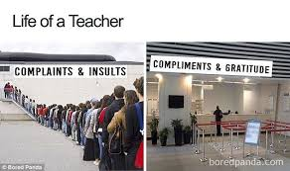
Plaint
(n.) a lament or complaint

Slide 15
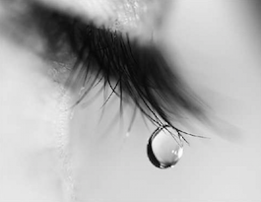
Plaintive
(adj.) sorrowful; expressing or evoking mourning or sadness

Slide 16

Quittance
(n.) a repayment; a compensation

Slide 17
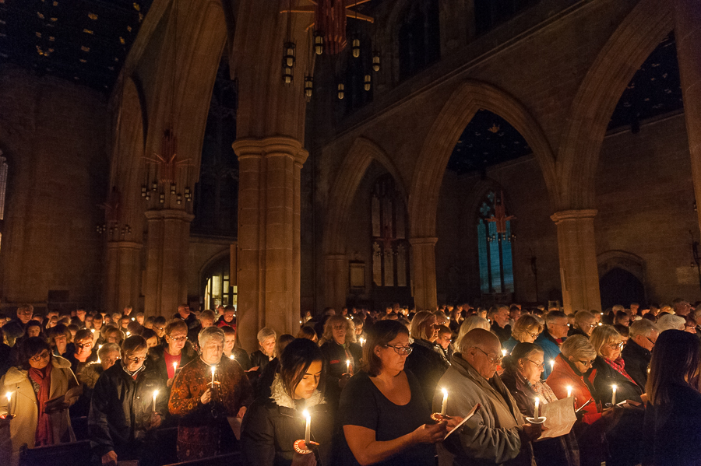
Requiem
(n.) a song or religious service for the dead or lost

Slide 18

Somnolent
(adj.) drowsy; sleepy

Slide 19

Sopor
(n.) sleep; drowsiness

Slide 20

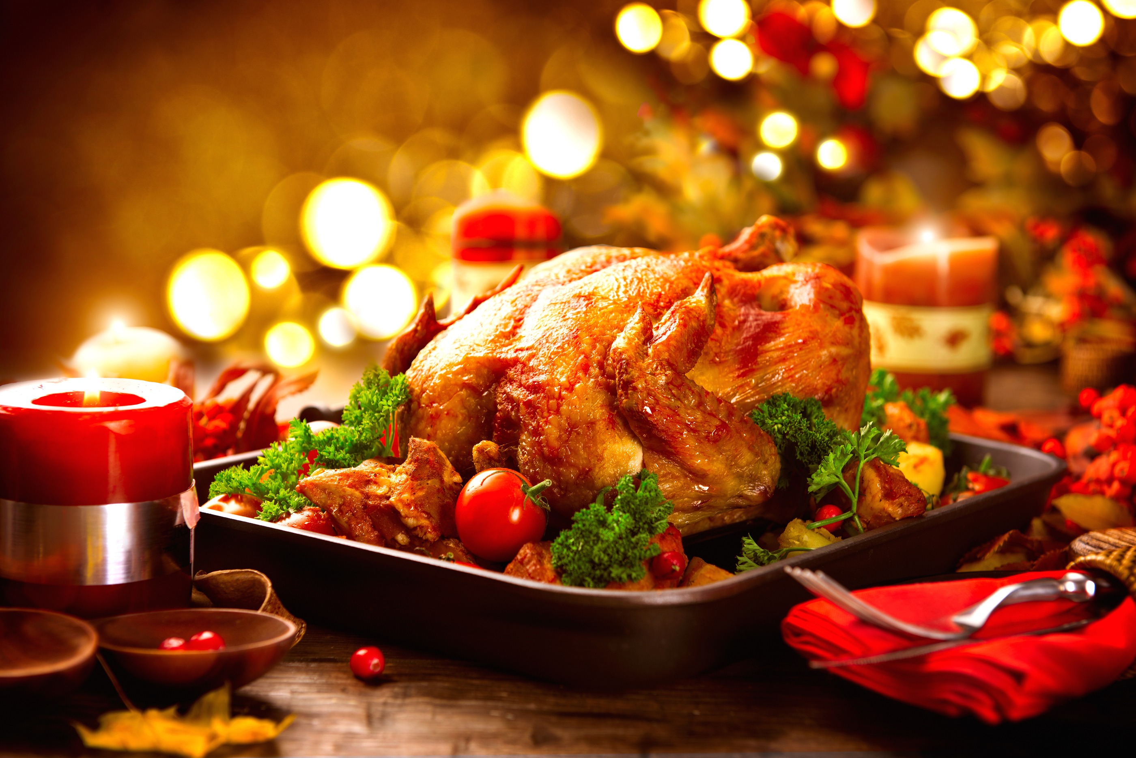
Soporific
(adj.) causing sleep or fatigue

Slide 21

Vigilant
(adj.) on the alert; watchful

