Slide 1
AP Vocab. Unit 5

Slide 2
Catholic
(adj.) covering a broad range; universal

Slide 3
Consummate
(adj.) perfect or ideal, especially in skill or accomplishment

Slide 4
Desolate
(adj.) deserted and lonely

Slide 5
Divulge
(v.) to make public

Slide 6
Hoi Polloi
(n.) the common people; the masses

Slide 7
Holistic
(adj.) concerning the whole rather than the parts

Slide 8
Monosyllabic
(adj.) having only one syllable

Slide 9
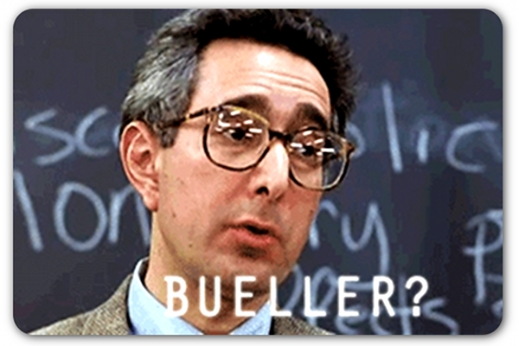
Monotone
(n.) the sameness of sound, style, manner, or color

Slide 10
Monotonous
(adj.) unvarying; lacking in variety

Slide 11
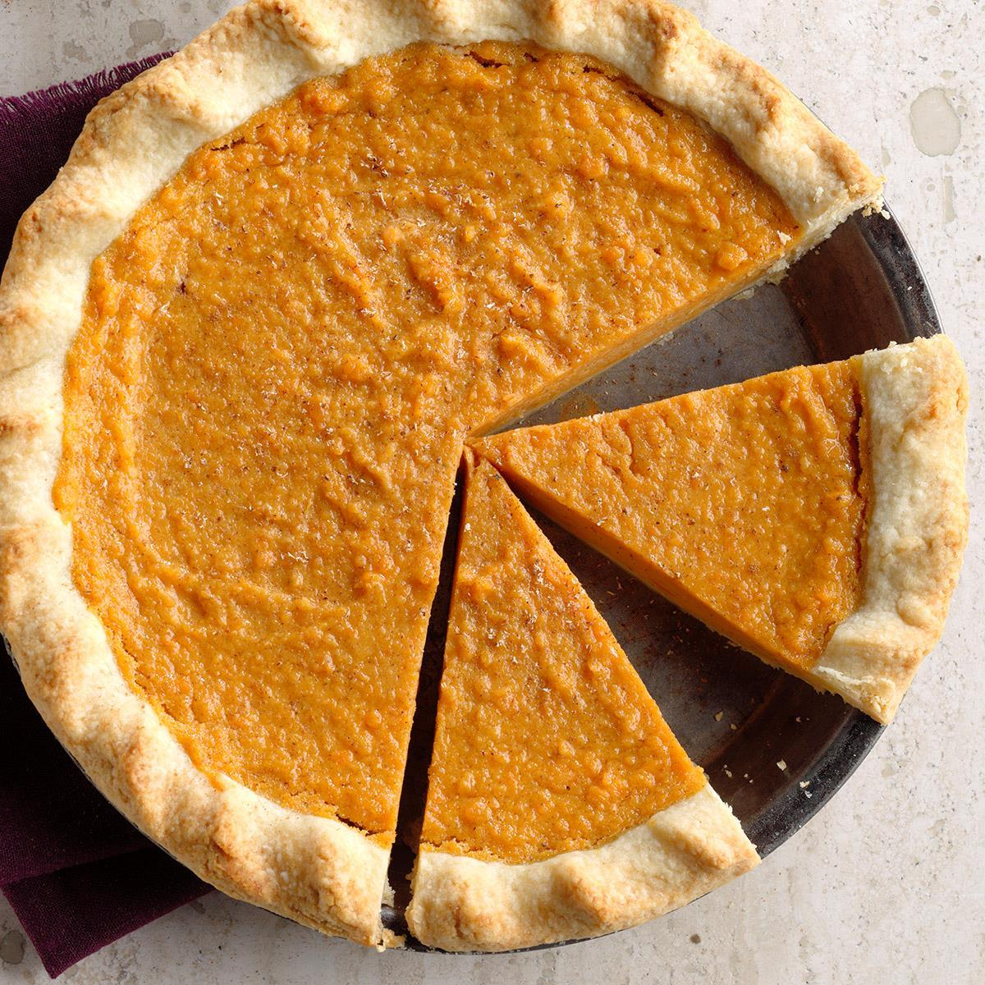
Parcel
(v.) to divide into parts and distribute

Slide 12
Parse
(v.) to examine or analyze

Slide 13
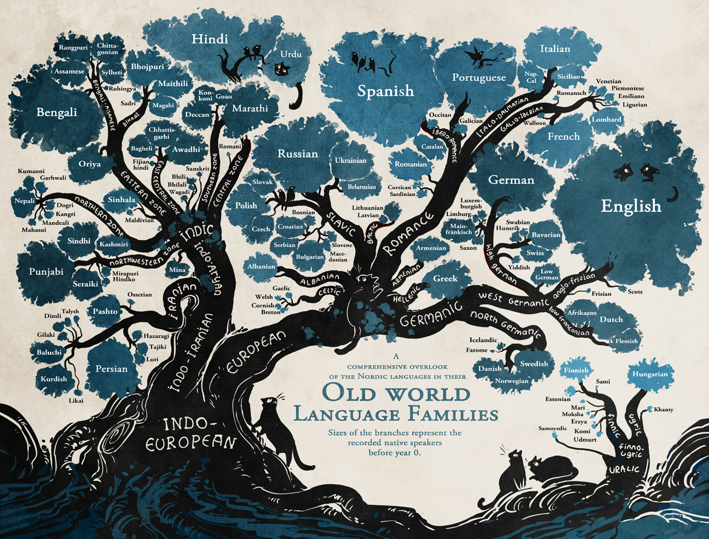
Polyglot
(n.) a person with the knowledge of several languages

Slide 14
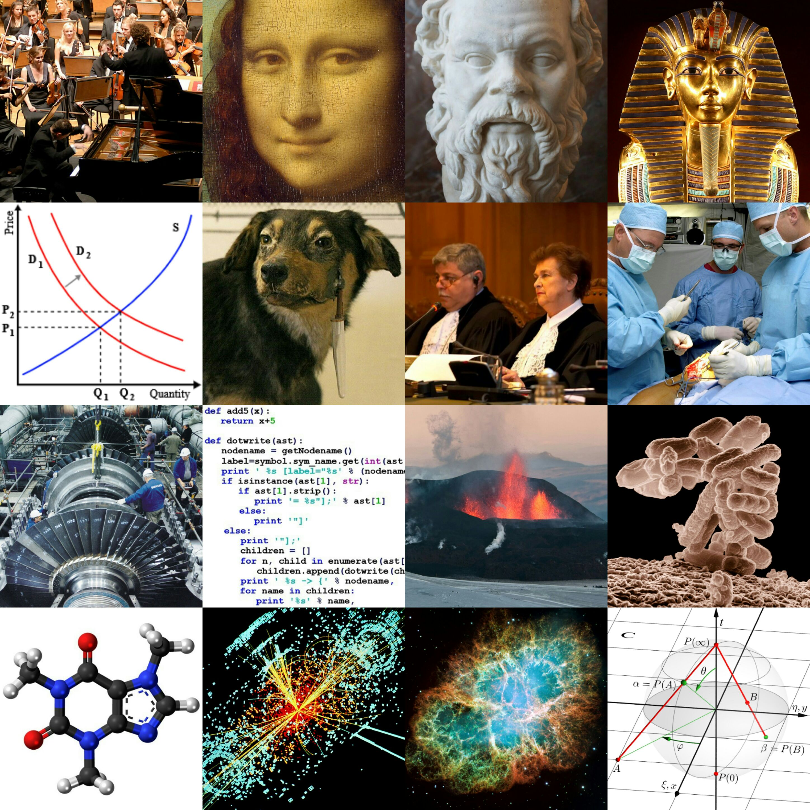
Polymath
(n.) a person with the knowledge of many subjects

Slide 15
Repartee
(n.) a quick, witty conversation

Slide 16
Solipsism
(n.) the theory that the self is the only reality; self-absorption

Slide 17
Summation
(n.) an accumulation; a total result

Slide 18
Totality
(n.) completeness

Slide 19
Trenchant
(adj.) sharply effective or insightful

Slide 20
Truncate
(v.) to cut short in the middle

Slide 21
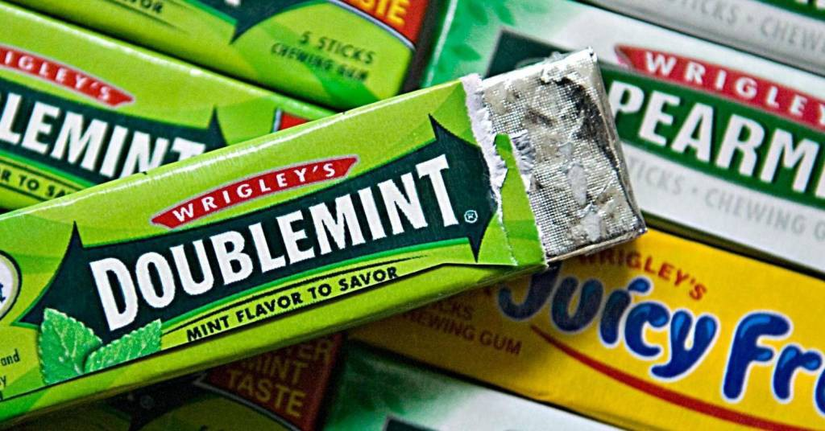
Vulgar
(adj.) of the common people

