Slide 1
Vocabulary Unit
AP & 10H

Slide 2
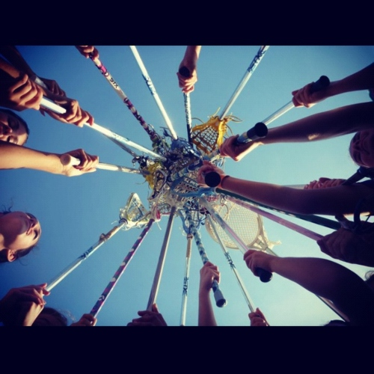
Adroit
skillful; expert in the use of hands or mind

Slide 3
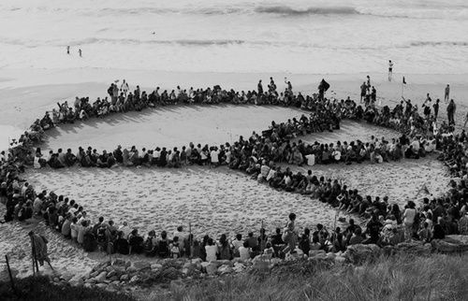
Amicable
peaceful; friendly

Slide 4
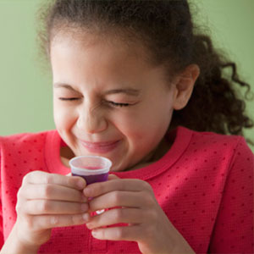
Averse
having a deep-seated distaste; opposed; unwilling

Slide 5
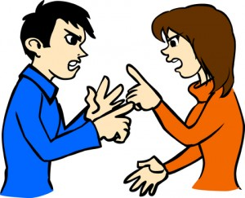
Belligerent
given to fighting; war-like; combative; aggressive; one engaged at war

Slide 6
Benevolent
kindly; charitable

Slide 7
Cursory
hasty; not thorough

Slide 8
Duplicity
treachery; deceitfulness

Slide 9
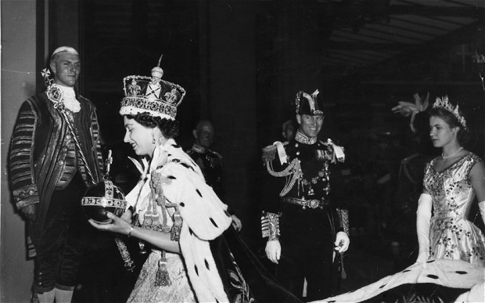
Extol
to praise extravagantly

Slide 10
Feasible
possible; able to be done

Slide 11
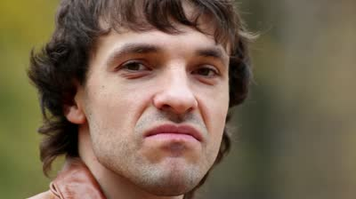
Grimace
a wry face, facial distortion; to make a wry face

Slide 12
Holocaust
a large scale destruction, especially by fire; a vast slaughter; a burnt offering

Slide 13
Impervious
not affected or hurt by; admitting of no passage or entrance

Slide 14
Impetus
a moving force, impulse, stimulus

Slide 15
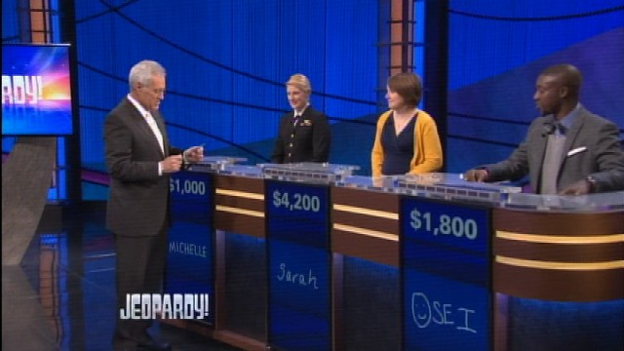
Jeopardy
danger

Slide 16
Meticulous
extremely careful; particular about details

Slide 17
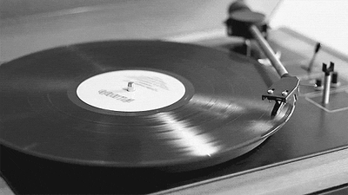
Nostalgia
a longing for something past; homesickness

Slide 18
Quintessence
the purest essence or form of something; the most typical example

Slide 19
Retrogress
to move backward; to return to an earlier condition

Slide 20
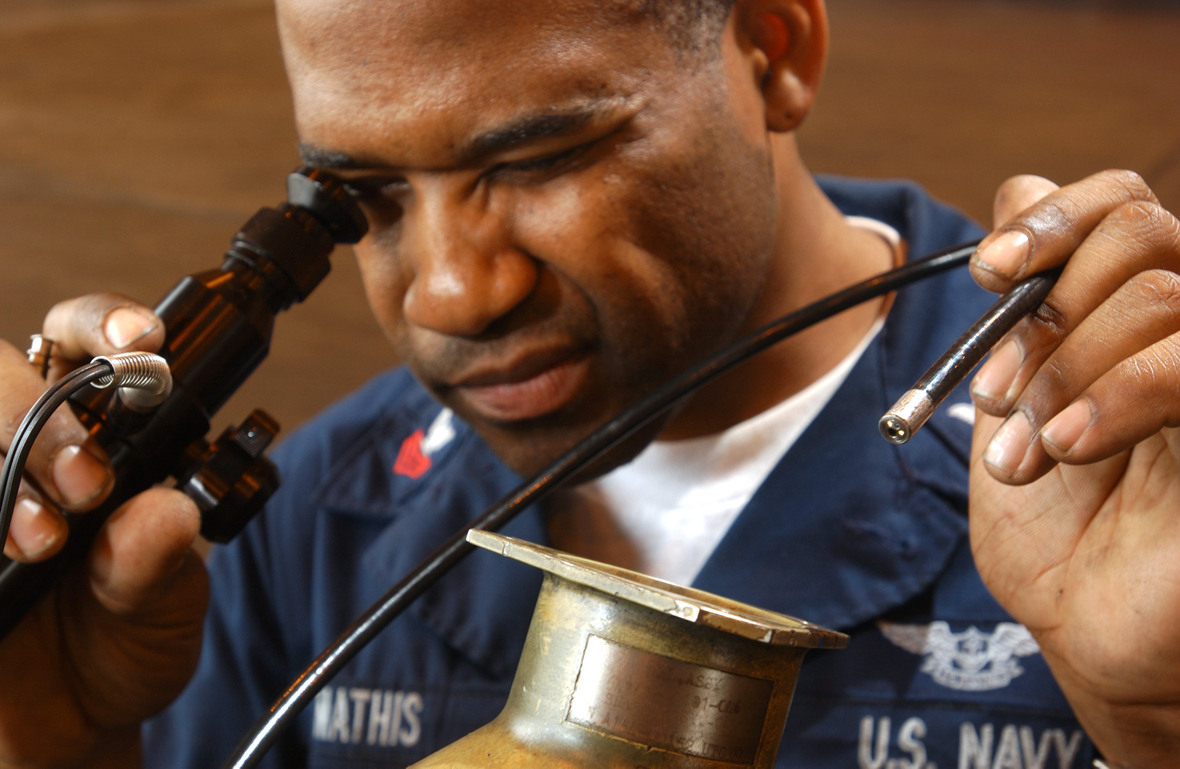
Scrutinize
to examine closely

Slide 21
Tepid
lukewarm; unenthusiastic; marked by an absence of interest

