Slide 1
Ayn Rand

Slide 2
Learning Objective
To be able to understand the characteristics of dystopian literature, comprehend plot, and recognize the role of characterization and setting.

Slide 3
Define.
Equality
Equity
Liberty
Anthem
Collectivism
Individualism
Notes:
Using the frayers, have students define each of the above words. Discuss collectively as a class afterwards.

Slide 4
Dystopian Characteristics
Futuristic Society
Bureaucratic Control
Lack of Individuality
Lack of Education
Rebel Protagonist

Slide 5
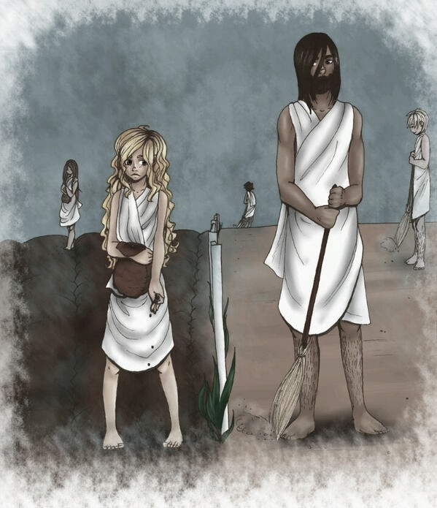
Meet the Characters
Equality 7-2521
Union 5-3992
International 4-8818
Liberty 5-3000
Fraternity 2-5503
Saint of the Pyre

Slide 6
The Society
In two or three sentences, write a description of the setting in your journal.
Be sure to mention:
The Unmentionable Times
Uncharted Forest
The Living Halls

Slide 7
EXPLAIN the Picture….

Slide 8
EXPLAIN the Picture….

Slide 9
EXPLAIN the Picture….

Slide 10
Reading Notes…
Answer questions for chapters 1 through 3. You must use COMPLETE SENTENCES. You may also use your book.

Slide 11
Word Specific Analysis Lesson Two | Anthem

Slide 12
Learning Objective
To be able to understand the influence of word choice and language selection on the meaning, atmosphere, and tone of the novella, Anthem.

Slide 13
Literary Terms Clarification
Connotation: societal implications that encompass a word. (Society’s definition of a word.)
Atmosphere: the mood created by the text.
Tone: the attitude a poet (or any writer) takes toward a character, event, or subject.

Slide 14
The Hook (Think, Pair, Share)
In your performance journal, be sure to jot down the first thing that you think of when I say a word. The word will change each time. For example:
I say rain. You think _______________ (cloud, England, spring, tears, blue, etc.). Write it down.

Slide 15
Color Symbolism
Red: aggression, blood, danger
Yellow: caution, attention
Green: fresh, beginning, go
Blue: sadness, calmness
Purple: loyalty
White: purity, goodness
Black: evil, death, darkness

Slide 16
Word Specific Analysis
Each of you will receive a quotation that has been selected from the poem. Within the quotation, there will be underlined words. For each underlined word, you need to create a mind map of words that could:
replace that word and still have the same meaning AND/OR
other words that are connected to that word.
You must have at least THREE for each underlined word. You may use a thesaurus if necessary.
Notes:
Distribute quotations- opportunity for differentiation.

Slide 17
Example Quotation
“The rain set early in to-night,
The sullen wind was soon awake,
It tore the elm-tops down for spite
And did its worst to vex the lake:
I listened with heart fit to break.”
Notes:
Use whiteboard to demonstrate the mind maps for the words.

